Slide 1

Cultural Events and Capacity
Revisit the Weather data considering Corona Virus COVIS-19
Normal operations, normal exceptions and exceptional exceptions
Presented to you by:
BEN DAVIES
We make heavy use of the comments section. Download the presentation for that data.
Notes:
Good afternoon.
This is a revisit of a presentation called “Incorporating Weather Data Into Capacity Planning Analysis”
Originally presented at St Louis CMG meeting in 2018, and CMG imPACt 2017.
While the original focus was on incorporating weather data into capacity analysis, a relevant observation was made around the impact that cultural events have on IT Capacity. This is a summary of those observations and expanding to include how these observations could be leveraged in the times of COVIS-19.

Slide 2
Agenda
Weather was a rubbish capacity input
Work from Home Corporate Policy Set Preconditions
Cultural Events change from where and how work is initiated, not necessarily how the work is done.
Flexibility and the use of corporate assts – Normal, normal exceptions, and exceptional exceptions
  Disaster Recovery Plan
  Business Continuity Plan
  Test and other equipment
  Routing magic / access control magic / distance measured in milliseconds
  Network bandwidth - everywhere
Call to action
Questions & Answers
Notes:
As this is a sumary and expansion of the weather as an input for our capacity planning. So let me start with a spoiler... The weather was a rubbish capacity input. But the excersize of analyzing that helped us better understand that large cultural events DID have an impact.
Our existing push for work from home set favorable preconditions – policy, equpment, procedure, mindset, ‘personal infrastructure’, tools and techniques.
Cultural events, most noteable in the main office of Chicago, drove VPN and VDI use. This changed from where and how work was initiated but not how the work was done on the Corporate network.
When we were confronted with a big cultural event, we had already though through use of corporate assets, specifically the disasster plan and Business Continuity Plan, so had a game plan and the authorizations, and a host of tools and techniques that could be used. We will discuss some of the specificas of these ☺
Then we will have a call to action
Then open for questions

Slide 3
Weather is Rubbish
But…

Slide 4
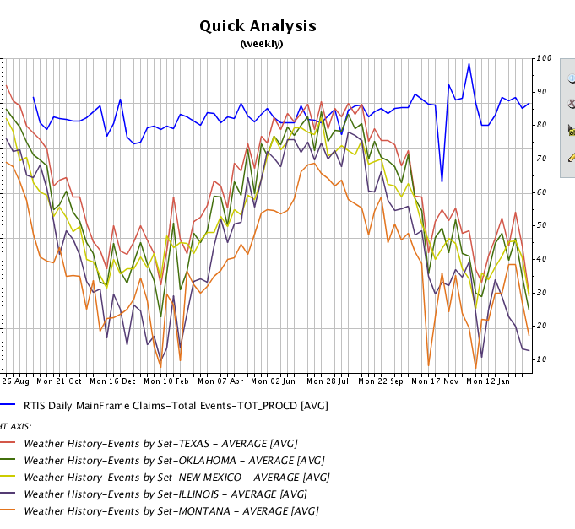
Claims Submitted VS. The Weather
Notes:
In this chart we can see the number of claims per weeks submitted (top line) and average temp in 5 different cities.
Long story short. No correlation, causation, leading or lagging indicators. Weather is a rubbish capacity planning metric (for us).

Slide 5
Equal opportunity causations
People being inside or outside did not diminish their propensity to hurt themselves.
Dumb luck and dumbassery are equal opportunity causations for injury.
Inside, outside, good weather or bad
Notes:
Ok a hidden slide from the original presentation. Dumb luck and dumbassery are equal opportunity causations for injury
== original slide text ==
We found that the insurance claim lifecycle is not consistent enough to correlate claim count to the weather. The time between being hurt (weather related or not), to filing a claim is haphazard, and one event may create dozens of claims over extended periods of time. Claims that are not weather related overwhelm any weather induced claims. While the actuarials could tell the cost of the claims that were ‘weather related’, the counts of claims on a given day, did not correlate to the weather.
We also found that the weather driving people inside or outside did not diminish a person's propensity to hurt themselves, as measured by claim counts. Dumb luck and dumbassery are equal opportunity causations for injury. Inside, outside, good weather or bad. One can rock climb indoors and even sky dive indoors. We have even combined sports that can be played anywhere. Cycle Ball, Unicycle Hockey and Chess Boxing
https://en.wikipedia.org/wiki/Cycle_ball
https://en.wikipedia.org/wiki/Unicycle_hockey
https://en.wikipedia.org/wiki/Chess_boxing

Slide 6
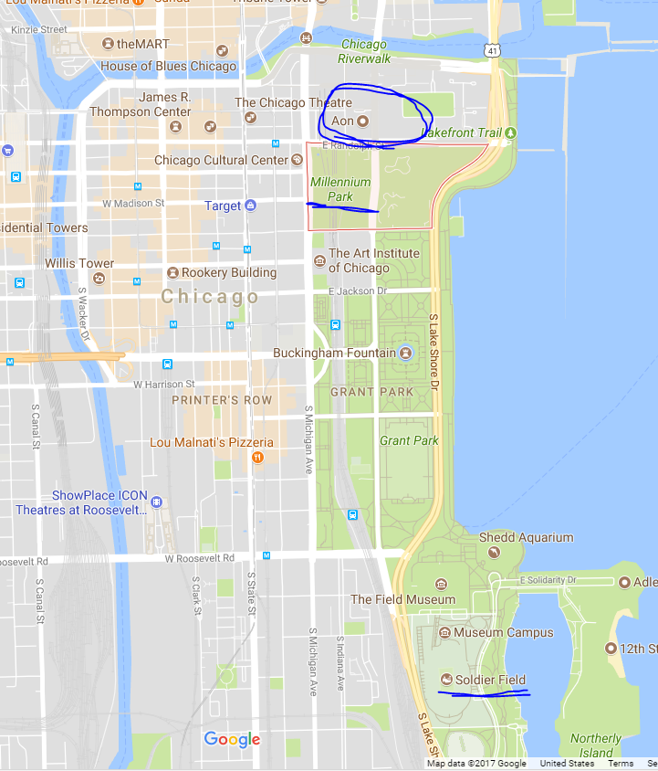
Big Local Cultural Events
Presidential Politics at the AON building
Black Hawks Win Sir Stanley’s Cup
Cubs World Series
Chicago Food Week
NATO Summit
Notes:
Chicago Cultural events impacted the office because it was at the north end of Millennium Park. And these events brought millions of additional people into the city, closed roads, and generally made the area around Millennium park an absolute mess.
With thousand or so people in that office, many would work from home to avoid the mess of downtown. THIS drove the VPN traffic and VDI traffic.
Our office is in the circle at the top of the map. Solder Field (Chicago Bears Stadium) is at the bottom and Millennium park is in-between.
The events that had a large impact was:
Presidential Politics at the AON building next to our building
Parades for Black Hawks Winning Sir Stanley’s Cup and the Cubs World Series win,
Also Chicago Food Week and the NATO Summit caused impacts.
===
2010 Chicago Blackhawks win Stanley Cup (June 2010)
2012 NATO Summit Chicago (May 2012).
2013 Chicago Blackhawks win Stanley Cup (June 2013)
2015 Winter Storm (Feb 2015)
2015 Chicago Blackhawks win Stanley Cup (June 2015)
2016 Presidential trips (April, October)
2016 Chicago Cubs win World Series (October 2016)

Slide 7
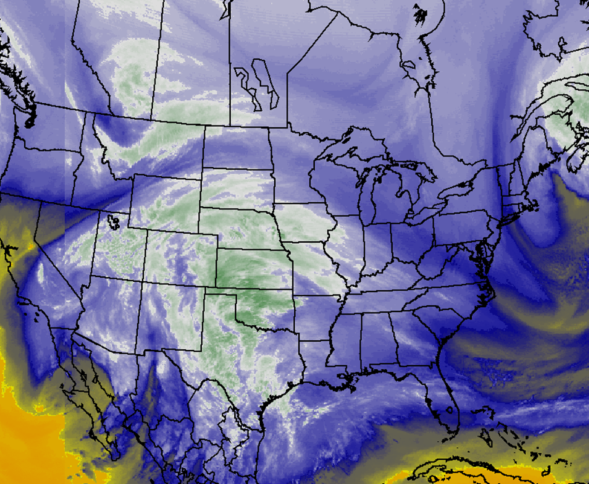
Except BIG Weather
February 2015 Snow
Notes:
While local weather did not drive large spikes, this big weather event surly would. As if it were a very large cultural event. Making a mess of not only Millennium part but half of the country.
The monster storm of Feb 2015 would combine regional cultural impacts in not trivial ways. Our models predicted a five to ten fold increase in utilization of the work from home technologies and infrastructure (VPN and VDI). The various technology owners exercised the business continuity plan (which is distinct from a disaster recovery plan) and quickly reinforced the VPN and VDI capacity to eventually service 8 times the then current capacity. Much of this capacity was given back after the cultural event.

Slide 8
Work From Home Corporate Policy

Slide 9
Work From Home Corporate Policy
Corporate policy was shifting to a more liberal work from home policy.
Without this work from home effort being well underway, we would not have been able to respond well to the massive weather shutdown.
This caused the design and addition of VPN systems and VDI systems, and new divisional policies, worker procedures, and encouragement to allow for most job functions to work from home. Some jobs were redefined such that work could be done from home.
Notes:
Corporate policy was shifting to a more liberal work from home policy.
Without this work from home effort being well underway, we would not have been able to respond well to the massive weather shutdown.
This caused the design and addition of VPN systems and VDI systems, and new divisional policies, worker procedures, and encouragement to allow for most job functions to work from home. Some jobs were redefined such that work could be done from home.
Significant Policy, procedure, tools and techniques developed and deployed. In short, a significant redesign of our normal internal processes.

Slide 10
Change From Where and How Work is Initiated

Slide 11
Cultural Events Change Work Initiation
These work from home policies changed from where and how the work is initiated but not necessarily how the work is done internal to the Corporation.
Once the work from home processes is in place and well practiced, delivered excellent results.
Notes:
The cultural events changed where and how the work is initiated but not necessarily how the work is done internal to the Corporation.
For example when workers came into the office to work, there was a ‘work list or assignments’ type of deal. When work shifted to work from home, that process changed to a ‘pull the next task’ type of deal. However, once the work was started, then internal processing within the Corporation remained the same.
Internal processes for work distribution, quality control, production rates, error rates, and such may change or be tweaked, but once in place, and well practiced, these processes produced excellent results and allowed for smaller office spaces (some office spaces disappearing altogether). The key for us was the work from home process being a much more ‘normal process’. The tools, techniques, software, infrastructure, engineering, security and other hurdles were already basically solved for. Moving existing resources, repurposing, reconfiguring, and realigning made the transitions achievable during the cultural event.

Slide 12
Flexibility and Use of Corporate Assets

Slide 13
Flexibility and Corporate Assets
Flexibility as defined in Policy and Procedure
  For Normal, normal exceptions, and exceptional exceptions
Disaster Recovery Plan
Business Continuity Plan
From and IBM.com site
A business continuity plan (BCP) is a document that outlines how a business will continue operating during an unplanned disruption in service. It’s more comprehensive than a disaster recovery plan and contains contingencies for business processes, assets, human resources and business partners – every aspect of the business that might be affected.
Notes:
Flexibility should be defined in Policy and Procedure. The various plans, programs, and processes should have broadly defined ‘Corporate duties, responsibilities, authorities’ for normal operations, normal exceptions, and exceptional exceptions.
For corporate assets most people immediately focus on the Disaster Recover Plan. However this normally focusses on the internal equipment, infrastructure etc. and what happens when these are ‘wiped out’ In a cultural event, these resources are likely to be intact.
We found the Business Continuity Plan had the duties, responsibilities, and authorizations needed to redirect resources for relatively short term solutions to ‘keep the lights on’ from a business sense.
HR intact and able to meet payroll?
Customer service able to work in alternate locations / methods to satisfy existing customers in a disrupted environment?
Account receivable and accounts payable. What policies, procedures, and practices can be employed to continue to transact business in a disrupted environment? Can Point of Sales devices be replaced with paper tallies? Can emergency supplies be purchased when the normal process is disrupted? What authorizations are needed? What limits are imposed?
Business Continuity is about keeping the business actually in business. Disaster recovery is a part of this plan, but the infrastructure is not impacted in a DR sense, during a cultural event.
Business Continuity Plan Allowed for the use of test and other equipment, as well as alternative business processes.
=====
https://www.ibm.com/services/business-continuity/plan
What is a business continuity plan?
A business continuity plan (BCP) is a document that outlines how a business will continue operating during an unplanned disruption in service. It’s more comprehensive than a disaster recovery plan and contains contingencies for business processes, assets, human resources and business partners – every aspect of the business that might be affected.
…
The 1990s brought a sharp increase in corporate globalization and the pervasiveness of data access. Businesses thought beyond disaster recovery and more holistically about the entire business continuity process. Companies realized that without a thorough business continuity plan they might lose customers and their competitive advantage. At the same time, business continuity planning was becoming more complex because it had to consider application architectures such as distributed applications, distributed processing, distributed data and hybrid computing environments.
===
https://www.cio.com/article/2381021/best-practices-how-to-create-an-effective-business-continuity-plan.html
Many people think a disaster recovery (DR) plan is the same as a business continuity plan, but a DR plan focuses mainly on restoring an IT infrastructure and operations after a crisis. It's actually just one part of a complete business continuity plan, as a BC plan looks at the continuity of the entire organization.
Do you have a way to get HR, manufacturing and sales and support functionally up and running so the company can continue to make money right after a disaster? For example, if the building that houses your customer service representatives is flattened by a tornado, do you know how those reps can handle customer calls? Will they work from home temporarily, or from an alternate location? The BC plan addresses these types of concern

Slide 14
Flexibility and Magic
Test and other equipment
  Routing magic
  Access Control (firewall) Magic
  Distances measured in milliseconds
  Network Bandwidth - everwhere
Notes:
With the flexibility and authorizations in the business continuity plan, and the magic of technology we were able to…
Use the test and other equipment for the short-term business continuity problem.
Using routing magic and access control magic, most of the reassignments were done without physically moving equipment from one rack to another.
When moving services around, physical distance is less important than distance / delay measured in milliseconds. Moving a VPN connection from Dallas to Chicago (a long physical way) was actually only about 15 milliseconds (.015 seconds) slower / further away. Conversely moving a device behind a firewall (zero physical distance) could be 500 milliseconds (.5 seconds) slower / further away.
The Most problematic resource (at least for us) was bandwidth. Not just with our internal network and internet connections, but the work from home connections and more importantly the work from home providers bandwidth.
We had people that routinely worked from home, but for the ‘cultural events’ their internet provider could not keep up with all the other people working from home (or home due to the weather and surfing the internet). There was very little we could do about this other than allow for flexible hours. For our corporate bandwidth redirecting traffic via routing magic (the power of internal virtual networks) allowed us to use the resources at hand.

Slide 15
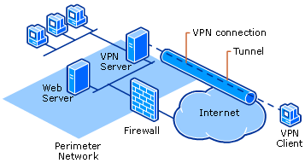
VPN Vs Normal Traffic
Notes:
Once the Work From Home paradigm was established, we basically had this network configuration.
An interesting observation is that when internal workers work from home on a large scale, the internet traffic drops significantly. So we were able, with the authorizations and provisions in the Business Continuity Plan, to ‘commandeer’ equipment to a new purpose and were authorized for alternative business processes.
So we added VDI to the pool behind the VPN devices and ‘borrowed’ bandwidth from the internet firewall circuit.
Bandwidth is the most likely resource to become taxed AND has a long lead time. This is where routing magic, and access control (firewall) magic comes in handy

Slide 16
Significant Result
We stayed open – processing claims and answering questions
After the storm, the aftermath made travel hazardous, but still we remained essentially fully staffed using the work from home resources, and business process that made working from home a ‘normal business activity’. Yes, many people did take PTO (Personal Time Off), but quite a few did not, specifically because business processes were modified to use the work from home technology, and the technology was expandable to meet this demand.
Notes:
This is a significant result as these employees, working from home, allowed the company to function uninterrupted. While many other companies were closed, losing revenue and disappointing customers during a stressful time, we remained open and processing claims, answering provider and user questions, and reacting to the local demands of the storm as it affected our locations.
This was made possible by a few brilliant observations that a big weather event is equivalent to a cultural event (not local weather), and allowed the capacity team to combine and forecast cultural event type impacts on the network resources.
After the storm, the aftermath made travel hazardous, but still we remained essentially fully staffed using the work from home resources, and business process that made working from home a ‘normal business activity’. Yes, many people did take PTO (Personal Time Off), but quite a few did not, specifically because business processes were modified to use the work from home technology, and the technology was expandable to meet this demand.

Slide 17
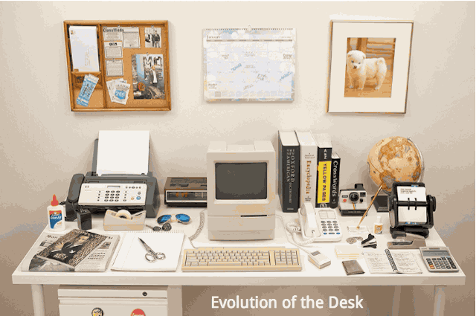

Why the Work From Home Paradyme Works
Notes:
Side note
The reason work from home “works” is that you have NOTHING left on your work desktop. ALL of your resources and services can be accessed via the Corporate computing resources.
<start the gif>
As the gif plays imagine all of the things that kept you attached to your desk and in the ‘office’. Paper files, folders, workflow tasks, references, and other physical resources, None remain. When you have a compute devices (can be your phone) and tools and techniques (software, process and procedure) and reliable connectivity (fast is helpful but not required) then you can be at work from ANYWHERE.
https://boygeniusreport.files.wordpress.com/2015/07/desk-evolution.jpg

Slide 18
Call To Action

Slide 19
Look for your existing Corporate Policy
If you have work from home now, you may have most of what you need Policy, procedure, mindset, tools and techniques
Business Continuity Plan likely has the authorization
Business continuity liberates some of the red tape so that you can survive probably with resources available now.
Notes:
Look for your existing Corporate Policy
If you have work from home now, you may have most of what you need Policy, procedure, mindset, tools and techniques
Business Continuity Plan likely has the authorization, permissions and framework to quickly make decisions that may have been outside of your ‘normal authority’ sans the cultural event.
Business continuity liberates some of the red tape so that you can survive, probably with resources available now. The tools and techniques are available, and the resources are available.
What you likely need is a new way to look at the problem. By definition it is an exceptional exception. And deservers an exceptional way to look at and solve the problem.

Slide 20
Questions & Answers

Slide 21

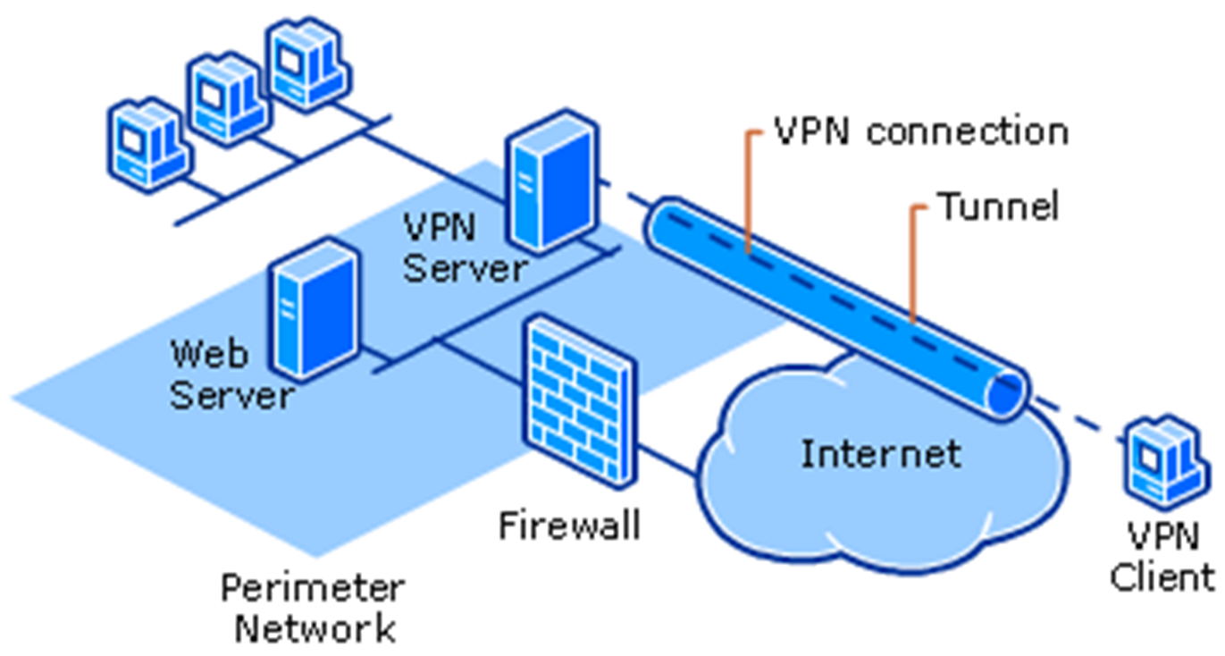
Questions and Answers
Weather was a rubbish capacity input
Work from Home Corporate Policy Set Preconditions
Cultural Events change from where and how work is initiated, not necessarily how the work is done.
Flexibility and the use of corporate assts – Normal, normal exceptions, and exceptional exceptions
  Disaster Recovery Plan
  Business Continuity Plan
  Test and other equipment
  Routing magic /
  access control magic /
  distance measured in milliseconds
  Network bandwidth - everywhere
Movìri Can Help
Call us.
Notes:
Moviri can help – Call us

