Slide 1
BMC TrueSight
Capacity Optimization
(BCO)
Use Case BCO015
Reading Charts for Actionable Intelligence
As an Application Manager or SME
Extensive use of the note field is used
Notes:
The notes field is used such that the notes are what a narrator would say while the slide is on the screen.
The screens show screen shots which are sometimes very data dense so the narration can be quite helpful.

Slide 2
Need Elevated Permissions and Caution
Running, changing and making charts requires BCOUser permissions. This is an elevated permission level, that while easily given, does allow the user to ruin existing charts. This costs the time and effort already put into the chart, and the time and effort to recreate the chart. Therefore, care must be used when changing existing charts.
Existing charts can be copied to the same ‘place’ or elsewhere such that you can modify the chart and ‘make it your own’. There are several techniques for this which are discussed here.
Using charts does require some thought and review that the data the chart suggests it is presenting is actually the data being used. As this can be changed by others, you should confirm when using the charts.
Notes:
There are only three levels of access in BCO. Administrator, BCOUser and BCOViewer.
BCOViewer is essentially a read only access. It gives considerable control in the Viewer and Reporting areas where the reports are already well though out, and all the user needs to do is apply filters to the data for different views.
BCOUser is an elevated permission level, and allows the user to run, change and make charts. The problem with this is there is no control to WHICH charts he can run, change and make. This introduces the risk that a user change an established chart such that it no longer meets the goals of the chart, essentially ruining the chart.
Administrator is the only permission level that can change data in the BCO database, and is held ‘tightly’ and is not easy to get. (there are only 5 administrators at this point.)

Slide 3
BCO Data
BCO data is NEVER wrong. The data comes from other sources and only parrots what it gets from that source, so the data BCO has is the data the source has.
However, BCO does make assumptions on what to do with the data to display it. So you must be careful to evaluate what the charts are suggesting vs. what the data was intended to suggest. This is not as easy as you might think.
A prime example is the metric of Employees + Contractors. Because it has a type of ‘Generic’ BCO will assume that it should sum the base number to get to the next larger aggregation, said differently add hours to get days, then add days to get weeks etc. This is obviously wrong when the base ‘generic’ number represents ‘Employees and Contractors’.
Notes:
BCO is a consumer of Business data and while it aggregates into 15 minute slices or 1 hour slices it is still just Business data, and therefore can never be wrong.
Assumptions are made based on data types as defined in BCO. This drives how, when, or if a series of data is aggregated when time lines are changed from the base line of the data. This is very likely to cause confusion, so the analyst must be aware THAT these assumptions have been made by BCO.

Slide 4
Find the Pattern
Finding a pattern in a chart is relatively easy. The difficulty is in determining if the pattern is ‘normal’ and whether exceptions are outliers or have special causes.
Notes:
Control chart
Histogram
Regression analysis
Run chart / time series

Slide 5
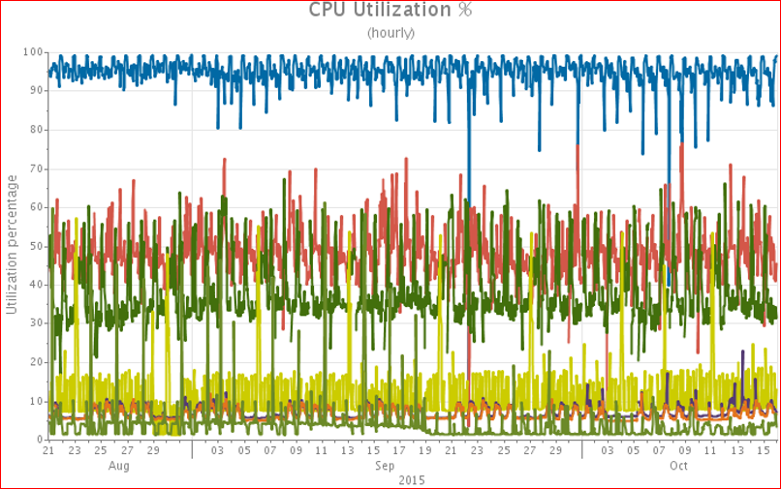
A “Normal” Line Chart
Notes:
The typical chart will show ‘everyone’ behaving normally.
These types of charts are useful to see where a pattern has changed. If you were not expecting a change, then you have an indication of where to look.

Slide 6
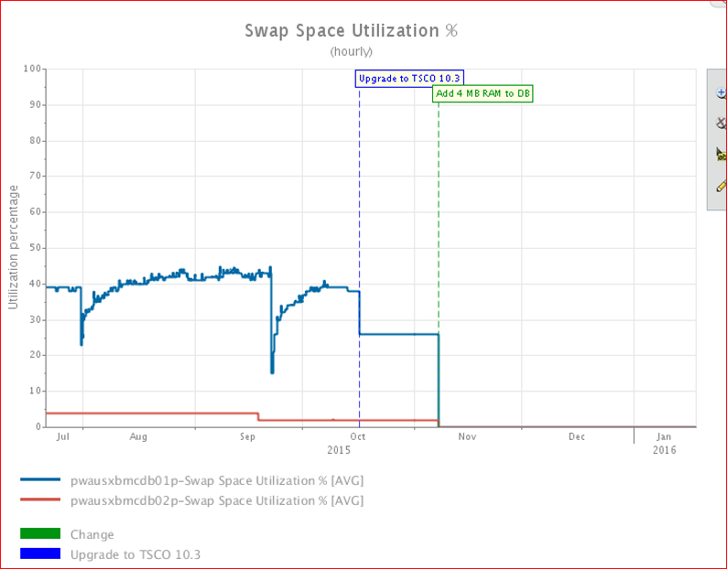
Notes:
This is the type of data you are looking for. In this case an event caused a pattern change. A separate event caused the pattern to change again. These charts are most useful for detecting a pattern change. Or in this case showing the result of a change.
The event flags are added to the device or system and will show up in reports with the flags turned on.

Slide 7
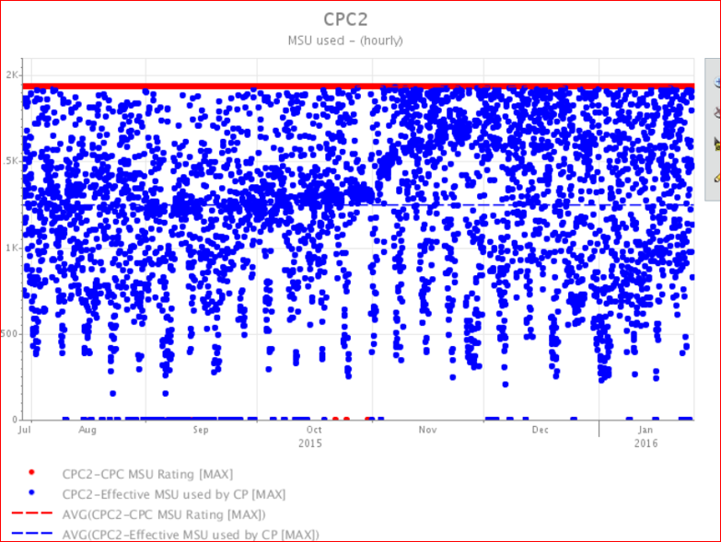
Example of Saturation – Dot Chart
Notes:
This is mainframe CPU. The ‘horizontal cluster’ on the left side of the screen at about 1250, is an indication of a constrained resource.
Around November 1st the constraint loosened but not removed. The ‘ horizontal cluster’ on the right of the screen is at about 1750.
This actionable intelligence is not findable with a line chart.
This goes to show that different investigative missions are served by different chart types.
Additionally, different types of findings are conveyed to managers with different charts than the analysis was done (typically).

Slide 8
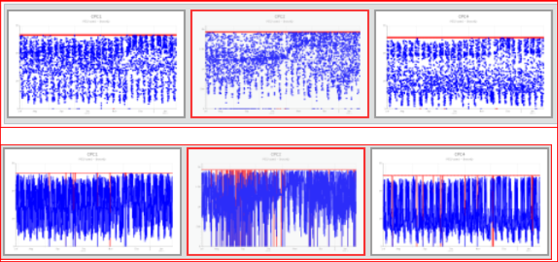
Line Charts Vs. Dot Charts
Notes:
This is the same data over the same period. Dot charts on the top with line charts on the bottom.
While this is mainframe CPU, it can be any metric that directly measures work. The constraint is indicated by the horizontal clusters in the dot charts.
The more noticeable the horizontal cluster and the more white space under the horizontal cluster the more constrained the system.

Slide 9
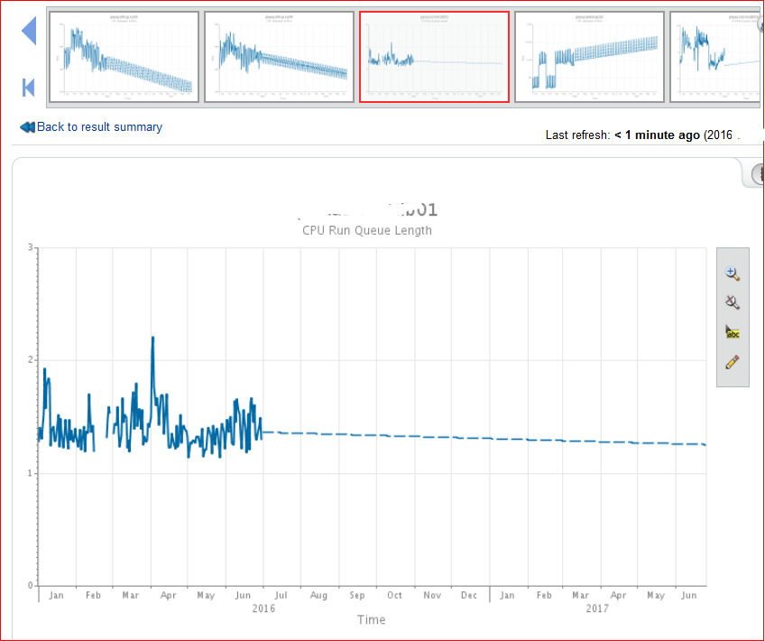
Forecast
Notes:
This is a simple forecast. In this case 6 months of history to project 12 months forward.
The analyst has some control over the metrics, algorithm, chart display, thresholds and other options.
Scenarios can be as complicated as multiple what if events for the system or individual metrics, or as simple as straight forecasting based on a particular history.

Slide 10
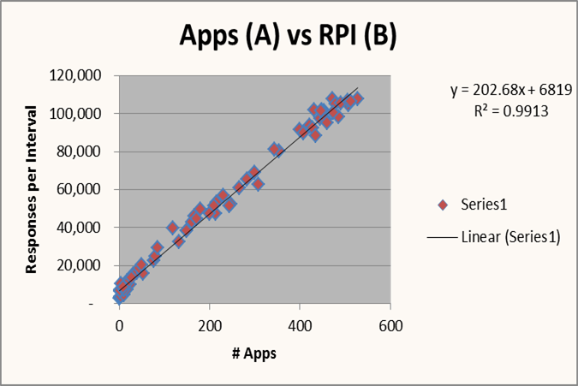
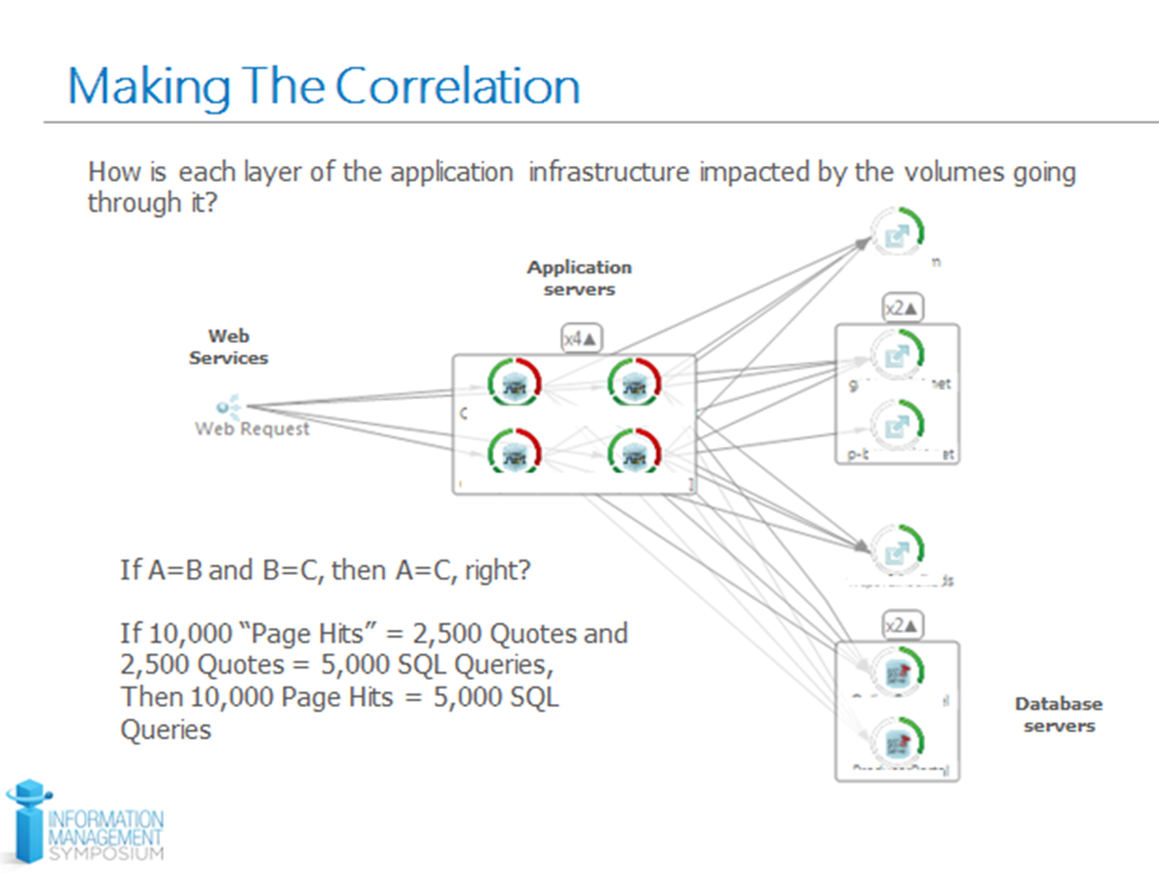
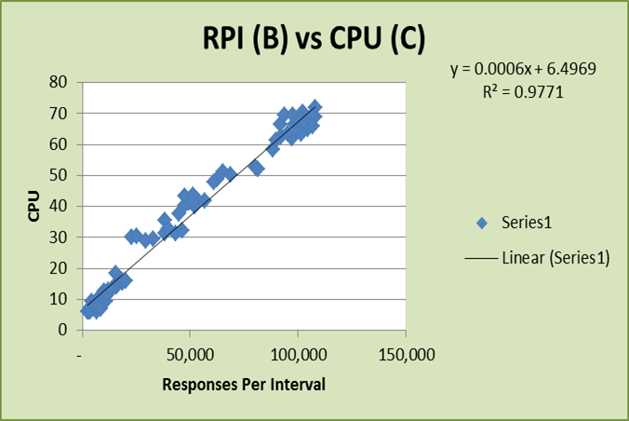
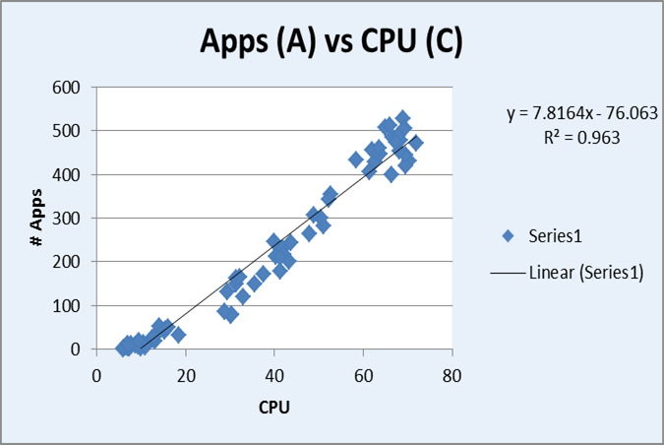
Notes:
If you can find effort metrics and work volumes that directly correlate then that is optimum. However, you may need to make indirect correlations using the transitive property of if a=b and b=c then a=c to determine how front end events drive back end events. However, you should be careful with these assumptions.
========
Equivalence Properties of Equality
The reflexive, symmetric, and transitive properties that are satisfied by the = symbol.
Reflexive Property a = a
Symmetric Property If a = b then b = a.
Transitive Property If a = b and b = c then a = c.

Slide 11
Conclusion

