Slide 1
BMC Capacity Optimization
(BCO)
Use Case BCO001
We got an alert from the Monitoring Team!
OR Other Reason to Use BCO…
How can BCO help?
Extensive use of the note field is used
Notes:
The notes field is used such that the notes are what a narrator would say while the slide is on the screen.
The screens show screen shots which are sometimes very data dense so the narration can be quite helpful.

Slide 2
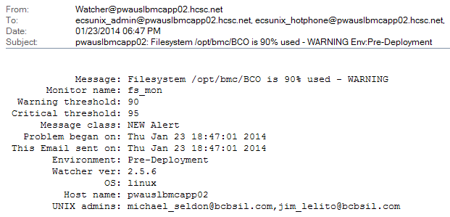
Evaluate the ‘Problem’
We got this email alert..
Pick out the server…
And the problem
Notes:
Our use case is a real use case of a mount point on the BCO server triggering an alert.
The server group in charge of our physical (or virtual) server got a notice. They evaluated it and sent it to the SME listed for the server. We got the message above with a request to ‘respond’.
The alert shows us that one of our servers has ‘filesystem is 90% used – WARNING’ , this is not yet critical according to the alert. This is, in fact, our second warning to as many days.
Problem statement: pwauslbmcapp02 Filesystem /opt/bmc/BCO is 90% used
As application SMEs, we know this is the server that does much of the ‘back end’ work of creating reports, doing our ETL (extract data from our sources, transform that data, and load that data into our database), and some administrative tasks. While it is not the web front end, end users will use this server for report generation.

Slide 3
Decide what Information is Needed
These questions happen is quick succession and not necessarily in this order.
Is the ‘application’ down or giving errors?
What is the history of the general resources on the server? Storage space on the pwauslbmcapp02 server, in this case.
What is the history of the specific resource? /opt/bmc/BCO in this case. (Yes this is a real alert on the BCO file system and we will use BCO to help analyze the alert.)
What happens if no action is taken? There might not be enough information for this yet, but this is an important question that informs what happens next and how urgently it happens.
Notes:
We now know what we need to find out, and asked these questions? (not all required BCO or its data).
Is the application down or giving errors? We logged in as a user and went to a few screens. Result - No errors, no unusual delays. This implies we have some time to investigate.
What is the history of the general resources on the server? We do not know but BCO will (likely) show this.
What is the history of the specific resource? We do not know but BCO will (likely) show this.
What happens when no action is taken? An internal discussion will show the downside of no action. This tends to show much of the bad things that can happen with no action, and tends to show why action is needed and how soon.

Slide 4
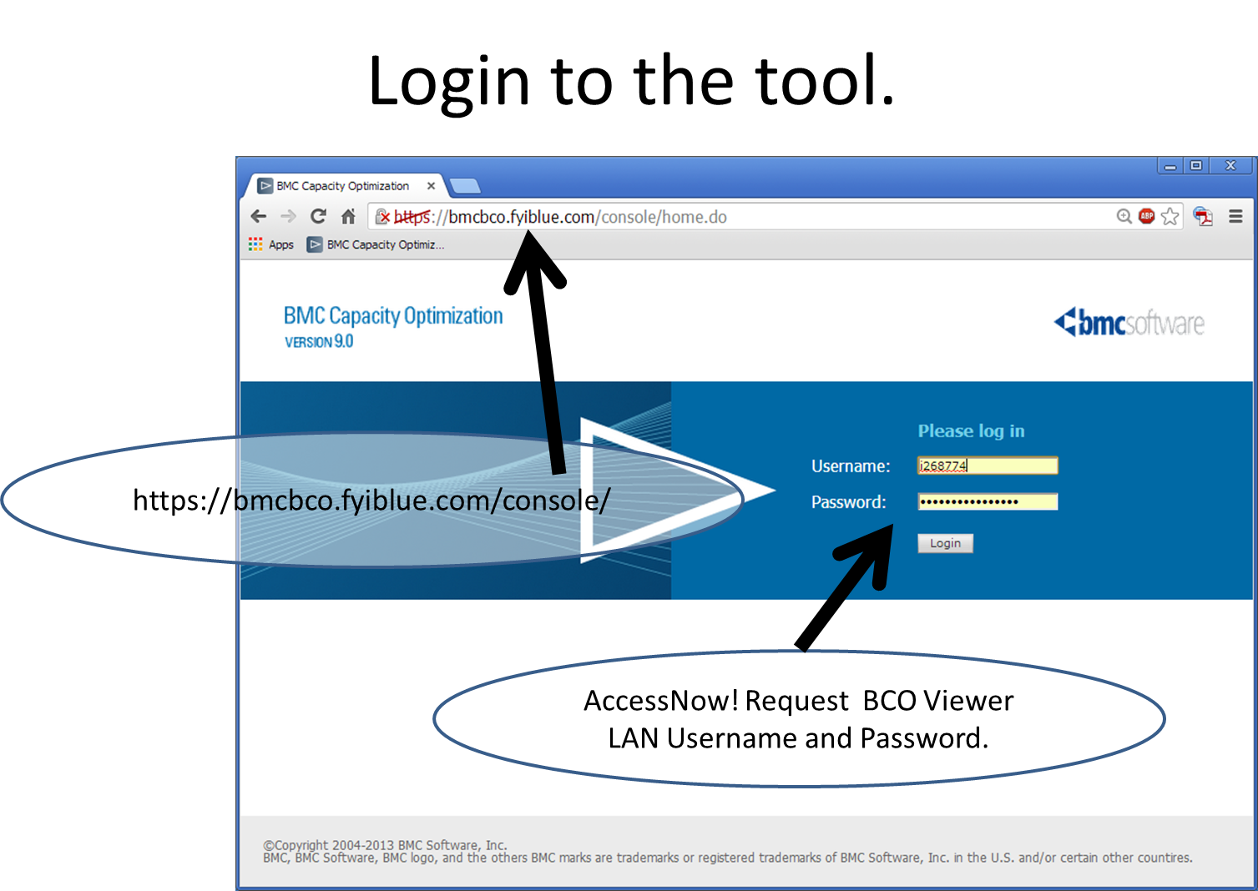
Log on to BCO
Notes:
Log into BCO with LAN Username and Password. https://bmcbco.fyiblue.com/console/
BCO is open to all application managers and owners (especially on the business side), SMEs, and ITG. IF access is not setup, you can request it, or call the BCO admin group, and we will for you and your group.
Michelle Desrosiers, Ben Davies (Rick Kickert, Manager)
=============
AccessNow! Request to the group BCO Viewer.
Also may request BCO User (allows ability to change Workspace reports and charts).
Login with LAN ID and Password
AccessNow! Become the user of record
Submit | Windows | Add Access
Domain is ADHCSCINT
Search for BCO Select BCO Viewer (or BCO User as appropriate)
Justification text..
BCO Viewer
BCO Viewer access is necessary to perform duties specific to monitoring the infrastructure and or application data available in the BCO tool. This access is mostly read only, and is to retrieve data for analysis and use reports available through the BCO tool.
BCO User
BCO User access is necessary as part of a capacity planning role, access to this group grants access to the BCO capacity planning tool. This is required to perform duties as capacity planner and includes creating reports, creating analysis, and monitoring the infrastructure and or application data available in the BCO tool.

Slide 5
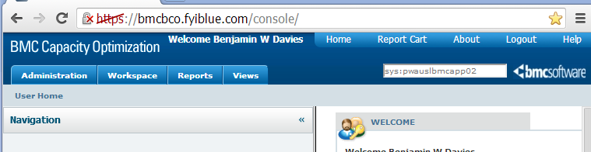
Find the System
Find the system. sys:pwauslbmcapp02
The sys: limits the search to just systems. You can use wild cards ? One charter * many charters. There are other key words workload: metricname: app: tag: type: You can use AND or OR and group with ()
You may want to add -type:object to remove unlikely matches.
Notes:
The easiest way to start, when you have a server name already is the search in the top right of the screen.
Paste in the name of the device. While the sys: is sometimes helpful, just the name generally works as well.
There is a large BCO manual and these search options are on Page 1536 in the 2869 page BCO 9.5.00 manual.
These may be helpful.
Type Filter= +type:system +subtype:*network* -type:object
Domain Filter= +(domain:alineo*) -(type:object enttype:*database* type:*analysis type:*report sys:*)
Application Filter= +((appid:2059 enttype:*database*) AND (RMAS enttype:*database*)) -type:object
System Filter= (+(sys:LIVE*OK*pwauslihsapp*) -(sys:retail*) -(sys:memprofil*) -type:object)
+ is to include - is to exclude the () make it more readable and are not always required.

Slide 6
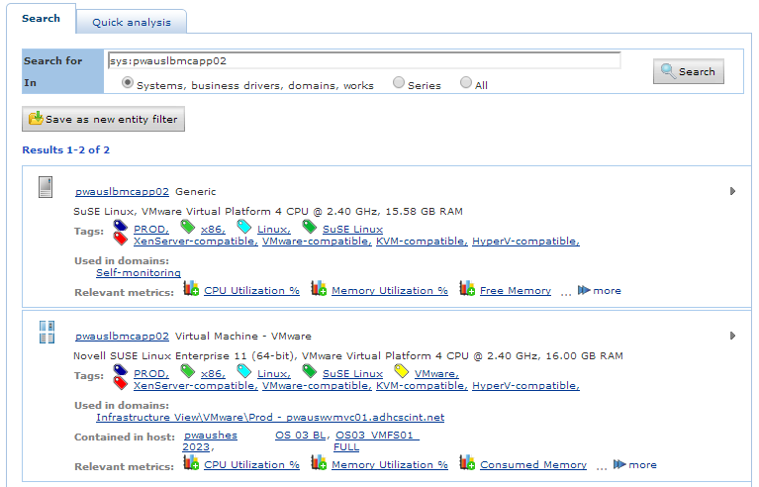
Evaluate the Result
We found two servers with the same name, which implies that they were discovered from at least two different sources which have not been reconciled. They are considered “PROD”, Linux, and are VMWare virtual servers. The appear to be the same device, so we click on the second server name for the server details as the quad icon is that of a ‘virtual’ server..
We can click on the name, domain, or jump directly to a metric.
Clicking on other hot links, will show similar items. All “PROD” devices or all “Linux” devices.
Notes:
Here we have two servers with the same name. This is not ‘normal’ but implies that the servers were ‘discovered’ independently but not reconciled as the same device. We will keep this in mind as we progress.
We can tell a little about the devices based on the associated tags, and domains. They seem to be PROD, Linux and virtual (versus dedicated hardware).
The first one is a ‘generic’ server and is probably the ‘odd one’
The second is a VMWare server and is probably the one that would be considered the ‘master’.
The icons are different suggesting the type.

Slide 7
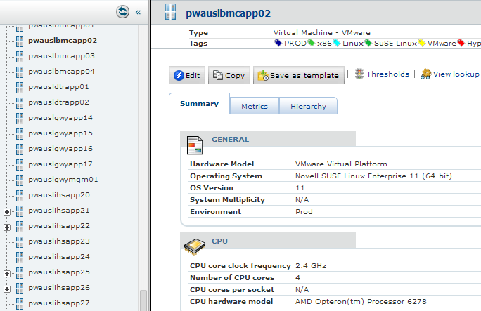

What Kinds of Data are Available?
Device Type. See note below.
Clicking the name navigates to the device on the left window.
The Hierarchy shows where this lives in relation to other things like what applications are associated and what children are with the server. Databases on a DB Server.
The important tab is the Metrics tab. Click that.
Shows the Summary that is what the server ‘is’.
Database Instance
VM Device
NOTE: There are dozens of device types and they have their own icons. These are a few and you will get used to seeing (and quickly identifying) your favorite types.
Generic Device
Notes:
Clicking the name will navigate on the left to the device (in this case). The panel on the right describes the noun or object on the left.
There are three tabs of Summary, Metrics, and Hierarchy.
Summary shows things about noun on the left. As this is a server name you see the OS, environment, size of CPU, amount of memory etc.
Metrics shows metrics associated with the noun on the left. Top half are slow moving metrics like OS and version, number of CPUs installed, clock rate of CPUs etc. These metrics can change but do not change often. If plotted these would tend to be a straight line over time.
The bottom half are volatile metrics like CPU utilization, storage utilization, Disk IO rate, Network Error rate etc. These metrics can come from a number of monitoring tools. BCO queries these monitoring tools once a day (generally) and creates 15 minute time slices for the metrics. These are then aggregated into hour, day, week etc. metrics, and are stored essentially ‘forever’. These aggregated metrics are useful for seeing long term trends.
Hierarchy shows which ‘parents’ (such as applications) have this noun associated. And shows which ‘children’ this noun has.

Slide 8
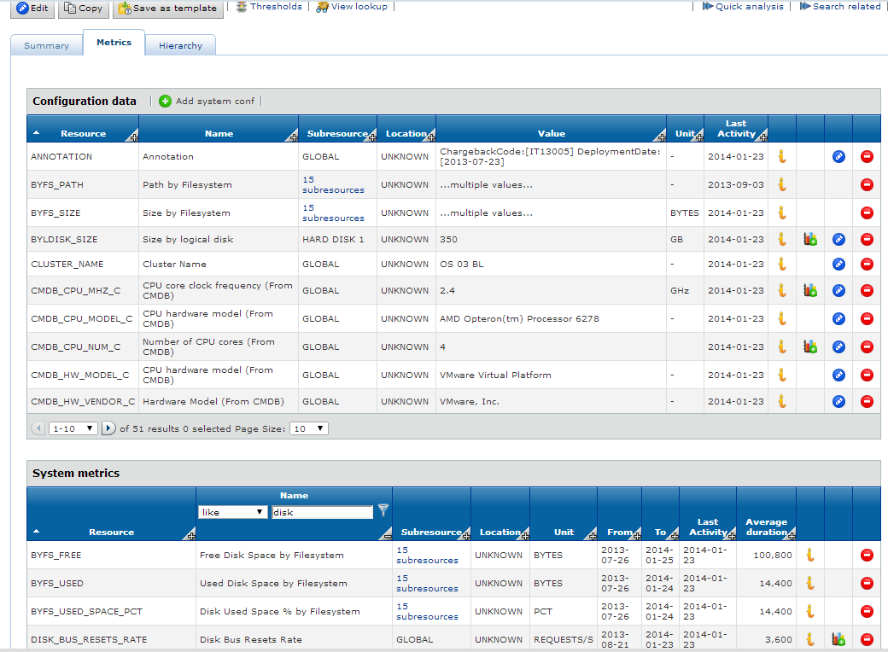
The Metrics Tab
The top section is slow moving metrics. The OS changes, but not often, the amount of RAM installed changes but not often.
The system metrics is where CPU, Disk IO, storage and other metrics are. Normally in 15 minute time slices, from yesterday and before. Older data is aggregated to Hour, Daily etc.
Columns can be sorted by clicking the header, and filtered by clicking the “+”.
Select either a sub resource, or graph using the graph icon.
Notes:
Metrics shows metrics associated with the noun on the left. Top half are slow moving metrics like OS and version, number of CPUs installed, clock rate of CPUs etc. These metrics can change but do not change often. If plotted these would tend to be a straight line over time.
The bottom half are volatile metrics like CPU utilization, storage utilization, Disk IO rate, Network Error rate etc. These metrics can come from a number of monitoring tools. BCO queries these monitoring tools once a day (generally) and creates 15 minute time slices for the metrics. These are then aggregated into hour, day, week etc. metrics, and are stored essentially ‘forever’. These aggregated metrics are useful for seeing long term trends.
Metrics can have subresources, such as a file system which can have individual mount points (c:\ d:\ /var /opt etc.) and network interface which can have subresources such as /lo /eth0 /wlan1
Find the metric of interest and click the graph icon to show a graph of that metric over time.

Slide 9
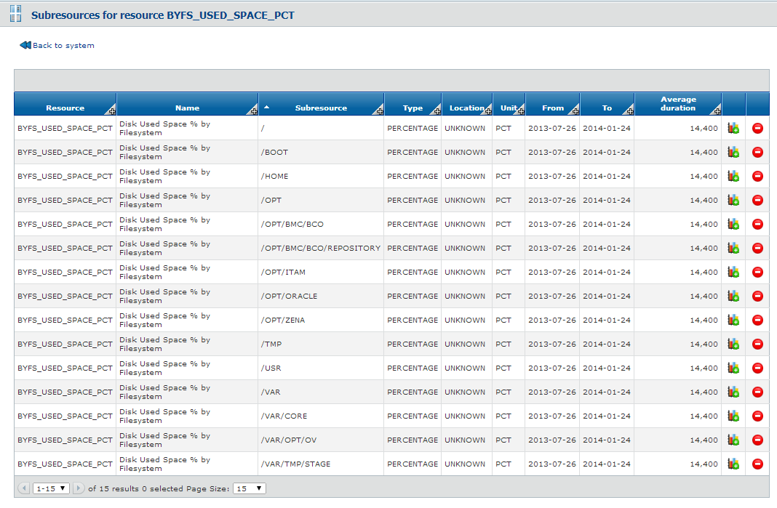
Disk Used by% by Filesystem
We see all the mount points so plot the one that was alerted on. We can add individual metrics to a graph then add any other metric from any other system to see how they compare.
Notes:
In this case we wanted a subresource of BYFS_USED_SPACE_PCT. Said another way the mount points are shown By FileSystem Used space as a percent.
Click the graph icon and see the metric over time. Come back to this screen and choose another and both will be displayed. This can be repeated for all of them (but there is an easier way). Any other metric can be shown on the same chart, by navigating to the other metric and clicking the chart icon.
While not all combination are helpful or even makes sense. This is a powerful feature of BCO.

Slide 10
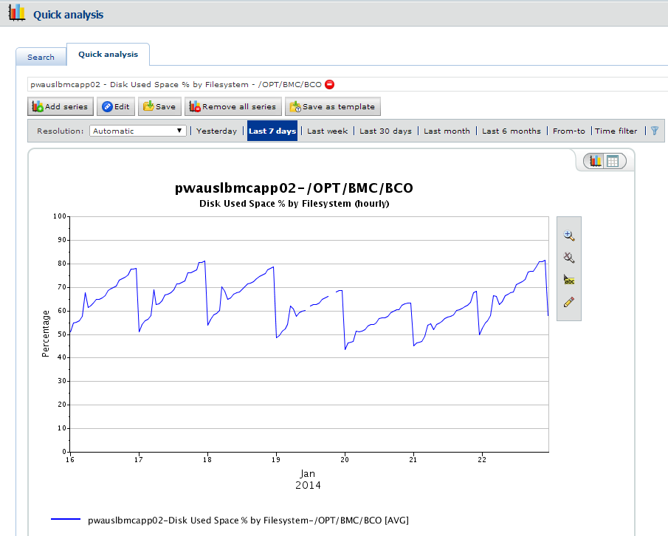
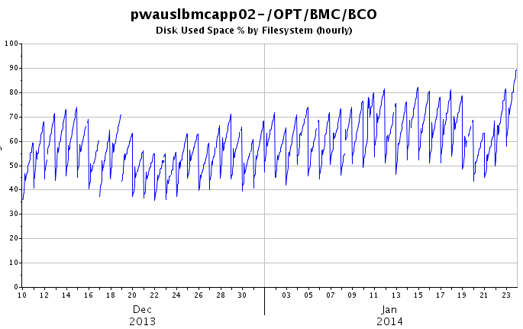
Initial Analysis
We see an increase that triggered the alert (apparently). The pattern looks like it may correct itself with the nightly cleanup job (the steep drops). This is a 7 day chart.
On a 45 day chart, there is an overall long term trend up.
This initial analysis helps inform our immediate actions, and is a basis for other analysis. The next steps are driven by what is observed (an overall up trend) and what is missing (an obvious anomaly). Additional data may show other issues, or confirm this is the only issue (for the moment). You may find the 01 device is responding differently which may mean something in the context of the application.
The BCO team can help with your investigation until you are comfortable with the tools and techniques.
Notes:
The 7 day chart shows that we are at a high point which probably caused the alert but there is nothing exceptional about today vs recent history. A steady rise through the day and a sudden drop late in the day (probably a purge event).
Moving to a 45 day chart (the longest chart you can have with hour data) shows an uptrend with higher highs and higher lows. The last day is a new high water mark, confirming that the alert is probably something new and likely to ‘keep getting worse’.
Based just on these charts, todays event is ‘normal’ but ‘concerning’. I probably do not have to take action immediately, but ignoring it will not likely work out well. Knowing what the system does, what the likely impacts of continuing on this trend are, and other ‘shop knowledge’ the SMEs bring to an analysis like this, goes a long way to reading the charts appropriately.
It is impossible for the BCO tool or capacity planning group to read these charts appropriately without some idea of what the system is and does. While some charts are patently bad news regardless of the application, there is still some knowledge that informs interpretation of the charts. Reading charts takes practice. The BCO team would like to help you read the chats, and will need your experience and understanding of the systems to interpret the chats effectively and appropriately.

Slide 11
Actionable Intelligence
A team meeting was convened to take action from this analysis. Your initial investigation should yield some action, even if it is willful inaction, otherwise, these efforts of data collection, assembly, display, and analysis are wasted.
The storage alert was a topic of conversation today with the application admin team, and it was decided that a group of misbehaved reports triggered the alert. However, the history of this mount point is volatile as it grows quite rapidly during the day, but gets reset as files are removed at the end of the day.
At this meeting we would like to discuss the options for action and settle on an official action. We seem to have these choices:
  Leave this alone and risk the disk reaching 100% disk utilization for these mount points. This will likely cause new reports to fail and probably hang the process that started the reports. Users would likely see errors, delays and make the interface unstable. This has no (direct) cost in time or ITG infrastructure resources, but directly impedes the mission of the application. This action is not recommended.
  Purge data that is 'older'. This is 'safe' if the reports or report residue are unused. This will cost time but not ITG infrastructure resources. This would likely be needed again periodically.
  The current cleanup process can be made more aggressive. This is 'safe' if the reports or report residue are unused. This will cost time but not ITG infrastructure resources. This is less likely to be needed again in the future as an aggressive purge keeps space clear.
  Increase the size allotted to the mount points in question. This could be a reallocation of other mount points or outright increase. The mechanics of this is unclear as are the impacts. This would likely require a service interruption (so should be done 'after hours'). A reallocation will cost time but not ITG infrastructure resource. An outright increase would require both time and ITG infrastructure resource. This action will require other ITG teams, is likely to be the most expensive in terms of man-hours or capital cost, but is most likely to be effective long term and could contribute to corporate efficiency goals.
Notes:
This analysis showed that there was an uptrend but the activity is ‘normal’ if elevated over the recent history. So while this does not likely present an immediate threat, some action should be considered.
We like to review the ‘do nothing option’ first as it focuses on the likely (bad) impacts and shows that some action is (likely) needed. That said, I am a fan of purposefully taking no action as my action plan, as long as the decision is made based on other choices and a reasonably complete review of options, costs, benefits and likely outcomes.
Options need not necessarily mean to add infrastructure resources. Re-allocation of existing resources are perfectly acceptable, and are easily justifiable based on the long term trends shown by BCO. That disk space you though you would need for logs may not be as used as expected, so would make a great place to ‘barrow from’. Resource efficiency is becoming more important, and issues like this are a perfect time to make efficiency changes.

Slide 12
Your Turn
Login to BCO https://bmcbco.fyiblue.com/console/
Find devices you know of and look at the metrics available
Look for applications you know of. Are all the devices associated?
Make or ‘borrow’ reports for your devices, services, and applications
Allow the BCO team to help get your reports started and mature them into scheduled reports email to you
Compare your systems against the work the systems do. These business metrics make for useful correlation analysis, ‘what if’ scenarios and forecasting
Turn this data in to actionable intelligence.
Notes:
Now it is your turn.
You are encouraged to find devices that are of interest to you. The systems can be assembled into groups, services, application or whatever you find helpful.
Once gathered together, reports can be generated then updated easily. Mature reports, and reports you find most helpful, can be scheduled and mailed to you. You do not need to create reports ‘from scratch’ but can barrow reports already made.
As the systems are better understood, these can be compared to the business metrics, or counts of work. These comparisons help with correlation analysis, ‘what if’ scenarios, and forecasting.
Turn this monitoring data in to actionable intelligence, and take action on it.

