Slide 1
BMC Capacity Optimization
(BCO)
Use Case BCO002
Setup My Application and Make Reports.
How can BCO help?
Extensive use of the note field is used
Notes:
The notes field is used such that the notes are what a narrator would say, while the slide is on the screen.
The screens show screen shots which are sometimes very data dense, so the narration can be quite helpful.

Slide 2
Evaluate the ‘Problem’
We have an application and wish to use BCO to ‘keep an eye’ on our app over time. We know about the app, we have a drawing, but we don’t know where to start with BCO.
Here are the questions that need answered (basically in this order)…
Log in to BCO and look to see if your application is modeled already. You can check on your main servers as well.
IF it is not there contact Configuration Management Team to see if it can be modeled, and when. <Contact data removed>
IF it will not be modeled soon, call the BCO team to help setup your app. <contact data removed>
Once your app in in BCO, you can make reports. The BCO Team can help, or you can copy others, or make your own.
There are other reporting options as well including scheduling reports to be retrievable online or emailed.
Notes:
This use case is that we have an application but it is not (yet) in the BCO tool.
How do we see IF our app is in the BCO tool?
How do we get our app in the BCO tool when it is not there already?
We KNOW what our app is, and we have a diagram for our app. Is that important?
How do we make reports in BCO that are helpful?

Slide 3
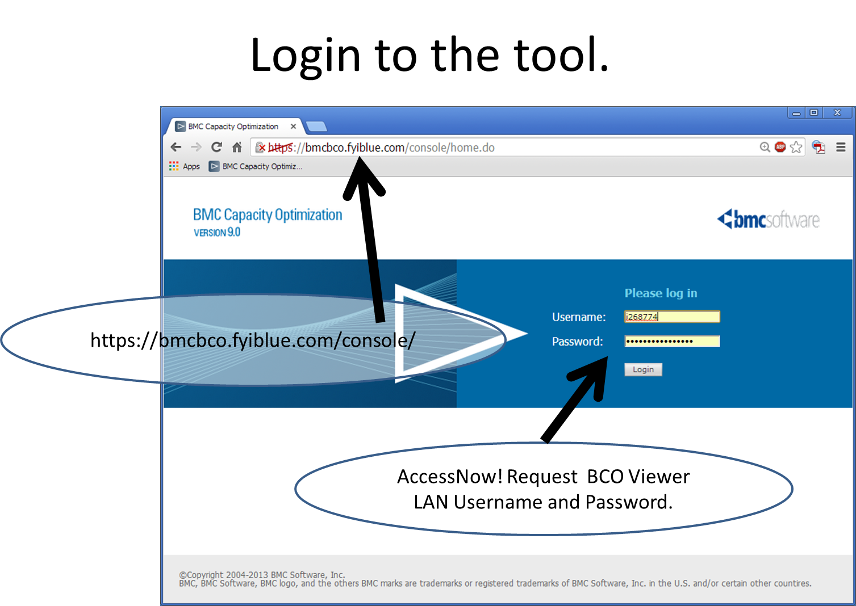
Log on to BCO
Notes:
Log into BCO with LAN Username and Password. https://bmcbco.fyiblue.com/console/
BCO is open to all application managers and owners (especially on the business side), SMEs, and ITG. IF access is not setup, you can request it, or call the BCO admin group, and we will for you and your group.
Michelle Desrosiers, Ben Davies (Rick Kickert, Manager)
=============
AccessNow! Request to the group BCO Viewer.
Also may request BCO User (allows ability to change Workspace reports and charts).
Login with LAN ID and Password
AccessNow! Become the user of record
Submit | Windows | Add Access
Domain is ADHCSCINT
Search for BCO Select BCO Viewer (or BCO User as appropriate)
Justification text..
BCO Viewer
BCO Viewer access is necessary to perform duties specific to monitoring the infrastructure and or application data available in the BCO tool. This access is mostly read only, and is to retrieve data for analysis and use reports available through the BCO tool.
BCO User
BCO User access is necessary as part of a capacity planning role, access to this group grants access to the BCO capacity planning tool. This is required to perform duties as capacity planner and includes creating reports, creating analysis, and monitoring the infrastructure and or application data available in the BCO tool.

Slide 4
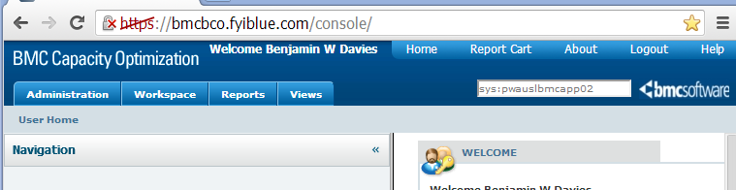
Find the System(s)
Find the system. sys:pwauslbmcapp02
The sys: limits the search to just systems. You can use wild cards ? One charter * many charters. There are other key words workload: metricname: app: tag: type: You can use AND or OR and group with ()
You may want to add -type:object to remove unlikely matches.
Notes:
Try a server name or three. Adding –type:object may help remove unlikely matches. Click the device name, then check the ‘Hierarchy’ tab. If this is associated with an application it will be in the ‘Parents’ section.
Try the application name and variations, long name, short name, just letters. Use wild cards.
Paste in the name of the device. While the sys: is sometimes helpful, just the name generally works as well.
There is a large BCO manual and these search options are on Page 1536 in the 2869 page BCO 9.5.00 manual.
These may be helpful.
Type Filter= +type:system +subtype:*network* -type:object
Domain Filter= +(domain:alineo*) -(type:object enttype:*database* type:*analysis type:*report sys:*)
Application Filter= +((appid:2059 enttype:*database*) AND (RMAS enttype:*database*)) -type:object
System Filter= (+(sys:LIVE*OK*pwauslihsapp*) -(sys:retail*) -(sys:memprofil*) -type:object)
+ is to include - is to exclude the () make it more readable and are not always required.

Slide 5
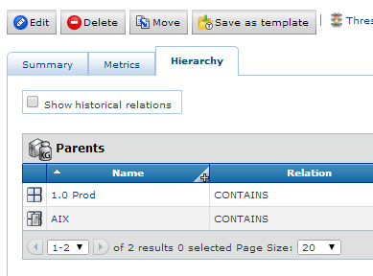
Find System Parents
Find the system. sys:pwauslbmcapp02
Click the Hierarchy tab. Look at the Parents section. These are the Applications associated and other grouping buckets.
Try several of your application servers, if none show your application, it is very likely that it is not modeled yet.
If your system names are not found, call the BCO Team, we will investigate. This is unlikely as we have 17,000+ named devices in BCO currently. Ben Davies 918.551.2242 (Rick Kickert Manager)
Notes:
Try a server name or three. Adding –type:object may help remove unlikely matches. Click the device name, then check the ‘Hierarchy’ tab. If this is associated with an application it will be in the ‘Parents’ section.

Slide 6
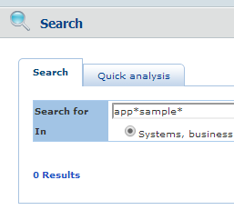
Find the Application Name(s)
Find the application. App:*sa?ple*
Try the application name and variations, long name, short name, just letters. Use wild cards.
You may want to add -type:object to remove unlikely matches.
IF it is not there, contact Configuration Management Team to see if it can be modeled, and when, having the official APM number (Application Portfolio Management) is helpful. Maria Bova-Cotts 972.996.8033 (Doug Smith, Manager).
Non APM apps can be created in BCO. Services, sub applications, or other groupings you find useful can also be created in BCO. Call the BCO Team, Ben Davies 918.551.2242 (Rick Kickert, Manager)
Notes:
Try the application name and variations, long name, short name, just letters. Use wild cards.
There is a ‘priority list’ but if your application is ‘easy to map’ and you only want one environment or any other concessions to make the mapping easy, you may be in luck. There are nearly 1,000 applications and all will (should) eventually be mapped, but having someone (you) ready to use these tools, can move your application ‘up the list’. Especially if your app is ‘easy to map’.

Slide 7
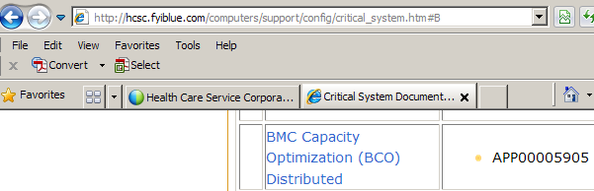
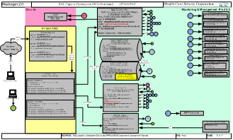
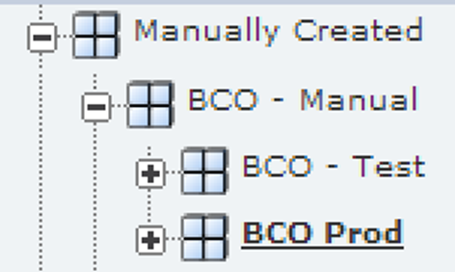
Make My Application, Please
We looked at the Critical System Documentation site.. http://critical_system.htm
And or got our system drawing
Picked off the devices we were interested in.
The BCO team will help make the application and show you where it is and how to get to it.
Here BCO is modeled in Test and Prod
Notes:
In our use case, Configuration Management said that we could not be mapped for several weeks. However, the BCO team agreed to model our application (or service, sub application, or other grouping).
Go to the Critical System Documentation site.. http://hcsc.fyiblue.com/computers/support/config/critical_system.htm
Or otherwise get your system drawing (or other documentation) to help build the device list.
The BCO team will help you make the application and associate the devices (and help get metrics if not available in BCO already). The reason you wish for the Configuration Team to make the application for you is that when a device is added or deleted ‘in real life’ the BCO model will not auto update (it would if it were discovered by the Configuration Team)
We can also work on ‘Business Metrics’ or the count of work your systems do. (that is a different use case).

Slide 8
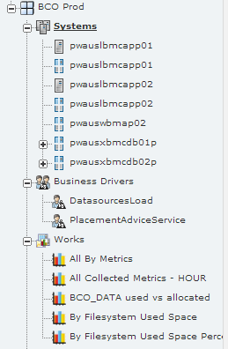
Show the Resulting Application
We added the servers.
Our Apache proxy Servers were not in BCO. So we sent a note to the Monitoring Team, <contact removed>. And they were not discovered by the Config Team, so they got a note as well.
We also added Business Metrics, which is the ‘count of work’ these systems do. This is needed for some correlation analysis and some modeling. In our case this was easy, but it generally is not so easy.
We also have some ‘Works’ or reports that have been borrowed from other places. More about that, next. You will find the reports are only as good as the data supplied.
Notes:
The BCO team modeled our application, however, our Apache proxy servers were not in BCO. This means that they are not being monitored by HP Performance Insight or any other monitoring tool BCO gets data from (there are many sources).
So we sent a note to the Monitoring Team (Andrew Martinez, Manager). pwauslihspxy03.app.hcscint.net and pwauslihspxy04.app.hcscint.net, they like to have the fully qualified domain name. This also implies that the devices have not been discovered by the Config Team. So we sent a note to them as well.
What this means to you, is that you should not expect that you can go from no data, to a fully modeled system, easily. You will find for a slew of reasons that the data you think you need is not immediately available to BCO, and may not be available from other groups either. BCO consumes data from several dozen places, It does not monitor systems directly, it consumes monitoring data from other monitoring apps. Many monitoring apps have incomplete coverage, mostly because no one needed the data before. BCO makes this data much more useable, so now more people are interested in the data, so these monitoring groups are backfilling to supply this data. Also, sometimes the data source is difficult to integrate with. So while the data source may have some data, it is not available to BCO.
Many times this ‘back fill’ goes quickly, sometimes it drags on and on.
The reports depends on this data to be relevant, complete, accurate, and available. To the extent this is true the reports are useful. When data is missing, interpretation of the existing data should be informed by what data is not available. While generally useful reports are possible, care must be used in your analysis, even with complete data.

Slide 9
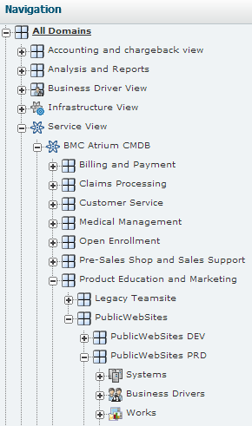
How About a Report, or Two
Making reports is a little difficult to explain, so we invite you to call for a demo or to use the Views tab. More on that next.
On the left menu, All Domains, Service View, BMC Atrium CMDB, Product Education and Marketing, PublicWebSites PRD, Works. This is our most mature App so it is a good bet that good reports can be copied from here.
Copy reports then modify them to suit, is the easiest way to make a report. Copy, don’t move. Thank you.
The good stuff is here!
Notes:
The public web site prod is our most mature application. The reports in Works for this section has many choices and you are free to look at the reports and decide which ones would be helpful to analyzing your application. When you find one or six or ten, COPY don’t move, please and thank you.

Slide 10
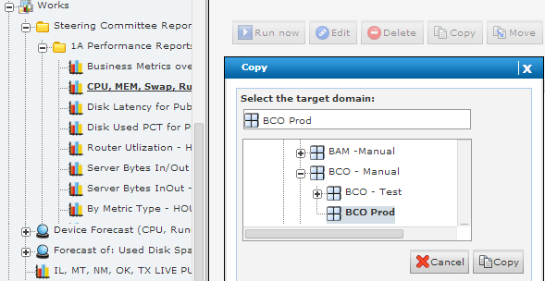
How About a Report, or Two
1- Review the reports, decide which ones would be helpful to analyzing your application.
2- Click the report to copy.
3- Click COPY
4- Navigate to your application. The window is bigger than shown.
5- Be sure to select your application!
6- Click Copy
Notes:
The public web site prod is our most mature application. The reports in Works for this section has many choices and you are free to look at the reports and decide which ones would be helpful to analyzing your application. When you find one or six or ten, COPY don’t move, please and thank you. Copy one at a time.

Slide 11
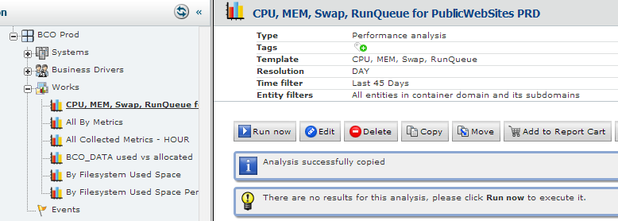
Copied. Now What?
1- Copy moves the report and brings you to the screen like this.
2- Confirm you are in the ‘right place’ (your application Works section)
4 – IF the filters are ok then you can ‘Run now’, and make changes later.
3- Check the Resolution, Time filter, Entity filter
5- IF you want to change anything, use the edit button.
Getting a good result takes practice and we are happy to ‘show you around’ but there is a ‘better way’
Notes:
The copied report should be checked that it covers the proper entities, timeframe and resolution. When these need to be changed click the Edit button. While editing reports takes some practice you will eventually get a set of reports you ‘like’ and that helps with your analysis.
When ready click ‘Run now’. My charts took about 4 seconds to run.

Slide 12
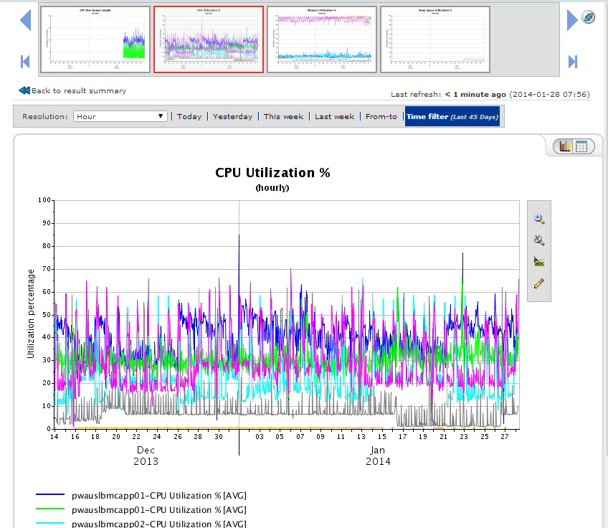
Report Run, Analyze, Action
1- Click a chart and get this screen.
The chart you click shows up in the bottom.
2- You can change the Resolution (I changed to hourly data), and time frame.
3- Create a table, that can be exported to Excel, and back to the chart.
4- Zoom in, and out.
5- Identify a point. Click then hover a data point.
6- change parts of the graph.
7- Analyze the graph, and data. Make an action plan, even if it is wilful inaction.
Take Action!
Notes:
When ready click ‘Run now’. My charts took about 4 seconds to run. I changed the resolution to one hour (Edit | General | Time resolution (9th section down) | Select Hour | Save | Run now )
As you click the little charts on the top, a larger version shows underneath. Analyze the data, change time span, look at the data tables, up trends, down trends, anomalies, outliers, correlations, anyone ‘falling behind’ or ‘out in front’ when they should all be about the same?
Make an action plan on your findings, even if the action is wilful inaction.
Then TAKE ACTION. All of this effort is wasted if you do not actually take an action.
You may think that a lot of effort went into making this chart and you don’t look forward to doing this for all of your applications. There MUST be a better way. And there is, but it is a little less flexible.

Slide 13
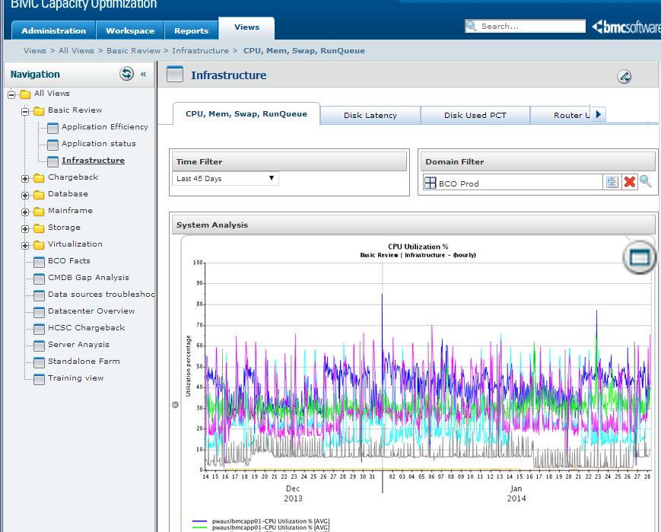
A Better (Different) Way
1- Click Views | Basic Review | Infrastructure
2- Select the report tab, Set time filter, Domain Filter
3- Analyze the graph, and data. Make an action plan, even if it is wilful inaction.
Take Action!
Switch between graphs.
Notes:
This same set of reports is available as a “View” on the View tab.
The first time you visit a view it has no idea what you want so nothing is displayed. It looks broken, even with errors that no data for given filter or something like that. Select a value for the filters and the view updates. Once filter can change what is displayed in another filter and the combination of filters controls the ‘report’ (generally speaking, Views are very flexible to make, but then the choices are limited to the filters.)
We chose the Views tab, then the Basic review folder, Infrastructure report. The CPU, Mem, Swap RunQueue report is adapted from the report we copied before. We liked it so much we made it a view. That is how views are made. A report is worked on for a while until it is ‘just right’ then that is made into a view (a manual process). Once done, the view is available to all domains with appropriate data (for the filters) and then will display.
We then select the time filter (45 days matches our previous report). Search with the lollypop looking icon (supposed to be a magnifying glass) for BCO. Select BCO Prod to match our previous report, the POOF!, well it takes a little longer that the other report but there you have it. A report you can send someone to without the ugliness of the Workspace tab.

Slide 14
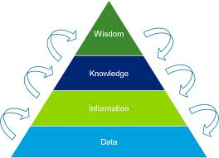
Your Turn
Now it is your turn. BCO is available for you, your manager, your team, and your customers. Take the data that is being collected and leverage that to make faster, fact based decisions.
Turn data into information; information into knowledge; knowledge into intelligence; and intelligence into wisdom . Then take the final step to make knowledge and wisdom into ACTION.
The BCO Team is here to help in anyway we can. Our mission is to get additional value out of the data we already have. It is a Corporate asset that should be used to further the Corporate Mission and Purpose.
More accurate, fact based decisions and actions
Notes:
It is your turn.
The BCO tool has assembled a considerable amount of data into one place such that it can be plotted, charted, correlated, analyzed, manipulated and compared. The BCO Team is here to help, but ultimately it is your system, application, sub application and equipment.
Having the data in one place can seem daunting, but with some effort, having the data in one place will be liberating. Quick, fact based decisions. Action where the results can be recorded and demonstrated on a graph promises to close the feedback loop and allow for relatively quick PDCA (Plan Do Check Act) cycle.
http://en.wikipedia.org/wiki/DIKW
DIKW Pyramid
The DIKW Pyramid, also known variously as the "DIKW Hierarchy", "Wisdom Hierarchy", the "Knowledge Hierarchy", the "Information Hierarchy", and the "Knowledge Pyramid",^{[1]} refers loosely to a class of models^{[2]} for representing purported structural and/or functional relationships between data, information, knowledge, and wisdom. "Typically information is defined in terms of data, knowledge in terms of information, and wisdom in terms of knowledge".^{[1]}
Not all versions of the DIKW model reference all four components (earlier versions not including data, later versions omitting or downplaying wisdom), and some include additional components. In addition to a hierarchy and a pyramid, the DIKW model has also been characterized as a chain,^{[3][4]} as a framework,^{[5]} and as a continuum.^{[6]}

Slide 15
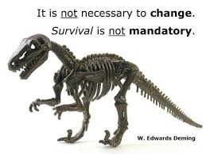
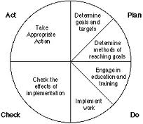
Plan, Do, Check, Act – Or Not
The Deming PDCA
Plan, Do, Check, Act
Cycle
In the Fast, Flexible, Adaptable World,
success / survival
is marked by
efficient, effective, appropriately informed ACTION.

