Slide 1
BMC Capacity Optimization
(BCO)
Use Case BCO004
As an application SME what can BCO tell me about my application in workspace tab?
And a use case of high storage utilization.
Extensive use of the note field is used
Notes:
The notes field is used such that the notes are what a narrator would say while the slide is on the screen.
The screens show screen shots which are sometimes very data dense so the narration can be quite helpful.

Slide 2
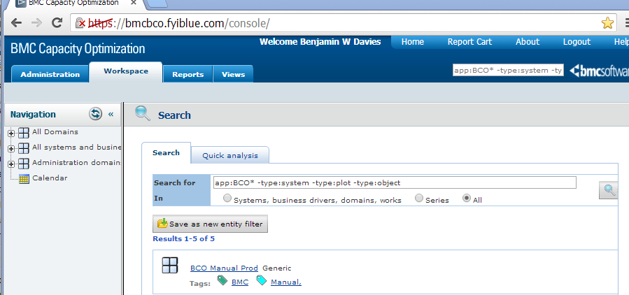
What Application is Being Evaluated
What application is being evaluated? Is it already modeled in BCO?
Do a search..
The example here is to look for an application commonly called BCO. If you do not find it use variations of the name or ‘poke around’ in the All domains tree.
We used the search string of app:BCO* -type:system -type:plot -type:object
This translates to all apps that start BCO with anything after that. Minus all systems. Minus all works or plots. Minus objects. This gave five results. Ours is first.
The “manual” in the name suggests that this version of the application has not yet been modeled by the Configuration Management team, and the Capacity team help us map our application. There are nearly a thousand applications / environments. Configuration Management has completed a couple hundred application / environments (early 2014)
Notes:
Our search string selects an application with the pattern BCO then anything * (zero or more charters) this gave 34 results
Minus thing with a type of system, this gave 16 results.
Minus things with a type of plot which includes charts, this gave 5 results
Minus thing with a type of object, which is a lot of stuff, and while this did not remove any other choices in this example, it tends to be a useful search filter.
There is a large BCO manual and these search options are on Page 1536 in the 2869 page BCO 9.5.00 manual.
These may be helpful.
Type Filter= +type:system +subtype:*network* -type:object
Domain Filter= +(domain:alineo*) -(type:object enttype:*database* type:*analysis type:*report sys:*)
Application Filter= +((appid:2059 enttype:*database*) AND (RMAS enttype:*database*)) -type:object
System Filter= (+(sys:LIVE*OK*pwauslihsapp*) -(sys:retail*) -(sys:memprofil*) -type:object)
+ is to include - is to exclude the () make it more readable and are not always required.

Slide 3
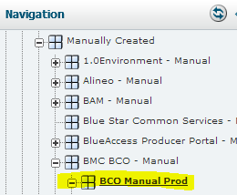
Was the Application Found?
When it is NOT already done, contact the BCO admin team for assistance. We will ask for Configuration Management to model it and send the app model to the CMDB (where BCO gets it).
Capacity team can make a ‘manual’ version of the application for quick analysis, but the configuration of the application is manual and not reliable after a few weeks. So we prefer to wait for the application to be modeled by the Configuration Management Team.
When it IS already done, and the search finds it, you are in business. Click on the application name and you are taken to the application in the All Domains Tree.
Notes:
Applications are put in BCO via them being discovered, mapped, vetted, and placed in the CMDB (Configuration Management Data Base) by the Configuration Management team. These discoveries are refreshed ‘nightly’, updated with adds and deletes, and is therefore the preferred method.
The applications are based on the APM (Application Portfolio Management) official definitions, and we have found much disagreement from SMEs of what should be included or excluded from a particular ‘application name’. What you know as the app, and what the official definition of the app is may not match. The official application definition is the one HCSC wishes to use.
IF the application is not mapped AND can not be mapped in a reasonable time (the definition of reasonable for any application depends on a number of factors), then the Capacity team can map the application. However, when an application is mapped by the configuration team, the manually configured application WILL be deleted.

Slide 4
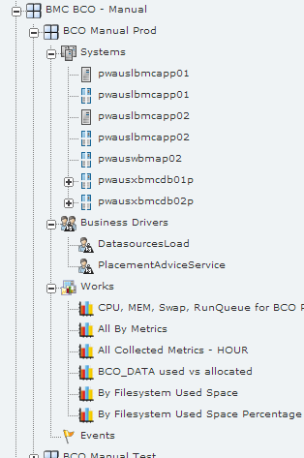
For an Application that was Found
The minimum to make an application is the systems OR the business drivers.
If you have Business drivers, and they are in BCO they can be associated.
Either or both can have Works (or reports) created. These can be copied from other applications and modified to see metrics in particular ways.
In our case we had the capacity team help find our business metrics, and borrow reports from other applications which we modified for our application.
Notes:
An application consists of (generally) the systems that make up the application . This does not generally include some of the shared devices, routers and minor equipment.
An application can consist of only the business metrics (count of work), but we have not had one like this yet (early 2014). Applications can, and should, include business metrics that they directly support, and indirectly support. If these metrics are not in BCO, the Capacity team would like to include them to the extent that they help with capacity modeling. You may find that there is a metric that is a close proxy for a direct measure of work. Such as hits to a ‘thank you for your order’ web page for completed orders. While it is possible to have an empty order this is (maybe) a very close proxy.
Once an application is setup, a number of works (or reports) can be made. The better the data, the better the reports, and all reports should be read “based on the metrics reported, by the devices included in the application definition, we conclude (or observer or whatever)…” It is important to understand the limits of the reports.
These reports need not be ‘made from scratch’ as existing reports in other apps can be copied to your app and customized to suit your data.

Slide 5
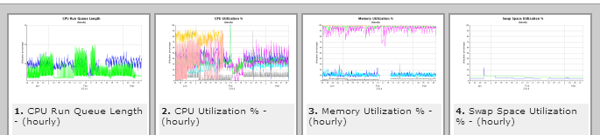
CPU, Mem, Swap, RunQueue
One chart for each metric allows us to show all systems and compare them against each other. By far one of our favorite reports.
Click the chart for a larger version. You can then see a table of the data and export that to Excel if you wish.
When It is helpful, you can make one chart per device, or put everything on one chart.
There is a lot of flexibility on what you put on a chart, but less flexibility on what the chart looks like, style wise. It is helpful to remember this is an analysis tool and is not intended as a chart designing tool.
Notes:
While the basic data can be changed and the basic chart, fine tweaking of charts is very difficult and frankly is not worth the effort. Changing the font size, including some labels but not others or other such customization is just not possible. These reports are intended to be used in analysis and are not intended to be used in a magazine. Keep this in mind when you are tempted to tweak a chart, and when setting the expectations of your data customers.
The CPU, Memory, Swap, and RunQueue series of charts is popular because it is very useful. You get one chart per metric and all devices that have been associated with an application (or chart grouping) AND have reported that metric will show on the report. The amount of history can be selected as can the level of detail (the more time, greater detail and more devices impacts the time it takes to print the reports). Hourly data is a good compromise between detailed and quick.
Charts can take some time and practice to get ‘just right’. Limiting the time to a week and number of devices to a few makes for quick chart definitions. Also, multiple windows such that you can see the last chart in one window, while you edit the definition in another, is quite helpful.

Slide 6
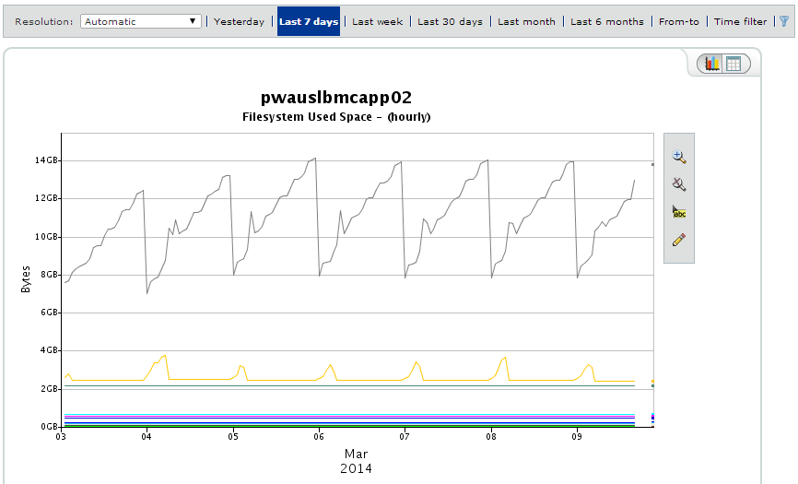
By Filesystem Used Space
This detail shows a devices and all of its mount points over time. “Normal” behavior is fairly easy to determine when you can see this hourly history back for several days. Note that a daily average would miss this daily growth and nightly reset.
You can change the amount of history (hourly data is not available past 45 days ago) and select a start and end date.
There are data ‘tricks’ that are helpful for interactive chart analysis (see the other use cases).
Notes:
This chart looks at hourly readings over the last week of space used. All but two mount points on this device are steady. Note that if these were daily averages you would miss this fluctuation. Also, you would not gain much if the sample size was smaller than an hour.
BCO charts, in a non error evaluation, shows trends and informs your definition of ‘normal’.
Reviewing the charts for what is missing is an interesting technique to extracting actionable intelligence. For example, in this chart ONLY two of the mount points have ANY fluctuation over the week shown. This may be quite unexpected on a development server with a lot of developers. It may also suggest that particular expected use patterns may or may not exist.
In this example the rate of growth for this mount point does not suggest that it is user based, week day based, or subject to external forces. It implies that a log file (or something like it) writes at a consistent rate throughout the day, and is ‘cleaned up’ once a day. Over all, there is a slight growth in the top mount point, as there are higher highs, and higher lows. This trend can be confirmed by increasing the history and may show up in a daily average chart over an extended period.

Slide 7

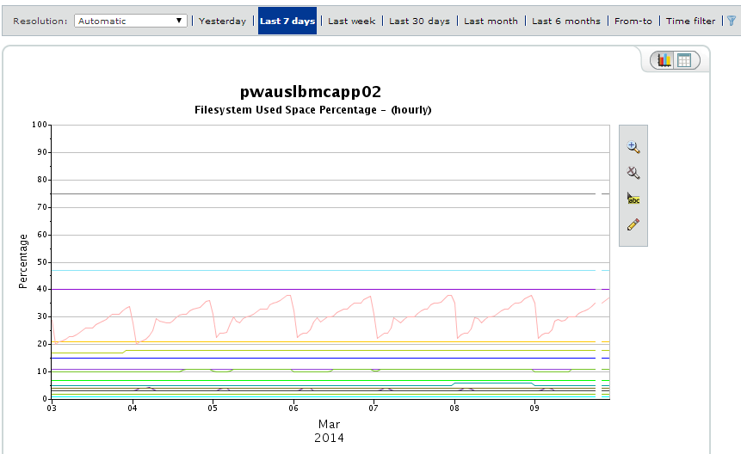
By File system Used Percent
This is the same data as the previous chart but expressed as a percentage. You see the same growth and reset but now see that it approaches 40% of available space, which adds context to the previous page.
Additional context is the mount point at 75% (/home) top line. On the previous chart you see that it is the third line down, less than 1GB.
This also places the
/Opt/BMC/BCO/REPOSITORY
mount point between 2 and 4% or between 2 to 4 GB
In this case these two charts work together to provide a ‘complete picture’ of storage on this device, and for the other devices in this application.
Notes:
This chart looks at hourly readings over the last week of space used as shown as a percent. All but two mount points on this device are steady as you would expect based on the previous chart, however, now there is some context that the volatile mount point moves from between 20% to 40%. This implies that the clean up routing can be ‘skipped’ 3 times before the disk is out of space (assumes that nothing else changes, and the pattern continues even if the clean up routine is skipped).
This also suggest that one of the mount points is ‘high utilization’ at 75% but does not fluctuate. While several others that are ‘low utilization’ but do not fluctuate either. This COULD BE an opportunity to ‘right size’ the mount points such that the utilization is increased. For the record this was explored and discounted for a number of reasons, including cost to do the change vs savings and that if varies from the ‘standard’ configuration, and that recovering the space is not achievable based on how the physical infrastructure in implemented. Be careful how you interpret the data and what conclusions you can make based just on the charts.

Slide 8
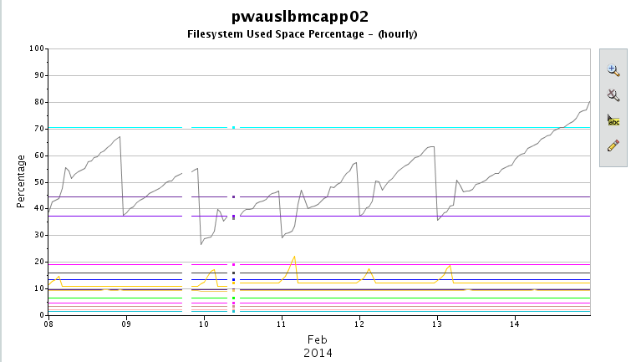
High Storage Space Utilization Warning
We got a high utilization percent warning on Feb 14th. The chart shows that the ‘clean up’ routine did not run.
The chart implies that, at the normal rate of growth, we would not ‘survive’ until the next clean up routine.
When we saw this chart, early the 15th, it was clear that waiting was not an option. And based on the slope of the line we had a few hours to resolve the issue. This is early on a Saturday, our options were limited, but we did not need to guess what the basic problem was (failed cleanup routine).
Notes:
Our warning message was received early the 15th, a Saturday. The BCO chart, even though did not have exactly current data proved helpful. Even if we got the message on the 14th, BCO shows what normal IS, and allows us to interpret the warning message against that normal. Either way, we quickly arrive at what the issue IS AND what the issue IS NOT. What is impacted and what IS NOT impacted. This intelligence helps to zero in on the issue and its by products, without being distracted by guessing what is or is not involved.
In this case we had one person in the team pursue why the clean up routine did not run, One person worked on finding something that could be deleted by ‘hand’ and the third person worked on arranging to more space specifically on this mount point as we realized we did not have enough space to recover from the clean up task running and ‘survive’ until the next clean up routine. This just was not enough space for this volatile of a mount point. We ‘only’ had three people to pursue things during the incident and KNEW where to direct our efforts, and we knew this very quickly based on the BCO chart and warning message.

Slide 9
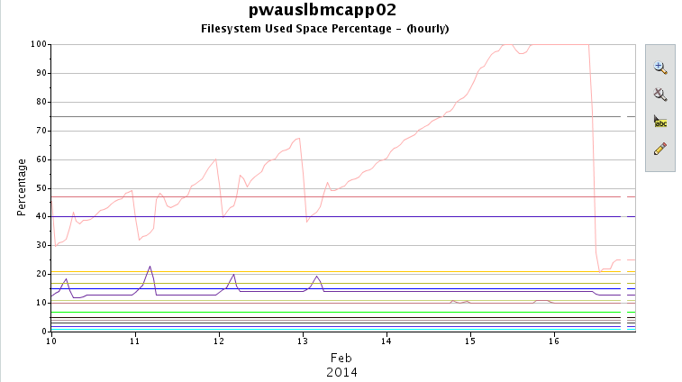
Struggle to Delete ‘Old Files’
We know that the mount point is /opt/BMC/BCO, but we are unclear as to our options. As this is a fairly new system, and we rely heavily on our consultant, it takes some time to clear some space. This gave us a ‘better play book’ and provided justification to add space to this mount point.
The point here is, that using BCO, the problem is quickly evaluated and efforts launched. These were fact based decisions, informed by history and confirmed with pin point investigation on the device(s).
Notes:
In this case we did not have a very good play book as the application is new to the group. A better play book would have allowed us to more quickly respond and we would not have reached 100% utilization.

Slide 10
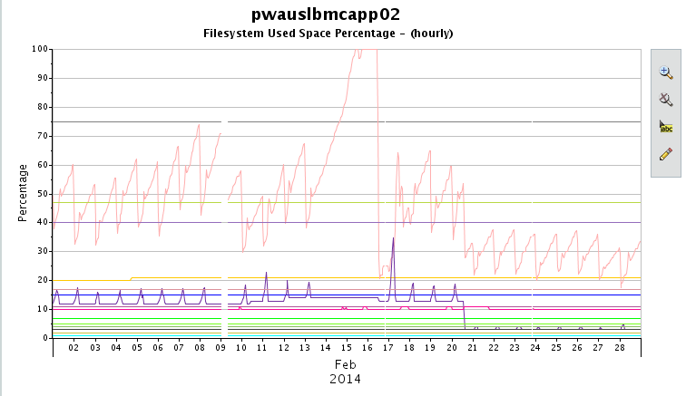
Recovery and the New Normal
This chart shows the incident, recovery from the incident, where new storage was added, and the new normal.
Notes:
This is a percent chart, so adding more space decreased the utilization. We take the same space (numerator), but have a larger space to work with (denominator), dividing that drives utilization percentage down. The opposite is also true. When space is taken away, you use the same space, but compare that to a smaller allotment, dividing that drives utilization percentage up.

Slide 11
Conclusion
With an error, alert, or other ‘mission’, BCO can inform what is normal for the metric or device in question. BCO does not have todays monitoring data, it is one day behind, but the trend can inform how to interpret a metric.
At worst it can only show what IS NOT a problem.
At best is can show, specifically, what IS a problem.
In our use case, BCO showed what the problem was not. It was not abnormal use, did not impact other devices, and did not impact other metrics.
In our use case, BCO showed specifically what the problem was. It was a clean up routing failed, what the impact(s) was, (high disk utilization on a specific mount point), we knew that this would result in the application would be ‘down’ from a user perspective, and an indication of how long we had to resolve the problem.
We were able to take action, KNOWING that we were solving for the right and proper problem. (Even if our play book did provide and quick solution.) and KNEW how long we had to failure. Our recovery was in place for business Monday morning.

