Slide 1
BMC Capacity Optimization
(BCO)
Use Case BCO006
As an SME group, how can we conduct investigations when we do not always know what devices or reports would be helpful?
Extensive use of the note field is used
Notes:
The notes field is used such that the notes are what a narrator would say while the slide is on the screen.
The screens show screen shots which are sometimes very data dense so the narration can be quite helpful.

Slide 2
Problem Statement and Solution
Problem Statement - Environments like the Command Center, Problem Management, Change Management, Infrastructure Design and a host of other SME groups, frequently need to investigate business metrics or system metrics that are not necessary groupable as an application. How can BCO help in this case?
Solution – BCO has a search function and allows for pre configured charts to be driven by searches. Creating a group of charts allows for common and not so common data to be gathered and plotted.
In this example we will use the Command Center as the SME group, and follow as they setup common charts, less common charts, create searches and apply the searches in the charts. (We will avoid reviewing analysis techniques, just create the charts.)
While device monitoring metrics are understood to be in BCO, business metrics are also available for analysis, correlation and comparison.
Notes:
In the problem statement we see that there are times when a group may wish to have the ability to investigate one or more business metrics or systems metrics and gather data available in BCO such that it can be analyzed, however, there is not necessarily a clear idea of what data will be relevant starting out or which charts will be useful.
The solution to this is to setup generally helpful charts and drive those charts with search results, which may me a list of business drivers or list of devices like servers.
This allows for easy assembly of data and commonly used charts, and some not so commonly used charts.
While the Command Center is the SME group in this use case, feel free to set up groupings of charts based on business metrics, device OS, or resource based (network charts, storage charts etc), or any other groupings you find helpful.

Slide 3
Decide on a Direction
The Command Center consulted with the Capacity Forecasting Services Team, who administer the BCO tool. There was a conversation about how the reports would be used, by whom, how often, what happens to the actionable intelligence of an investigation, etc.
The Command Center managers decided to mimic the concepts used by the Capacity Forecasting Services Team.
This decision is made easier as it can be modified along the way and as the SME groups begin to use it. Adjustments are relatively straight forward.
Now that a direction is decided, setup the reporting area. (This may require a higher level of permissions in the BCO tool. )
Notes:
The early conversations are somewhat awkward in that the SME group is unsure how the charts will be helpful, how the system will actually be used by the SME group and do not want to make decisions that are difficult (expensive) to change later. In this case, the Command Center and the Capacity Forecasting Services Team have similar data needs, they just take different action based on the data. Also, the ability to easily change direction, made picking any direction an easy first step.
As the SME group becomes more comfortable and proficient at the BCO tool and using the data available, the charts needed may change. New charts are relatively easy to create, and old charts are easily updated or removed. This flexibility suggests that choosing any direction and adjusting as you go, is a good first step.
There may need to be granted a higher level of permissions in the BCO tool to get access to the ability to copy, update, edit or otherwise work with the charts. This can be granted by the Capacity Forecasting Service Team.

Slide 4
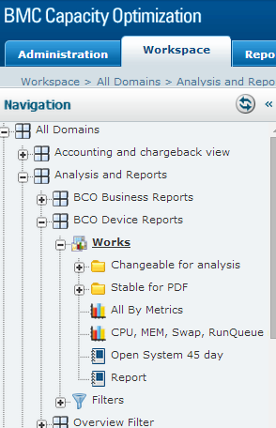
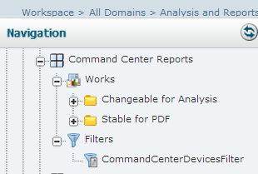
Setup the Reporting Area
Using this as the baseline replicate the structure.
Group Name
Report ‘bucket’
Volatile Reports – encouraged to change
Stable Reports – Should be left alone
Filter – Drives the reports
Notes:
This is best to be setup with the help of the Capacity Forecasting Services Team. Instructions are covered in other use cases and is available using the BCO 9.5 documentation.
http://community.fyiblue.com/sites/PMPIipsICP/Shared%20Documents/BMC%20Capacity%20Optimization%209.5.00.pdf
Once setup this will not need to be done again for normal daily work.
Some thought should be given to how the reports will be used and by whom. Mostly, what is the likelihood that multiple people will be in the reporting area at the same time. If there is a high likelihood that the filters will need to be changeable by multiple people at around the same time, this layout will need to be changed. Thought as to if business metrics are to be charted or device monitoring metrics or a correlation between them will be needed. Also if the charts will be used in reports, or if a specific set of charts are needed for a specific customer then this will likely need to be accounted for.
The good news is that these can be incorporated after the fact, but should be considered up front.

Slide 5
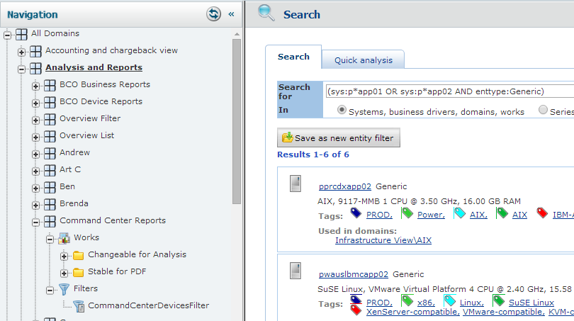
Decide on a search string
Make a search string that will drive the report.
This example search string is only to be sure the devices you wish to include are included.
The search could be as simple as (sys:app01 OR sys:app02 OR sys:app03) or can be as complicated as you wish to make it.
Once you have found a search that is appropriate this gets copied to your filter.
We used the search string of (sys:p*app01 OR sys:p*app02 AND enttype:Generic)
This translates to all apps that start with ‘p’ (intended for production servers) that end with ‘app01’ or ‘app02’ AND are entity type of ‘generic’. This gave six results.
Notes:
Work on a search string that will drive the repots.
The example is (sys:p*app01 OR sys:p*app02 AND enttype:Generic) which gives six results. Many times all you have is a list of devices that are of interest. In that case a simple list is appropriate, such as (sys:pwauslihsapp11 OR sys:pwauslwasapp65 OR sys:pwauslwasapp66 OR sys:pwauslwasapp75) – this was the list in the filter at the time of this writing.
It may help you to know that this is part of an SQL statement.. SELECT the metrics needed for the chart WHERE the device name is LIKE (your search string). This is why the connector word is OR and not AND. Also, the connector key word must be upper case. See the manual for more information on search options and formats.
A text editor will help format from the way you get your target list to a useable search string. Search and replace can be helpful. Search the end of the line code and replace with a space plus OR sys: can get you a list of devices quickly.
There is a large BCO manual and these search options are on Page 1536 in the 2869 page BCO 9.5.00 manual.
These may be helpful.
Type Filter= +type:system +subtype:*network* -type:object
Domain Filter= +(domain:alineo*) -(type:object enttype:*database* type:*analysis type:*report sys:*)
Application Filter= +((appid:2059 enttype:*database*) AND (RMAS enttype:*database*)) -type:object
System Filter= (+(sys:LIVE*OK*pwauslihsapp*) -(sys:retail*) -(sys:memprofil*) -type:object)
+ is to include - is to exclude the () make it more readable and are not always required.

Slide 6
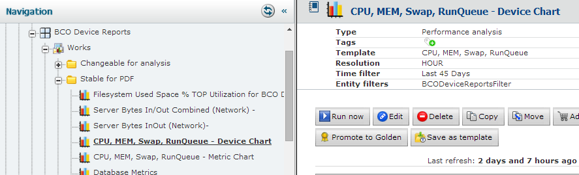
Make a Set of Reports
Making a set of reports can be as easy as clicking Copy on an existing report, and saving it to the new location, then pointing the source to the appropriate filter. Do this for any reports you wish to ‘borrow’.
The copy can sometimes ‘break’ the copied report if the new filter does not yield data expected by the report. There are techniques to resolve this, but are outside the scope of this document. The Capacity Forecasting Services Team can assist in correcting copied charts.
Notes:
Make a set of reports by copying reports you have found helpful that others groups have made, create reports you find helpful, or that your customers have requested. The key is that these charts are based on the devices found by the filter and when the chart is well designed getting actionable intelligence out of becomes easier.
Coping the charts can sometimes break the copied report. When this happens you will need to either ‘reinvent’ the report or use other techniques to copy from the original. This can be complicated but the Capacity Forecasting Services Team will help.
It is worth spending some time to make the reports ‘exactly’ as you wish them as they will be reused. For example the chart that shows CPU, Memory, RunQueue and Swap space took more than a week to get it to ‘look right’ but once it was ‘right’ updating it to show new devies only takes a few minutes. You will see the CPU, MEM, Swap, RunQueue report in a few forms in nearly every report grouping. The effort spent making the report useful is worth it, when you see how frequently the report is used, and with very little effort.

Slide 7
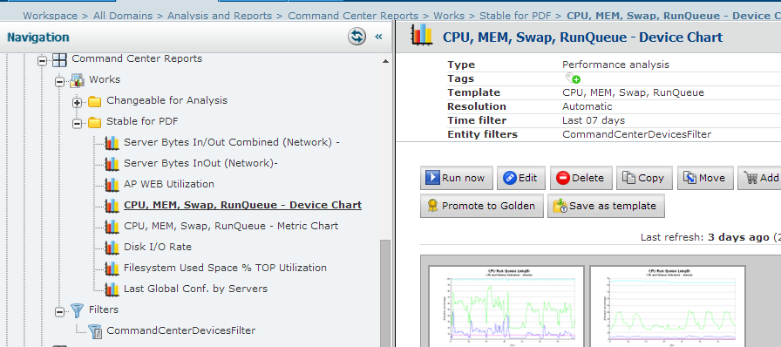
Update the Filter and Run Charts
Update the Filter. Select a chart. Run the chart. Edit as necessary to get the chart ‘perfect’.
Notes:
With the filter updated, (you should be sure the filter gives data that the chart would plot), select the chart and run it. Evaluate the result with a critical eye, and edit as necessary. You may find that two slightly different versions of a chart is necessary such as the CPU, MEM, Swap and RunQueue charts. One version shows all devices on their own chart. Each metric from that device is on the chart. The other version shows all of the devices for CPU on chart, all of the devices for MEM on one chart etc. The idea is you can see how the group compares to each other and how each device reports on its own.
Generically this is a good chart, as are most of the charts in the Stable for PCF section. The intent is these are relevant charts when the data they are plotting exists. Other charts are for specific cases and are in the changeable for analysis grouping. You can make appropriate buckets depending on what you find interesting and helpful.
Additionally, when an application is being reviewed you can create repots specific to that application in the application area of BCO. Even copy your favorite report to the application area (and change the filter) so others can benefit from the time you spent making useful charts.
Most of the charts shown are line charts, however other types of charts are available. Tables, bar, scatter, stacked and others. Feel free to experiment and know that a well designed chart can be easily used, so it is generally worth spending some time on making useful reports.

Slide 8
Practice, Deliver Value, Share
With the filter and charts setup, practice, practice, practice.
Use the charts to deliver value. Not only report your investigation findings, show your work. What charts did you find helpful in analysis? Show them. They will help your audience.
What reports do you find most useful? Share them with others. It is easy to copy and modify, so while I may not find your chart perfect for my needs, I can copy your chart and technique, and come up with better analysis by borrowing your charts, tools, and techniques.
What data do you find most useful? Share your data with other groups, and use data from other groups (be sure you are interpreting it appropriately) to enhance your understanding and analysis.

Slide 9
Conclusion
Copying your favorite charts into your groups work area in BCO is relively easy.
Charts can be driven with search results.
Conducting a ‘routine investigation’ can be facilitated with combining well made charts with the search results. Once something interesting is discovered, other charts that may not be so refined, can aid in analyzing.
Narrow focus of filters and user specific charts may be useful in creating reports to your customers and management.
Sharing your charts, tools and techniques makes everyone else ‘better’ at BCO, analysis and extracting value from the data that is in BCO.
The data in BCO is a Corporate asset and should be used to the fullest extent that is practical. Focusing on just your data misses correlations and associations that can be quiet helpful, and create a competitive advantage to you, your group and HCSC.

