Slide 1

Making Data as Accessible as Chocolate at a Birthday Party to Liberate Business Users
September 9, 2016
Mr. Ben Davies
Senior IT Business Consultant
Twitter @MrBenHoney
We make considerable use of the notes section. Download this presentation
Notes:
Welcome, we will start in a minute … at exactly 10:15
Welcome to the “Making Data as Accessible as Chocolate at a Birthday Party to Liberate Business Users”
This is a conversation, we hope you participate in, to discuss how an “open-door” policy, that provides access to data from BMC TrueSight Capacity Optimization, can help drive agendas that have nothing to do with capacity. We realized huge payback by making data as available as chocolate at a birthday party. That is, removing IT as an impediment, made non-IT groups self-sufficient, by enabling them to create their own reports based on “their” data.
If you were expecting something else, you are in the wrong room, but we are glad to have you.
====
https://bmc.g2planet.com/bmcengage2016/public_session_view.php?agenda_session_id=87
Making Data as Accessible as Chocolate at a Birthday Party to Liberate Business Users
Session ID:
704
Date / Time:
Friday, September 9, 10:15 am - 11:00 am
Room:
Ironwood 7
Description:
Learn how an “open-door” policy that provides access to data from BMC TrueSight Capacity Optimization can help drive agendas that have nothing to do with capacity. We realized huge payback by making data as available as chocolate at a birthday party. That is, removing IT as an impediment made non-IT groups self-sufficient, enabling them to create their own reports based on “their” data.
In this session, we’ll discuss the challenges and issues we ran into, how we solved for them, and basic familiarization training we provided to solve the immediate need, as well as the just-in-time training situations we’ve encountered. You’ll discover new ways to benefit from BMC TrueSight Capacity Optimization that have nothing whatsoever to do with capacity planning—ways to liberate data and business users who were simply too difficult to deliver to before BMC.
Level:
Intermediate
Presentation Type:
Business
Product(s):
BMC TrueSight Capacity Optimization
Type:
Customer/Industry Breakout
Track:
Digital Transformation Best Practices, Performance, Capacity, and Analytics
Speaker(s):
Vito Bitondo, Lead IT Business Consultant, HCSC
Ben Davies, Senior IT Business Consultant, HCSC
Status:
Available

Slide 2
Agenda
1
Introduction
2
What We Did, and Why This Matters
3
Problems, Challenges and Issues – Oh My!
Call to Action / Questions!
Card with “Chocolate” on the back
© Copyright 2016 BMC Software, Inc.
Notes:
Agenda for this session is to do a quick introduction.
Explain what we did, and why this matters.
Then discuss the problems, challenges and issues we saw and what we did about them.
We end with a call to action and questions. However, feel free to ask questions as they come up.
There will be some examples and our presentation makes extensive use of the notes field in PowerPoint. So be sure to give us your card with “Chocolate” on the back and we will send this presentation and materials to you.

Slide 3


Founded in 1936
More than 14.5 million members strong
Largest customer-owned health insurer in the United States, fourth largest overall
Provides health coverage through Blue Cross and Blue Shield ® Plans in Illinois, Montana, New Mexico, Oklahoma and Texas
Provides dental, life and disability insurance through Dearborn National
21,000+ employees, 60 local offices
State-of-the-art technology, including two Tier IV data centers —industry's highest reliability level
National footprint; multiple subsidiaries and lines of business
By Alanscottwalker - Own work, CC BY-SA 3.0, https://commons.wikimedia.org/w/index.php?curid=11648264
Notes:
I work at, Health Care Service Corporation, a Mutual Legal Reserve Company, an Independent Licensee of the Blue Cross and Blue Shield Association.
Founded in 1936. With 14.5 million members, 55 billion gross revenue, five Blue Cross and Blue Shield ® state plans (Illinois, Texas, Oklahoma, New Mexico, Montana), multiple subsidiaries and lines of business, 22,000 employees, 60 local offices, and two tier IV (4) data centers, we are big by any definition.
TIME Magazine states we are number 5 in their top 20 privately held companies. (June 2015)
http://time.com/3854318/largest-private-companies-america/
Download this presentation. There are links in the notes section the talks about how architecturally interesting this building is.
===
Data accurate to early 2015.
http://www.hcsc.com/
http://www.hcsc.com/hcsc_hq.html
http://en.wikipedia.org/wiki/Blue_Cross_Blue_Shield_Tower
Received Trustee award for the HCSC Blue Cross Blue Shield of Illinois (BCBSIL) headquarters vertical completion project from the Chicago Architecture Foundation in 2006
http://www.glasssteelandstone.com/PrinterFriendlyBuildingDetail.php?BuildingName=Blue%20Cross-Blue%20Shield%20Of%20Illinois%20Tower&LocationCity=Chicago&LocationState=Illinois&LocationNation=United%20States

Slide 4
Our purpose:
“To do everything in our power to Stand with
our Members in sickness and health.”
Our vision:
Drive competitive advantage via efficiencies and cost-effectiveness through IT optimization, simplification, and agile infrastructure & applications
Notes:
Our corporate purpose is “to do everything in our power to stand with our members in sickness and health” and the IT vision is to “drive competitive advantage via efficiencies and cost-effectiveness through IT optimization, simplification, and agile infrastructure and applications.”
We are using BMC TrueSight Capacity Optimization and other BMC tools to directly support our Corporate Purpose and Vision.
This is a shameless plug, but, HCSC is a good company, that tries to be a good company.
However, good software and good intentions are not enough. Effort must be exerted to apply the good software to achieve a goal. This effort is substantial, but effort is required. There is actionable intelligence to be gained, if you apply these tools and techniques presented in this session, and actually put them to use.
==

Slide 5

What We Did, and Why This Matters
We chose to treat metric data is a corporate asset.
We chose to invite ‘everyone’ to the party, and gave read access like chocolate at a birthday party.
What we got is about a dozen other efforts using the metric data for other than capacity purposes. This is FREE VALUE
Metrics are a corporate asset that should be leveraged for any legitimate purpose
Notes:
We chose to treat metric data as a Corporate asset. And we chose to invite ‘everyone’ to the party. We give read access like chocolate at a birthday party.
In my opinion, BCO provides a strategic advantage when existing metrics can be leveraged for other legitimate purposes.
Liberating the data, liberates other users to gain actionable intelligence with data the Corporation has already. BCO makes it relatively easily available and accessible. Data can be placed in different contexts, and analyzed through other than a capacity lens. This value is FREE VALUE
Metrics are a Corporate asset, that should be leveraged to any legitimate purpose.

Slide 6

Problems, Challenges and Issues – Oh My!
Last year we discussed ‘No Fault Found’…
There is actionable intelligence here.
Notes:
Problems, Challenges and Issues – Oh My!. Last year, we discussed how our command center and other users used BMC TrueSight Capacity Optimization to gain actionable intelligence.
In those examples, users used the capacity data in non capacity roles and helped provide historical context in ‘service down’ type calls, proactively identified potential service outages.
Your Problems, Challenges and Issues LOOK LIKE THIS! They WANT to be found. They WANT attention.
Let SMEs, app owners, project managers, and anyone else seeking actionable intelligence, into BMC TrueSight Capacity Optimization, and LET THEM find their problems Challenges and Issues.
Let me be clear here… The problems, challenges, and issues look just like this. They want to be found. Let your customers find their own issues in their own data, without IT interference.
How did we do this??...

Slide 7
Treat Metric Data as a Corporate Asset
Treat data as a Corporate asset, and make others do the same.
Don’t let data ‘owners’ keep you from their data. Slay FUD Dragons!
Centralize data, give context, allow access.
You will get resistance, mostly from managers who see access to data as their source of individual power. They are the enemy.
Notes:
We started by seeing metric data as a CORPORATE ASSET.
Treat data as a Corporate asset, and make others do the same. When you get this data, enable and encourage access. Give access like giving chocolate at a birthday party.
Data ‘owners’ will try to keep you from ‘THEIR’ data. They will say that you don’t understand it, and that any attempt to publish ‘their’ data will be met with charges of back stabbing, sabotage, and FUD. Fear Uncertainty and Doubt. Don’t let FUD Dragons get the best of you. Slay the FUD Dragons.
Centralize data, give context, allow access.
You will get resistance from managers who see access to data as their source of individual power. They are the enemy. While they are “SOOO last century”, they will protect their perceived source of power at all costs, so be careful.

Slide 8
What Data Do You NEED?
Once you get access, you will decide what you ‘need’. Be careful not to take ‘everything’
.
For Device Capacity – CPU, memory, swap, run queue etc.
For Other Capacity – IO rate, read rate, write rate, etc.
For Equipment – Owner, contact, configuration, etc.
For Services – Owner, management, description, etc.
For Workloads – Owner, management, counts, rates, etc.
Configuration includes ASSOCIATIONS!
These data points are key to deriving other actionable intelligence as it provides context and links needed to gaining actionable intelligence.
Notes:
Once you get access, you will decide what you ‘need’. It will be different than you expect. Be careful not to take ‘everything’
For Device Capacity – CPU, memory, swap, run queue etc.
For Other Capacity – IO rate, read rate, write rate, etc.
For Equipment – Owner, contact, configuration, management, software installed, etc.
For Services – Owner, contact, configuration, management, description, etc.
For Workloads – Owner, contact, configuration, management, counts, rates, etc.
Configuration includes ASSOCIATIONS! We get most of our association table data from the BMC Atrium discovery tool and models. BCO (in our case) depends on this data.
These data points are key to deriving other actionable intelligence as it provides context and links needed to gaining actionable intelligence.
What we missed early, and ended up back filling was the owner, contact and management data. It is obvious when you get the data as you are actively having the conversations. However, later when the ETL breaks, or data is questioned, we needed to re find this information. When our customers wanted to understand where the data came from and who to go ask when actionable intelligence was found, we did not have this data. Shame on us. We ended up ‘back filling’ this data.

Slide 9
Open Door Policy
Once you open the door. You need to provide some training or guidance.
We do this with a welcome note.
Short, focused training. Samples available.
Just in time training.
Being inundated with requests, you wish. That would be a good problem to have. You will be surprised who your best customers are.
Notes:
Once you open the door, you will need to provide some training or guidance or other help as needed.
We did this with a welcome note. We tried to extend an invitation to whole pages of the org chart at a time, and sent them a welcome note that shows the link to BCO and links to self directed training.
We also offer just in time training.
Don’t be afraid of being inundated with requests. That is a good problem to have. We thought the hardware teams would be early and eager adopters. That is STILL not true some years later. They are convinced that they do not need BCO data as they have the ‘real data’ and ‘real tools’. Our report showing hundreds of mount points at greater than 98% full (and less than 5% used) suggests they have an unjustifiably high opinion of their efforts.
We found that the application owners and special project managers were are best customers.
I can find very little reason NOT to open the door.
One is cost. IF BMC changes the licensing model to count logins, that would be problematic.
Being in a heavily regulated industry or environment where managing complex permissions may be enough to revoke the invitation.
Dinosaur management where silo separation is considered a good thing. No one wants to work there anyway.

Slide 10
Cost of Training and Training Aids
This will cost you:
A little time to make basic training aids
Some one-on-one training time
Some management time – IF you are successful
Leave your card with “Chocolate” on the back and we will send you our training materials.
Notes:
The cost of training and training aids is not that much ..
We spent a little time to make basic training aids. Ours is based on 9.5 and we have not updated it for 10.3. No need as the basic concepts are the same.
We did some one on one training, a kind of ‘train the trainer’ deal. This was something that liberated them to train their group. A good investment of time especially if the group becomes an active user group.
There is some management time but we find this to be only a few hours a month. ‘fixing reports’ helping with new requests and some just in time training. But this only happens IF you are successful. You should wish that this is a semi regular use of your time.

Slide 11
Benefits of Open Door
The corporation gains:
Additional value from existing data
Additional actionable intelligence
Transparency
All of these gains can add substantially to the bottom line. Cost avoidance is competitive advantage.
Notes:
The benefits of an open door policy is that the corporation gains additional value from existing data. You paid a lot of money and resource into gathering that data, why would wish for others NOT to gain value from it??
The Corporation gains actionable intelligence. We find that it is possible to get this without BCO but so difficult that no one actually does. Once BCO makes the data easily accessible then it becomes worth the time to find the actionable intelligence.
The Corporation gains from the transparency. Data clean up when no one is looking is hidden technical debt. With others able to see the data the data is now worth keeping up. Better data, leads to better understandings, leads to better decisions.
All of this has potential to add substantially to the bottom line. Cost avoidance is competitive advantage.

Slide 12
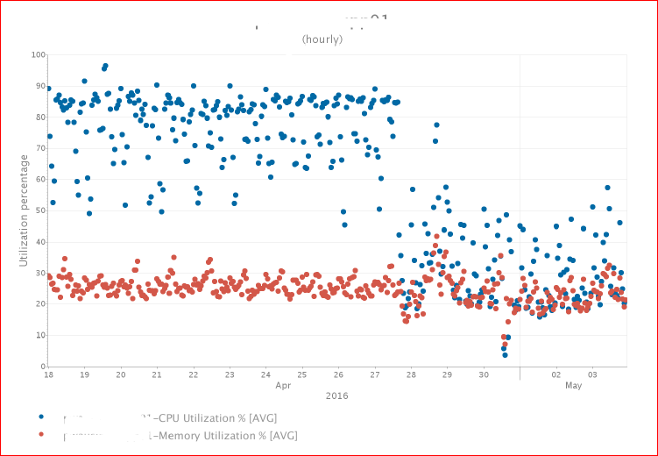
Proof
A group looked at their database service and completed a ‘code change’.
On their own, they were able to test the change, and see the production results.
By not involving IT and not needing hardware, bottom line cost avoidance of $10,000
Notes:
This system was monitored by the application owner. They saw that CPU was very high (left of the chart).
In this case the app owner determined that the device was ‘choking’ on corrupted data, processing it over and over. Once the data was removed (by removing the ‘temporary working database’) the data was cleared and the device was allowed to NOT spend cycles on needless work.
Change happened at 16:00 on the 27th. The device did not reboot only services stopped, fix made, and services started. The whole process took 15 minutes to do, but many weeks for the solution to be devised.
The ‘before’ chart and other indications clearly showed the ‘problem’ of a constrained resource. This is visual demonstration that some action needs to be taken. In this case it was a code ‘fix’, but it could have been a hardware change, software change, configuration change or some other action.
Bottom line result. Cost avoidance of system upgrade, avoided initiating investigation by IT (would have triggered a project that would need funding for IT time)
Total impact – App team analysis (would have been needed anyway).
Savings $8,000 hardware, (the default answer)
30 man hours @ ≈$65 = $1,950.00
= about $10,000 NOT SPENT.
Case 00091523

Slide 13

Summary Review
Get data into TSCO, and use it
Treat metric data as a corporate asset
Allow access for all legitimate purposes – like chocolate at a birthday party
Facilitate making actionable intelligence
Notes:
So our Summary Review
First, and starting right now, treat metric data as a corporate asset
Put forth the effort to get data in TSCO, then put forth the effort to extract actionable intelligence from that data.
Allow access to TSCO for all legitimate purposes. Give access “Like chocolate at a birthday party”.
Facilitate sharing tools and techniques, to make actionable intelligence. Share among your team and with others. By allowing other entities to leverage this already existing data, and combining it with knowledge they have, NEW insights and actionable intelligence are gained with limited additional expense.
We have had significant positive experience with ‘minimum idle workers’, High CPU, High storage utilization, and general analysis. And these experiences are NON CAPACITY related. Application owners, equipment owners, problem management, asset management, financial management, troubleshooting, etc. etc. ALL of this value is essentially FREE.

Slide 14

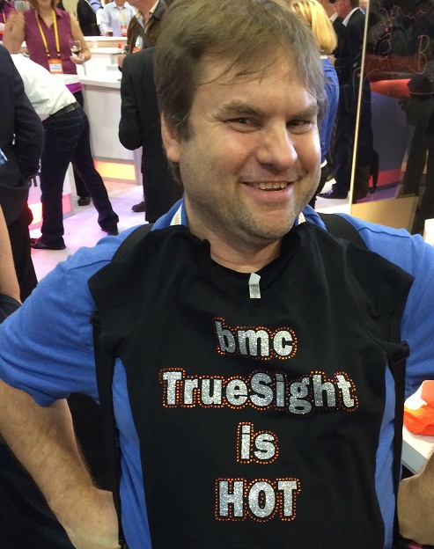



Submit your card with: “Chocolate” on the back and we will send you a link to the presentation and materials.
Thank You.
Ben Davies
Sr. IT Business Consultant
918.814.6588
ben_davies@hcsc.net
www.hcsc.com
Twitter @MrBenHoney
Submit a review at the registration desk. Say that Mr. Ben is awesome!
Mostly because we are, but also because we asked nicely. Please.
I have three sessions – so I am in competition with other versions of myself
Notes:
Thank you for your time and attention.
Feel free to talk to us, at the conference, or by phone or email.
Please submit a review at the registration desk. Say that Mr. Ben is awesome! Mostly because we are, but also because we asked nicely. Please.
I have three sessions this year – so I am in competition with the other versions of myself.
Submit your card with: “Chocolate” on the back and we will send you a link to the presentation.
https://twitter.com/MrBenHoney
@MrBenHoney

Slide 15

Call to Action and Questions
What YOU should do, starting now:
Treat metric data as a corporate asset.
Get data into TSCO, and use it.
Allow access for all legitimate purposes.
Facilitate making actionable intelligence.
THIS IS FREE VALUE
Notes:
So our call to action is:
First, and starting right now, treat metric data as a corporate asset
Put forth the effort to get data in TSCO, then put forth the effort to extract actionable intelligence from that data.
Allow access to TSCO for all legitimate purposes. Give access like chocolate at a birthday party.
Facilitate sharing tools, and techniques to make actionable intelligence. Share among your team and with others. By allowing other entities to leverage this already existing data, and combining it with knowledge they have, NEW insights and actionable intelligence are gained with limited additional expense.
Take competitive advantage by gaining this FREE VALUE

Slide 16

© Copyright 2016 BMC Software, Inc.

Slide 17
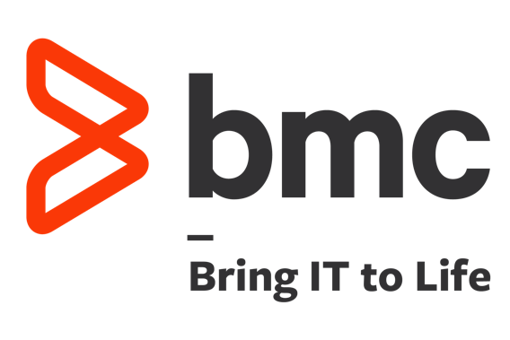
© Copyright 2016 BMC Software, Inc.

Slide 18
Bonus
Material
And other example users

Slide 19
Sir or Madam,
A request has been submitted on your behalf to provide you 'Viewer' access to the BCO (BMC Capacity Optimization) tool.
Viewer permissions allow you to view the Views tab, an interactive, dynamic reporting option, view the canned reports on the Reports tab, and view the device, business metrics, reports and charts on the Workspace tab (but not update). This level of access is more than adequate to consume the data available in BCO.
You may find these helpful in using BCO, but know the entire Capacity Planning Team is available to help in whatever way we can.
BCO Overview
http://BCO-Overview20131028a.pptx
We got an alert from the Monitoring Team!
OR Other Reason to Use BCO…
http://BCOUseCase001.pptx
Setup My Application and Make Reports.
How can BCO help?
http://BCOUseCase002.pptx
As an application SME what can BCO tell me about my application in workspace tab?
And a use case of high storage utilization.
http://BCOUseCase004.pptx
As an SME group, how can we conduct investigations when we do not always know what devices or reports would be helpful?
http://BCOUseCase006.pptx
Link to BCO user documentation... very large.
http://BMC_TrueSight_Capacity_Optimization_10.0.0.pdf
Thank you for your time from the Capacity Planning Team.
Notes:
This is our welcome letter. It gives links to training and a quick introduction.
Keep the note short as they don’t generally respond to this note. We get better reaction when they ask for help with BCO, then we resend the note. That they find helpful.

Slide 20
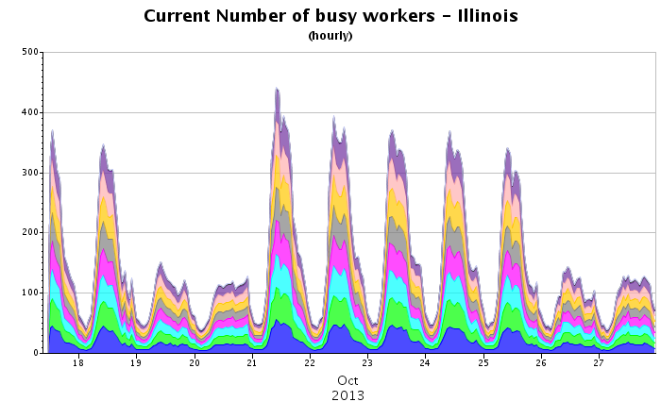
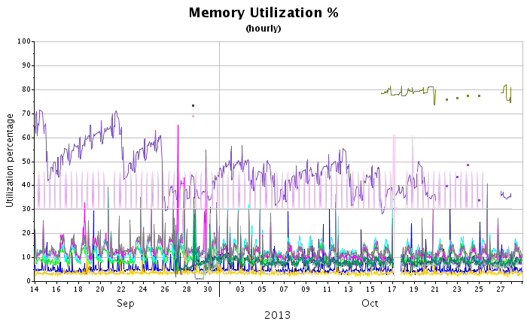
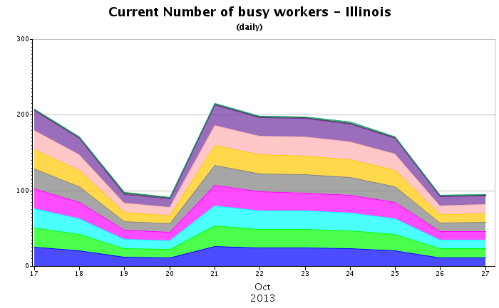
Basic Metric Trending
Device metrics and business metrics can be trended in detail to show short term trends and in larger time slices to show longer term trends.
Notes:
From the Overview example.
Basic trending can be done with device metrics as well as business metrics and is the least interesting reports you get from BCO. Anyone with this data now can create these reports now, but they are not related to any other data so while they may be interesting on their own, they are much more interesting when combined with other data, trends, and observations.
In the examples memory is a device metric while ‘busy workers’ is a business metric and more exactly a proxy for concurrent web users (on the Illinois web site). The hourly chart shows variation within the day while the daily chart of the same data for the same time shows trend over the week. Longer time frames and larger aggregates offer yet different views of the data.

Slide 21
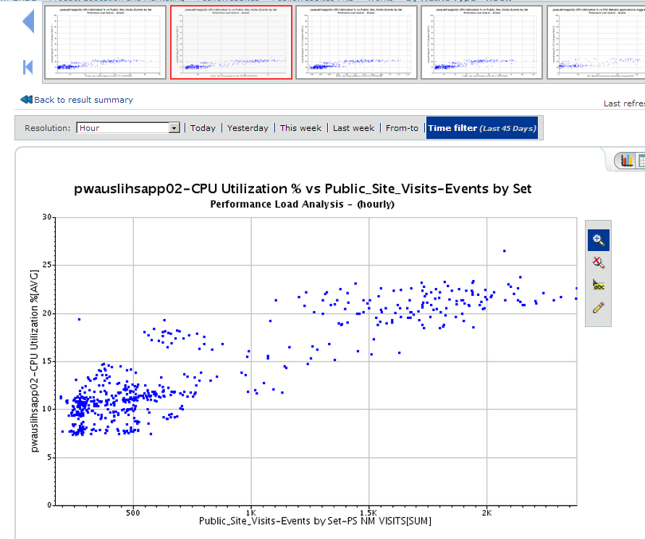
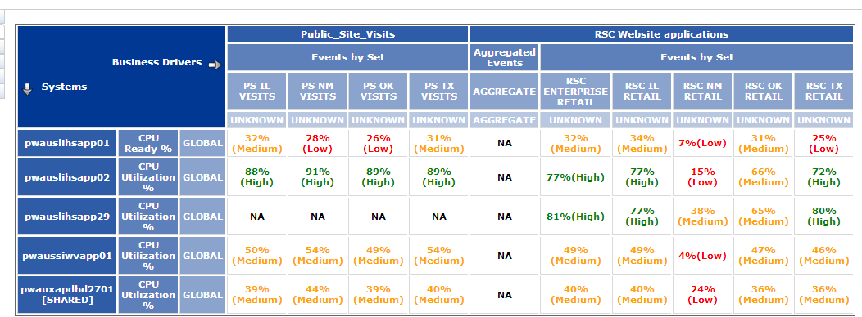
Correlation Map
A high correlation suggests that the two metrics are closely related. As one moves, the other moves in a predictable way. This implies that as Public Site Visits increase CPU Utilization % on pwauslishapp02 increases at a predictable rate.
Notes:
From the Overview example.
A high correlation suggests that the two metrics are closely related. As one moves, the other moves in a predictable way. This implies that as Public Site Visits increase CPU Utilization % on pwauslishapp02 increases at a predictable rate.
Implied in this is that this predicts when a threshold will be reached as the work increases. SME and business knowledge temper these conclusions but the conclusions can be made. The more complete the data the more complete the model. The more complete the model the more reliable the result.

Slide 22
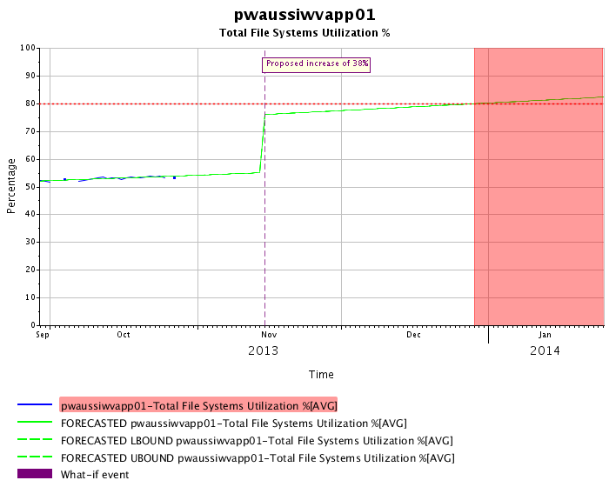
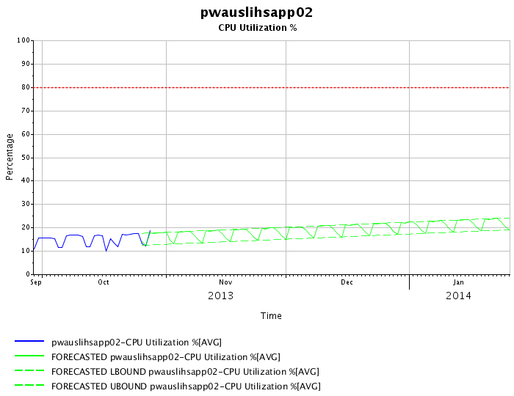
Generic Forecast and What IF?
Generic forecast shows not just average but peaks and valleys.
This what if scenario assumes a 38% increase on November 15th. And suggests the 80% threshold will be reached late December.
Notes:
From the Overview example.
Generic Forecasts will evaluate history and forecast the future. This can be device metrics or business metrics but implicitly suppose that the past is a reasonable predictor of the future. Or in other words, the future will not have influences not already seen in the historic data. Forecasts can seen monthly seasonality and yearly seasonality and make forecast accommodations for that. But, ‘black swans’ or other un usual events will not be accounted for.
What if scenarios will predict just as generic forecast will but can insert unusual events. These events can be increases or decreases and several can be incorporated into a model. The correlation analysis will help equate a predicted increase in one metric to the impact on other metrics making the models flexible for forecasting indirect metrics. Again, the more complete the data the more complete the models, and these models are complex and take considerable time.

Slide 23
Overview Summary
BMC Capacity Optimization - BCO is a capacity tool (not a monitoring tool), that can use nearly any structured data currently available (read only, automated access preferred).
BCO combines this data for correlation, comparison, analysis and reporting.
The data you use for analysis is of interest to the BCO group for inclusion to the BCO tool.
The BCO tool is a capacity tool but the correlation, comparison, analysis and reporting features could be of benefit to more than just capacity planning.
You are welcome to use the BCO data and tool, and we would like to have access to your data for inclusion to BCO.
Notes:
From the Overview example.

Slide 24
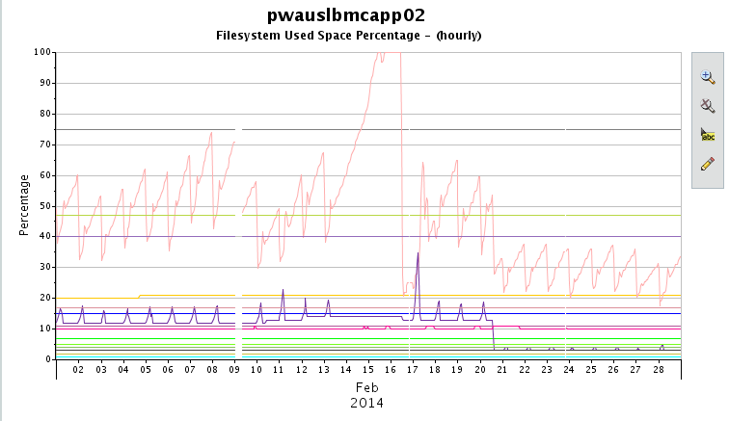
Recovery and the New Normal
This chart shows the incident, recovery from the incident, where new storage was added, and the new normal.
Notes:
From Use Case 0004
This is a percent chart, so adding more space decreased the utilization. We take the same space (numerator), but have a larger space to work with (denominator), dividing that drives utilization percentage down. The opposite is also true. When space is taken away, you use the same space, but compare that to a smaller allotment, dividing that drives utilization percentage up.

Slide 25
Conclusion
With an error, alert, or other ‘mission’, BCO can inform what is normal for the metric or device in question. BCO does not have todays monitoring data, it is one day behind, but the trend can inform how to interpret a metric.
At worst it can only show what IS NOT a problem.
At best is can show, specifically, what IS a problem.
In our use case, BCO showed what the problem was not. It was not abnormal use, did not impact other devices, and did not impact other metrics.
In our use case, BCO showed specifically what the problem was. It was a clean up routing failed, what the impact(s) was, (high disk utilization on a specific mount point), we knew that this would result in the application would be ‘down’ from a user perspective, and an indication of how long we had to resolve the problem.
We were able to take action, KNOWING that we were solving for the right and proper problem. (Even if our play book did provide and quick solution.) and KNEW how long we had to failure. Our recovery was in place for business Monday morning.
Notes:
From Use Case 0004

