Slide 1
Actionable Intelligence Lifecycle
And The Conscious Use Of Conceptual Models
The Evolution of a Question to Data to ETL to Chart to Action to View
Using TrueSight Capacity Optimization 11.3
December 2018
We make extensive use of the notes section so download the presentation
Notes:
Good Morning. I am Ben Davies from Movìri, where our tag line is “it’s all about performance”.
This is a conversation about the Actionable Intelligence Lifecycle, and the purposeful, conscious, use of conceptual models.
We are using an example of the evolution of a question that turned into a search for data, then making an ETL (Extract Transform Load) to get data into a capacity tool, where we made charts, analyzed them using dozens of different conceptual models, and took action. All using BMCs TrueSight Capacity Optimization 11.3 solution.
While we show the detailed steps used in the TSCO solution, the models, tools and techniques apply to any data analysis effort. Let me emphasize, the conscious use of models is one of the main points of this conversation.
Please keep your hands inside the ride, we will be taking off in just a moment.
We make extensive use of the notes section so download the presentation from http://mlcu.com/articles.html
There are queries and other details to reproduce the ETL used – IF you use TSCO you may find this helpful.
There are also links to sources and other Scooby snacks for those that care to look.
===
Presented at the Greater Boston Computer Measurement Group “GBCMG” December 6, 2018.
https://www.meetup.com/Performance-Engineering-and-Capacity-Planning/events/lkqqbqyxpblc/

Slide 2
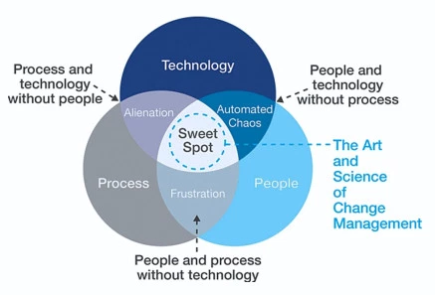
Agenda
  Consciously Use Your Conceptual Models
  A Question
  The Data and Investigation
  The ETL Design and Redesign
  The Chart, Analysis, Intelligence, Action Cycle
  The People, Process, xx Models (technology, product, solution, profit, productivity…)
  Summary And Call To Action
Notes:
Here is our agenda
We will discuss Consciously Use Your Conceptual Models
Like any good data investigation, we start with a question. Which is, in itself, a conceptual model.
Which leads us to the data and the investigation – with hundreds of potential models to choose from
When the data seems to be useful, we design an ETL to get the data – a data model
Then we can chart, analyze, assemble intelligence, and take action. And repeat, and repeat again. – More models, and is itself a model.
Then, finally, incorporate the People, Processes, xx Models. Another family of models (google “people process”)
Then summarize and A Call To Action – another model
There should be time for questions at the end but feel free to interject.
===
https://supplychaintrend.com/2016/12/13/sop-a-vision-for-the-future-the-expert-interview-series-7/

Slide 3

Conceptual Models
Conceptual models establish and define relevant terms, concepts, scope, relationships, and interaction.
A conceptual model is a representation of a system, made of the composition of concepts which are used to help people know, understand, or simulate a subject the model represents.
You have been taught models all your life. In grade school, college, and professionally. Don’t let them go to waste.
Consciously USE YOUR MODELS
Notes:
Conceptual models establish and define relevant terms, concepts, scope, relationships, and interaction. They can do other things as well and have their limitations, so choose wisely
Here is part of the text from our friends at Wikipedia. Emphasis is mine.
A conceptual model is a representation of a system, made of the composition of concepts which are used to help people know, understand, or simulate a subject the model represents.
There are thousands of models. You learned them in grade school, high school and collage. Don’t let them go to waste. Consciously USE YOUR MODELS.
People use models all the time, they just don’t seem to consciously use them. This suggestion is to intentionally, overtly, consciously, use your models.
===
https://en.wikipedia.org/wiki/Conceptual_model

Slide 4

A Question
Notes:
Our journey started with attending a presentation that discussed ETL Development, presented by the cool kids at Movìri. (07. ETL Development – OpenETL.pptx)
The presentation was broken into three parts.
An Introduction to Open ETLs,
Open ETLs: SQL Extractors, and
Open ETLs: CSV Parsers.
The most interesting part, at that moment, was a section called “Configure a new database extractor from the TSCO DB in order to create a Business Driver that counts the number of daily logins..”
I found the example useful, so I implemented the example, and expanded on the ideas. This presentation is that journey.
The goal of this presentation is to show the steps to make this outcome for sure, but the real value is in seeing the journey, and for you to be inspired to ask your own questions, and consciously apply models, tools and techniques to answer those questions. In the end we expect to have some actionable intelligence for the TSCO solution, but also a roadmap to actionable intelligence for other analysis tasks as well.
===
Moviri.com Call the Boston, Massachusetts office if you wish this presentation.
https://www.tibco.com/blog/2012/09/18/big-data-in-real-time/

Slide 5
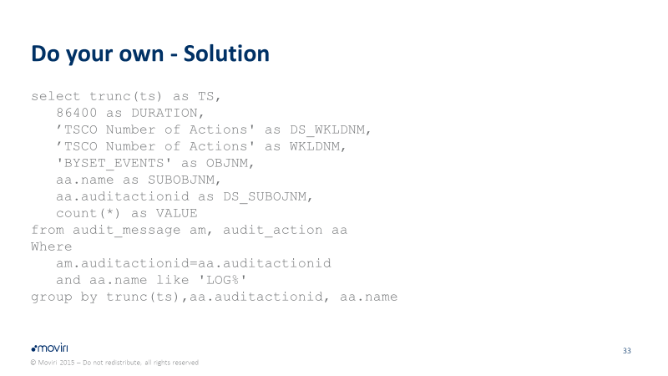
The TSCO ETL Data Model
The basics of and ETL
Time Stamp
Duration
DS_WKLDNM
WKLDNM
OBJNM
SUBOBJNM
VALUE
And a Limiting clause
Notes:
Using the presentation as our guide we ‘investigated’ the data source, and ‘designed’ an ETL.
Here is the original presentations ETL to get the number of log in events. It has all of the required information for the ETL model: Time Stamp, duration, data source workload name, TSCO workload name, Object name (That is to say the TSCO metric name – search for “match and gap” in the documentation), the value, and the limiting clause to only get the expected data from the data source.
This is a BMC TSCO ETL Model.

Slide 6
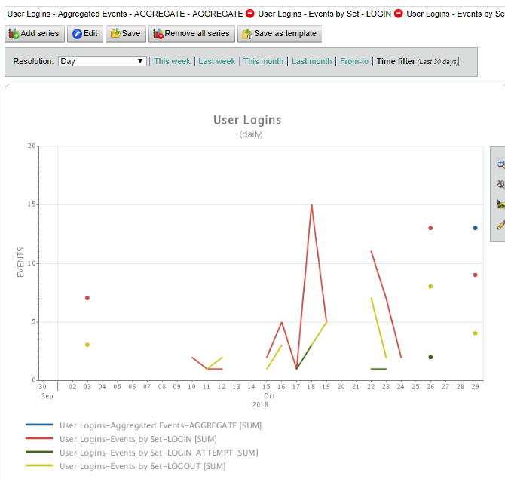
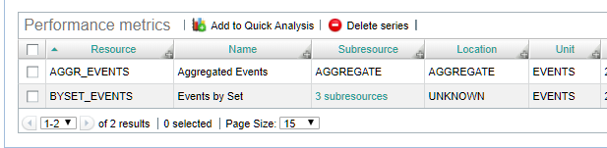
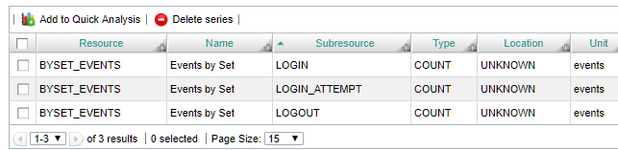
Evaluate With Models
Notes:
After our ETL runs the data shows an aggregated total, and three event types. Login and logout we expected, but Login_attempt was a surprise that needed to be researched.
Turns out that is failed login attempts.
The chart shows the data plotted over time. As this is our demo environment the result is sparse, but you can imagine tracking daily logins to show a trend, so this looks good.
We have successfully implemented and evaluated the presentation example using our models.
What models did we use? Plan Do Check Act and variations, TSCO ETL Model, data investigation models, (time analysis, data table, data query, data comparisons) etc.

Slide 7
The Most Powerful* Model In Computing
If I Can Do THAT…
Then I Should Be Able To…
*According to @MrBenHoney
Notes:
Now for the next step, the most powerful model in computing…
If I can do that… Then I should be able to …
There are many different levels here.
If I can Answer the Login data question.
Then I should be able to Apply that to another question.
If I can make an ETL to get just login data.
Then I should be able to make an ETL to get other data.
If I can query the table for log data.
Then I should be ale to query other tables for other data.
The point is : Here is a simple model to help build on what you already know.
If I [know, can do, etc.] that..
Then I should be able to [know, do, etc.] …
===
Twitter @MrBenHoney

Slide 8
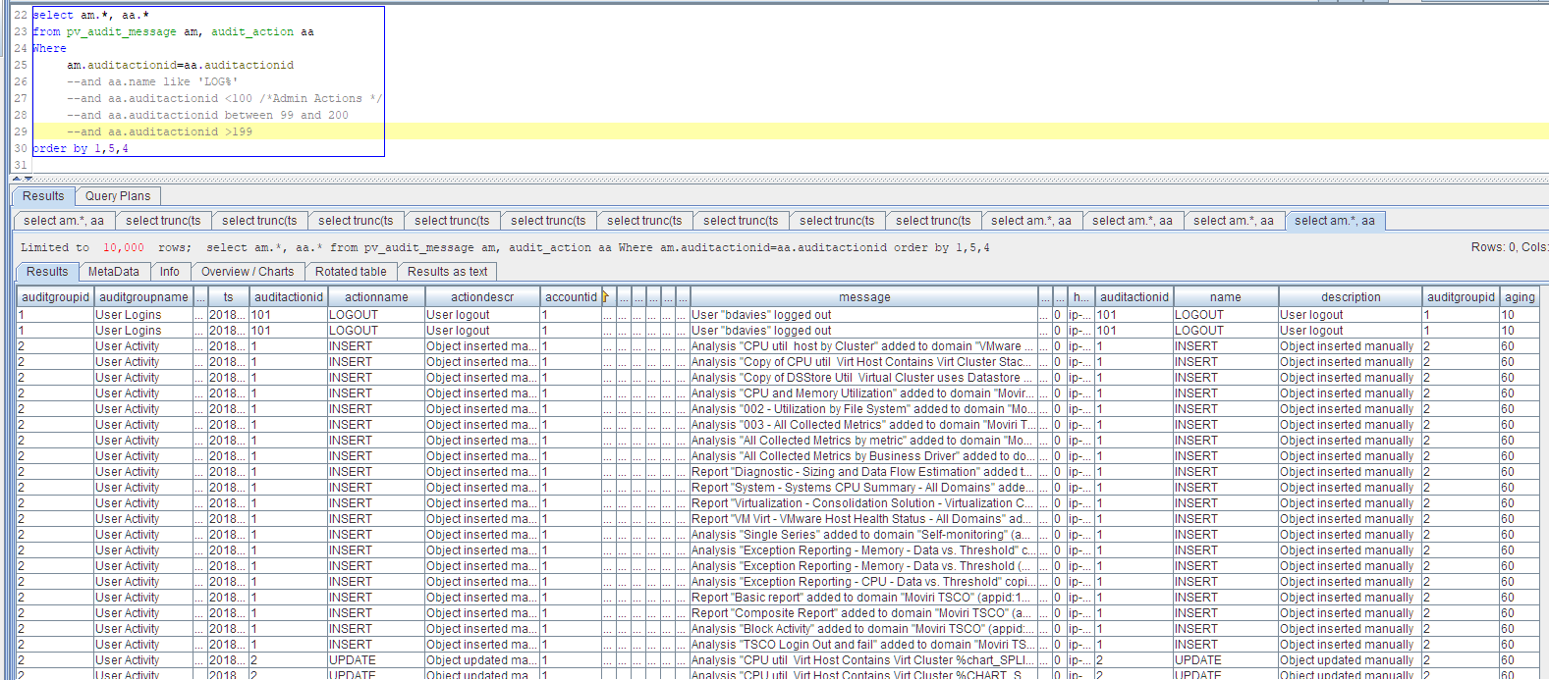
What is Available?
Notes:
Using the “if I can do THAT, then I should be able to… “ model, we ask a new question. What other data is available?
Out investigation progressed through a number of queries.
This one shows all columns from both tables (audit_message and audit_action) (many un interesting columns were hidden to show only the relevant ones).
Note that the “where statement” has several investigation lines that have been commented out. Add them back one at a time to investigate what is in each, or make your own. Imagine how you would use this information in a chart, report, investigation, analysis, audit or in other documentation. Change the order of the columns, which columns would be evaluated together, what questions does the data suggests, or which questions the data seems to answer.
This step is when I decided that there was more interesting information than just logins and logouts. And a PERFECT example of “if I can do that… then I should be able to…”
We use several investigation models, tools and techniques
This is free form analysis, the most interesting thing you are likely to do all week.
===
select am.*, aa.*
from pv_audit_message am, audit_action aa
Where
am.auditactionid=aa.auditactionid
--and aa.name like 'LOG%'
--and aa.auditactionid <100 /*Admin Actions */
--and aa.auditactionid between 99 and 200
--and aa.auditactionid >199
order by 1,5,4

Slide 9
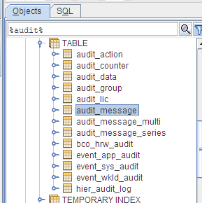
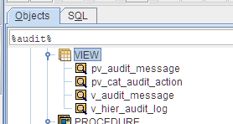
The Data and Investigation
Notes:
We notice audit_message and audit_action as the tables used in the example. (Previous slide)
Being curious data investigators we investigate what other audit type tables are available.. If I can see this audit table, then I should be able to see all audit tables. Notice that there are public views, which a good database citizen should use when available.
We investigated what was in each table and decided on the tables we needed. We appreciated that the software vendor made the table names reasonably represent what the tables contain and did not seem to hide tables with unrelated names.
We also appreciated seeing public views. Public views (data presentation models) are your friend, you should use them as much as practicable.
For the record we used SQuirreL SQL Client, but any query tool should allow for a filter / search.
==
The deal with public views. Public views, originally seen as a security device to limit access to sensitive data by removing it from the public view, this layer of obfuscation also allows for the table denormalization and for the structure to change without impacting users. Users query the views, the views essentially query the real database. This frees the database designers to change the database structures and still preserves simple user interactions.
Advantages and Disadvantages of views in Sql Server
https://www.c-sharpcorner.com/blogs/advantages-and-disadvantages-of-views-in-sql-server1

Slide 10
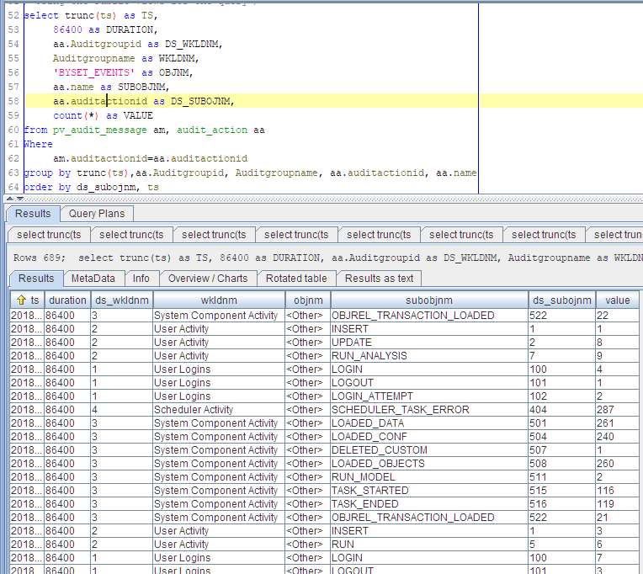
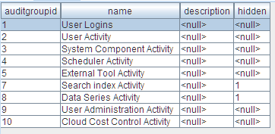
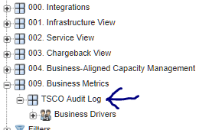
TSCO Result – Conscious Use Of Our Models Tools and Techniques
Notes:
Once we realized that there were only 10 items in the audit_group table (top right), and 146 in the audit_action table (left), we decided to make each audit group its own workload, with each action a sub object name. That is the maximum Business metrics at the moment, but we thought through what happens when new items are added by the software developer, they get added automatically when they show up in the log.
Then we decided where they would ‘live’ in the tree (bottom right). And with that we remake our ETL.
This specific result is only relevant to our TSCO Solution.
However, the point is that we used, consciously used, our models, tools and techniques, to get to this result.
===
select trunc(ts) as TS,
86400 as DURATION,
aa.Auditgroupid as DS_WKLDNM,
Auditgroupname as WKLDNM,
'BYSET_EVENTS' as OBJNM,
aa.name as SUBOBJNM,
aa.auditactionid as DS_SUBOJNM,
count(*) as VALUE
from pv_audit_message am, audit_action aa
Where
am.auditactionid=aa.auditactionid
group by trunc(ts),aa.Auditgroupid, Auditgroupname, aa.auditactionid, aa.name
order by ds_subojnm, ts

Slide 11
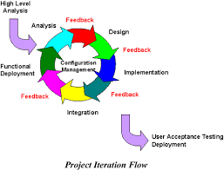
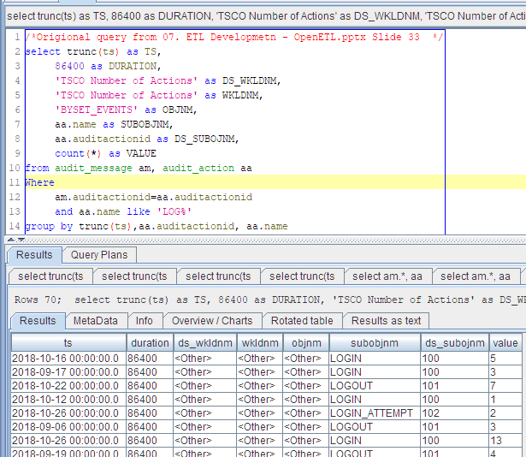
The ETL Design and Redesign
Can be subtractive!
Notes:
As an iterative model / process, the first ETL design was right out of the original presentation. Then we make reports and see how the data appears in charts, reports, and analysis. Then go back to the data and investigate what other data is available (back a few slides), analyze what the data says and what questions it helps ask, and what questions it help answer. Then redesign the ETL.
Repeat as often as is helpful, but no more. Many iterative models do not show when to ‘stop’. There is a rule of thumb that you should only get data that you will analyze, and you only analyze data to answer business questions, or meet a business objective. Avoid the urge to ‘get everything’ but also don’t be afraid to get all data that is helpful for analysis, provides context, and that has a customer (you and your team may be your own customer).
There is a chicken and egg problem, you need to add data to be useful. The caution is not to add data without some purpose (customer), even if the customer is yourself. You should even entertain removing data that has proven un useful. Most iterative models imply additive processes, but there is (normally) nothing in the model that precludes subtraction.
When there is no customer for the data (answer a business question, provide context, or meet a business objective), then remove the data. This itself, is a useful model.
==
https://www.quora.com/Why-is-software-design-an-iterative-process

Slide 12
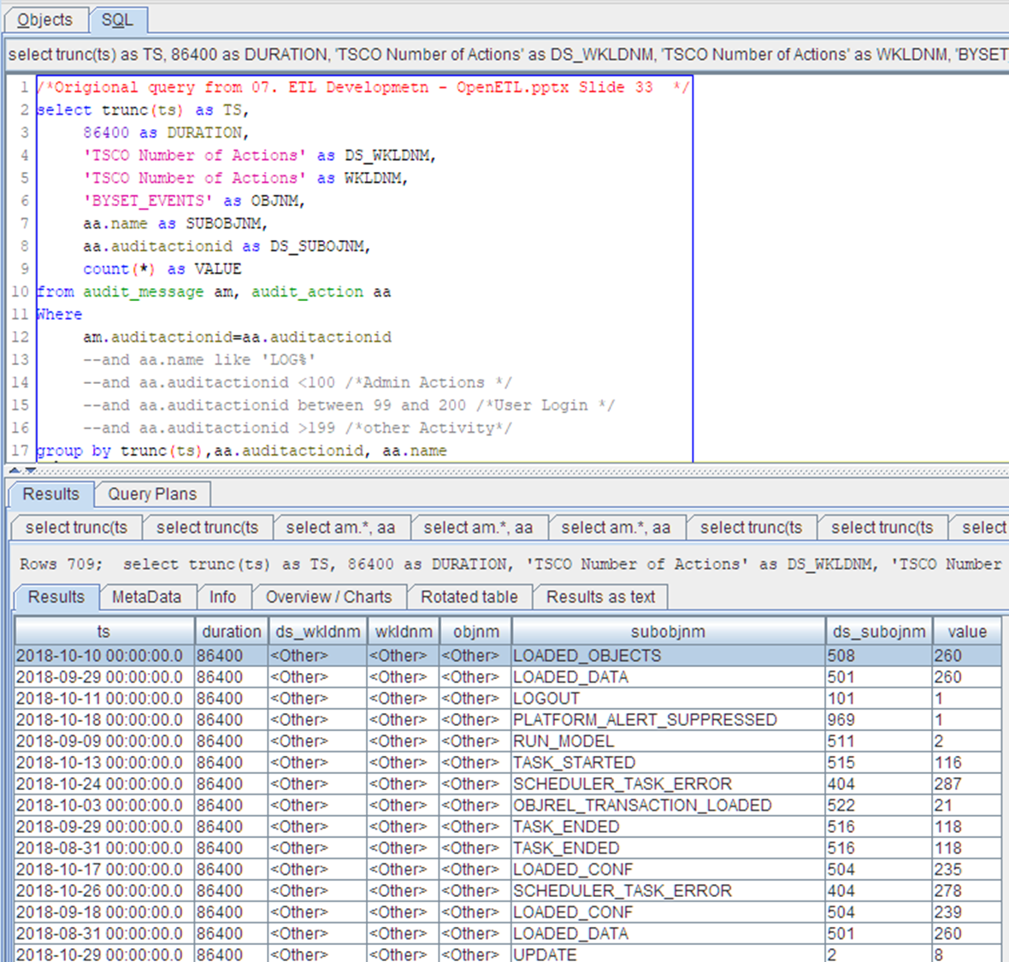
Changed ETL Again
Notes:
Changed the ETL to show all events and tried to report against them.
Note the subobjnm has a lot of other items.

Slide 13
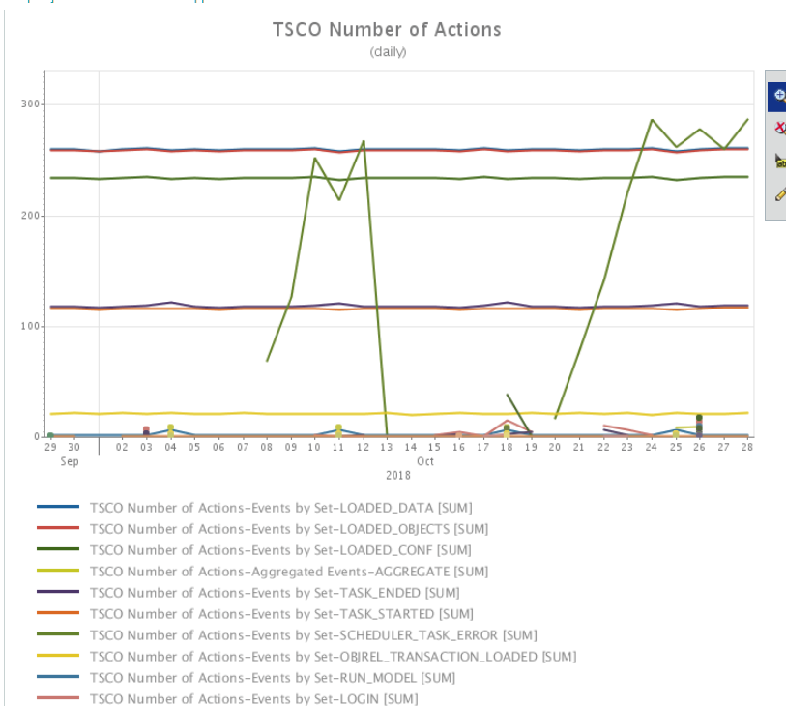
Used Models to:
Plot
Interpret
Analyze
Compare and
Take Action
Notes:
This put all items in one “bucket” which was less satisfying. This proved difficult to chart as they ended up in one bucket and singling one type out was not easily done.
It is helpful to have a tool box of models, tools, and techniques, for refining this information to actionable intelligence.
We are still in our iterative process model, While we use other models to plot, interpret, analyze etc. Many models can be used at once.

Slide 14
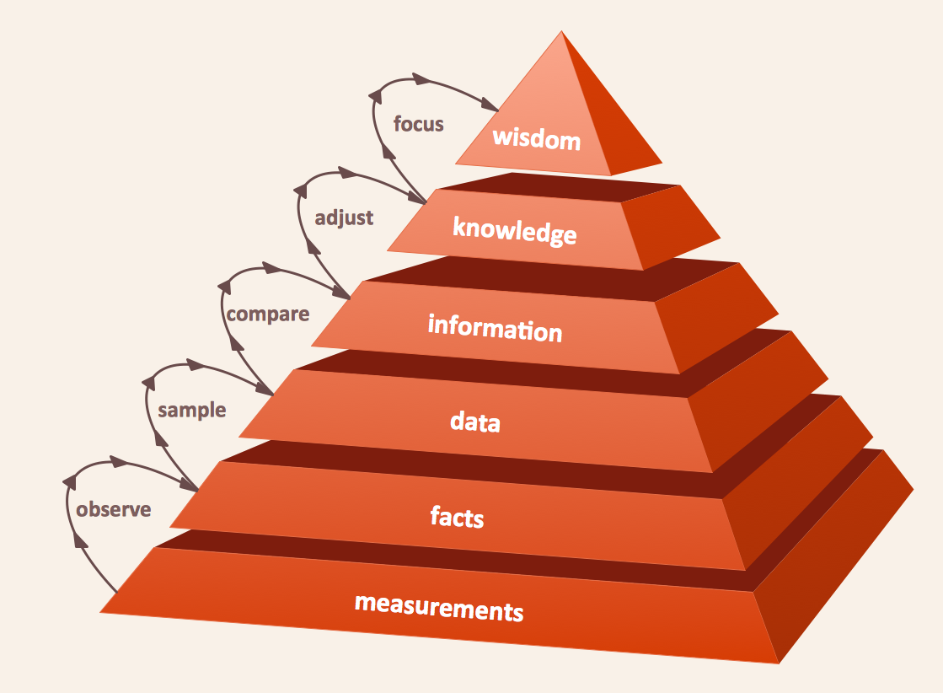
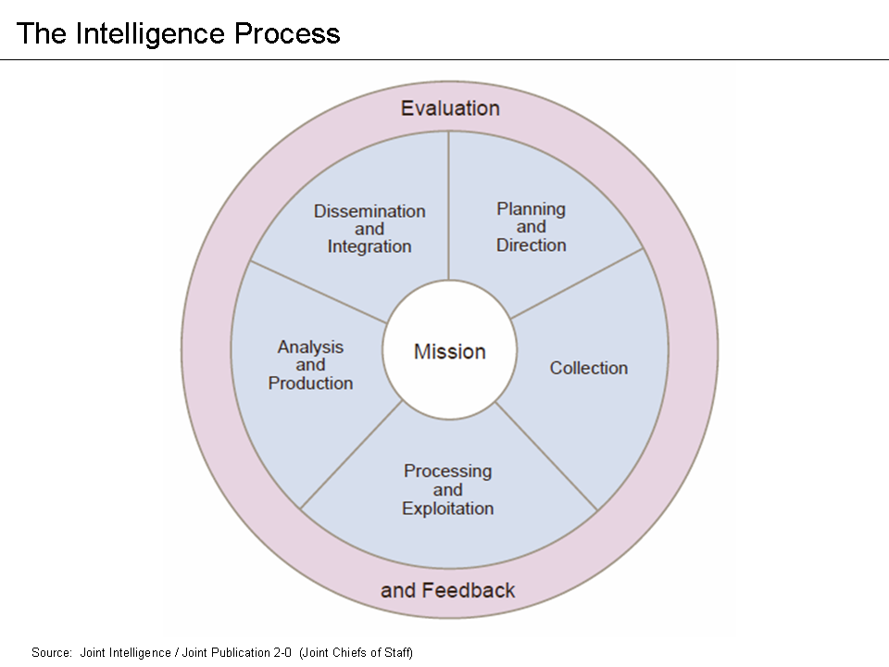
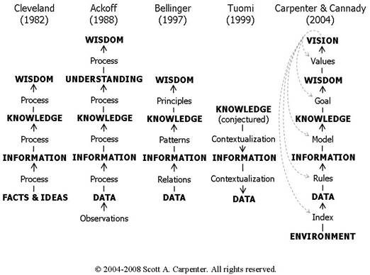
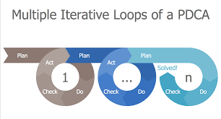
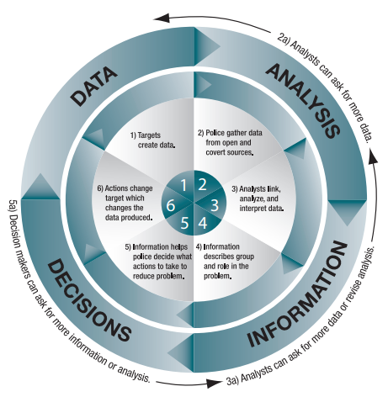
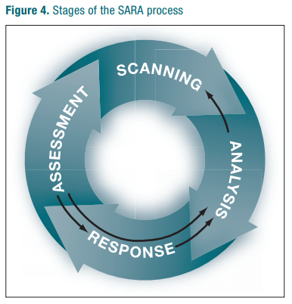
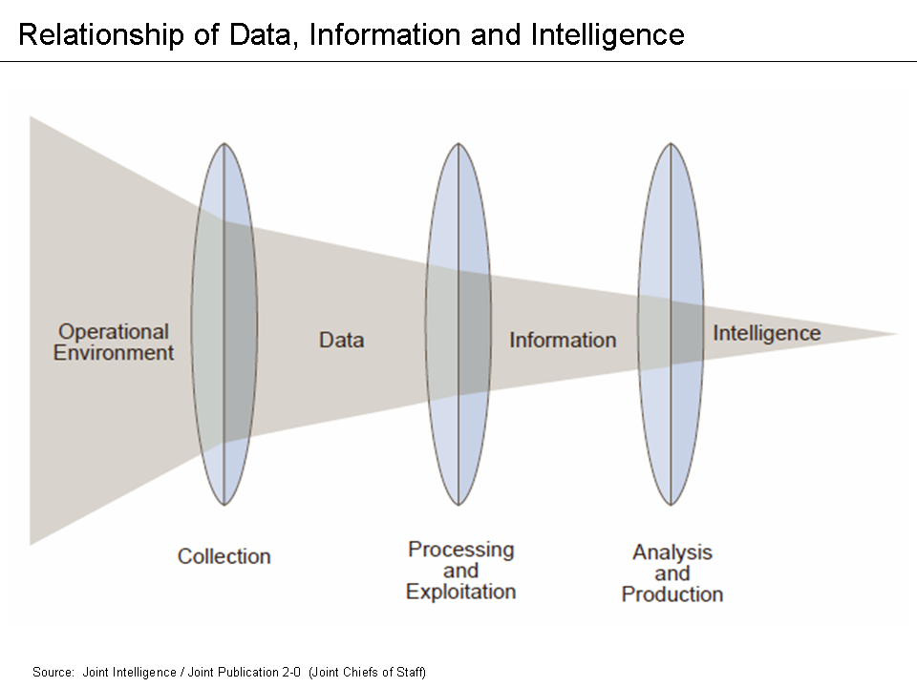
The Chart, Analysis, Intelligence, Action Cycle
Notes:
Conceptual models are incredibly useful. They give a framework to ‘process’ a problem / question. Plan Do Check Act, and Data Information Knowledge Wisdom are very useful, flexible, models.
In our case, we adapted the DIKW model to make the Chart, Analysis, Intelligence, Action, Cycle. Notice that others have expanded, contracted, inverted, and otherwise ‘messed with’ the DIKW model. We have included several examples of the purposeful use of models in the notes. Look up the “Intelligence Analysis for Problem Solves“, which is a study in the use of models in law enforcement.
We are still in our iterative process model So we went back to look more closely at the data source.
====
https://en.wikipedia.org/wiki/Intelligence_cycle
By Joint Chiefs of Staff - http://www.dtic.mil/doctrine/new_pubs/jp2_0.pdf, Public Domain, https://commons.wikimedia.org/w/index.php?curid=47853466
By U.S. Joint Chiefs of Staff JP2-0 - http://www.dtic.mil/doctrine/new_pubs/jp2_0.pdf, Public Domain, https://commons.wikimedia.org/w/index.php?curid=47853614
Intelligence Analysis for Problem Solvers
https://ric-zai-inc.com/Publications/cops-p275-pub.pdf
At 140 pages is a bit long for casual reading but is an excellent example of using and adapting models (in this case for law enforcement). The adaption and conscious use of models, research, and data is helpful in showing the flexibility and value of models.
Center for Problem-Oriented Policing (www.popcenter.org)
https://en.wikipedia.org/wiki/DIKW_pyramid
A Primer: Enterprise Wisdom Management and the Flow of Understanding
http://www.cognitivecybernetics.com/PrimerFoU.html
https://www.conceptdraw.com/solution-park/management-plan-do-check-act
https://www.conceptdraw.com/How-To-Guide/dikw-pyramid

Slide 15
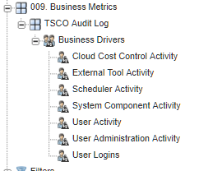
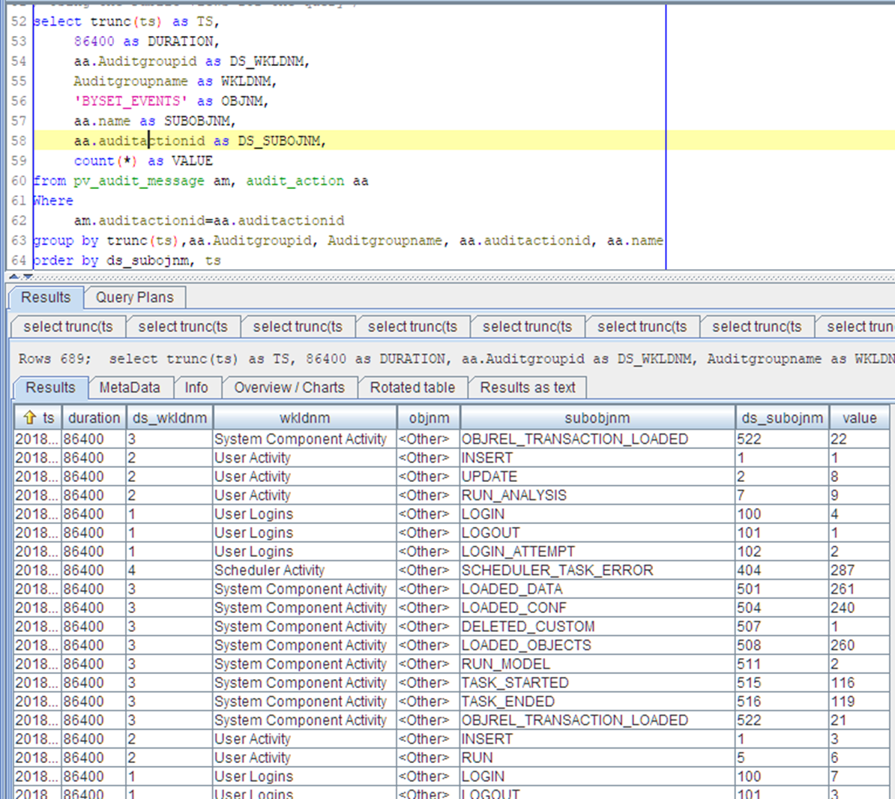
Plan Do Check Act - Again
Notes:
We find an audit group table that defines 10 major groupings and an Audit_action table that subdivides into 146 specific actions.
This query gives us the 10 major groupings with the sub groupings below them. As items show up in the logs the business drivers will be made.
This better suits our reporting and use in models, as each grouping is serviced by a specific device (or two), and each grouping has a summary count (rather than one big summary count).
Sample reports show…
===
Query used in the ETL.
select trunc(ts) as TS,
86400 as DURATION,
aa.Auditgroupid as DS_WKLDNM,
Auditgroupname as WKLDNM,
'BYSET_EVENTS' as OBJNM,
aa.name as SUBOBJNM,
aa.auditactionid as DS_SUBOJNM,
count(*) as VALUE
from pv_audit_message am, audit_action aa
Where
am.auditactionid=aa.auditactionid
group by trunc(ts), aa.Auditgroupid, Auditgroupname, aa.auditactionid, aa.name
order by ds_subojnm, ts

Slide 16
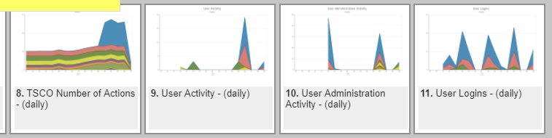
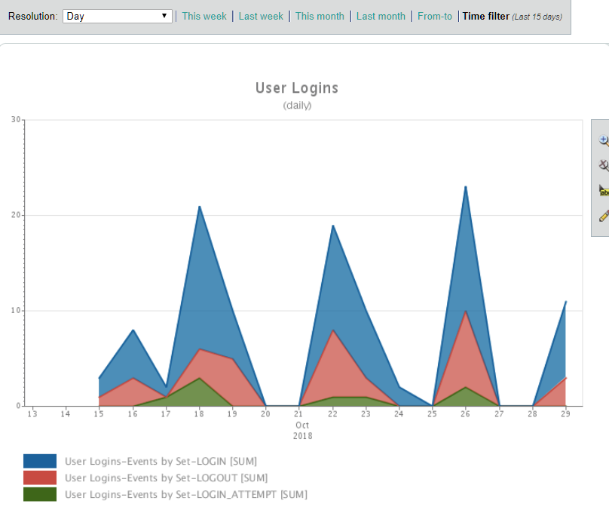
Plot, Chart, Interpret …
Notes:
Sample reports show User Logins, User Activity, and other break outs of the data.
This seems suitable.
This also suggested that the TSCO Number of Actions data should be removed. It is possible to get this data by combining the other data, so there is no need to store it as a separate metric. Well, at least not now. If we find a customer for this data AND combining constituent parts is not a suitable solution, we will revisit the question.

Slide 17
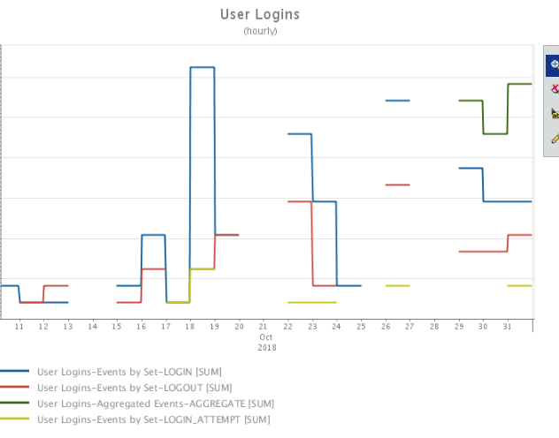
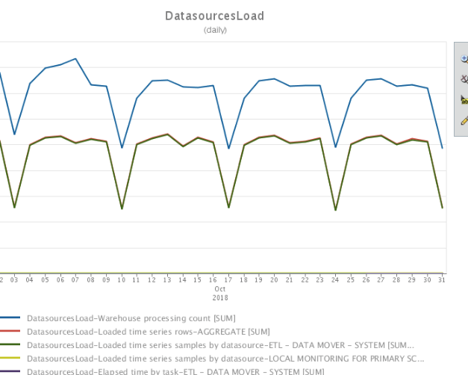
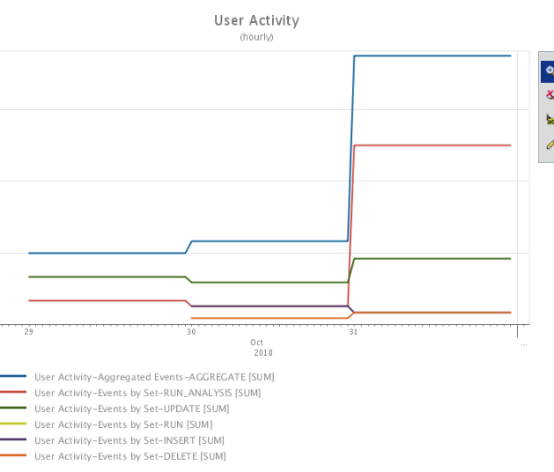
Delivering Actionable Intelligence
Notes:
Our Chart Analysis Intelligence Action cycle has delivered actionable intelligence.
Specifically the trends and patterns of logins, patterns of data load, and User Activities.
While these do not seem helpful in our test environment, these are promising in a more active environment.
Here is where we ended our modified Chart, Analysis, Intelligence, Action cycle. But ‘ended’ is used loosely as the users continue to use these data, charts, analysis, intelligence, and take action, in their own models, they are evaluating if additional data is needed. We will then ‘restart’ this model / process.

Slide 18
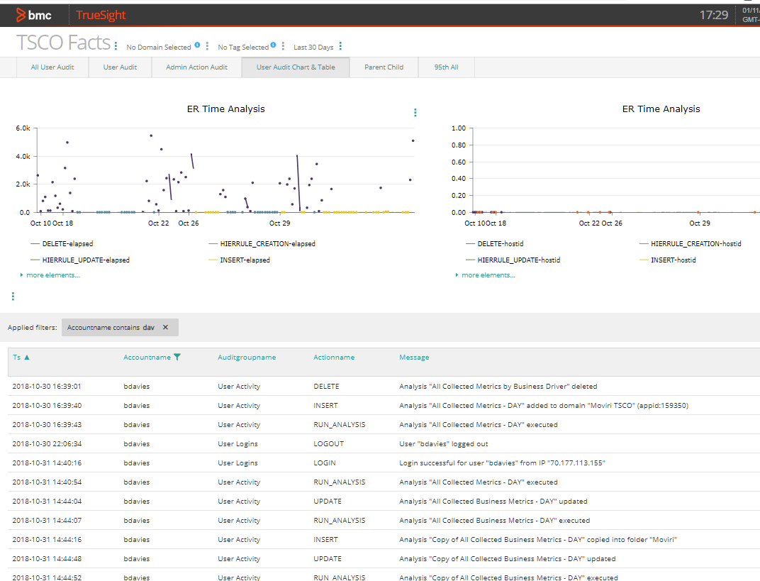
The View
Another model for delivering actionable intelligence.
Remember that models can suggest REMOVING as well as adding.
Notes:
As a separate process, we evaluate (using a cost benefit model) if we should make a TSCO View.
Views are designed and redesigned to help the customer monitor well understood and well controlled data environments.
Views change as the customers focus changes.
Many of the same models go into this evaluating, making, and delivering, the View.
In this particular case it is not clear if this delivers value or not. Our continuous improvement model may show that REMOVING data / information, specifically this view, may be warranted. Models are NOT always additive.

Slide 19
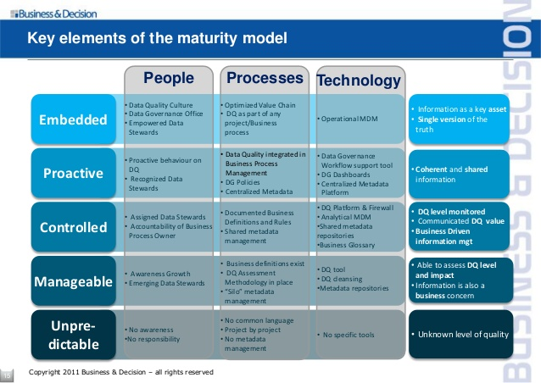
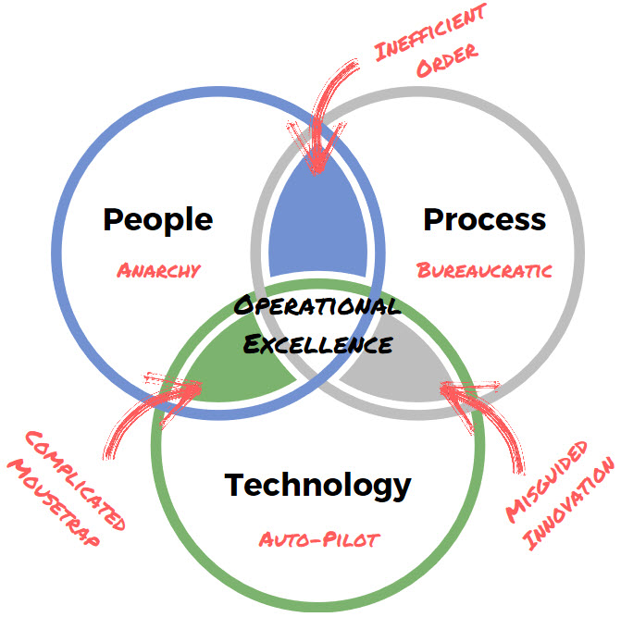
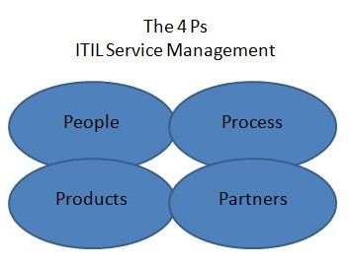
The People, Process, xxx Models
In Real Life…
Not this clean or symmetrical
Notes:
Finish with the People, Process, xxx Models.
While the people, process, and procedure / technology / products / partners / etc. has been considered throughout the process, periodically they should be rebalanced.
The mental model shows all have equal size and weight and converge on a well defined middle. In real life it is not this clean or symmetrical. However, balancing these goes a long way to maturing the individual effort specifically, and the organization generally.
The idea in these models is to align competing forces such that a misalignment does not cause organizational issues. To the extent that organization issues are shown, helps determine organizational maturity (top right model). There are models to help mature the organization as well.
===
http://www.atxadvisory.com/about-us/atx-overview/
https://www.slideshare.net/BusinessandDecision/2011-mdm-en
https://www.ashfordglobalit.com/training-blog/itil-tips-and-training/understanding-the-four-ps-of-itil-service-management.html

Slide 20

Summary And Call To Action
The whole process looks like the Agile Scrum Model with progress marked by cycles within cycles.
Your goal as Capacity Planner is to Identify Actionable Intelligence (and to take action).
To do this well, you Consciously Use Your Conceptual Models
Call to action…
Consciously USE your Models – Make Actionable Intelligence
Notes:
This whole adventure can be summarized into this Scrum looking logic loop. Progress is measured with process loops with their own process loops operate along the way. Implied in this is that other models, tools, and techniques are also employed to achieve some outcome.
Your goal as a capacity planner is to identify actionable intelligence which causes action to be taken.
To do this, you use your conceptual models. To do this well, you should consciously use your conceptual models.
So there is no mistaking the call to action – Consciously use your models, make actionable intelligence.
===
https://ema.net.br/blog/2009/09/scrum-gestao-agil-de-projetos/

Slide 21
Movìri Can Help
Capacity Management
Monitoring
Analytics
Operations and Cloud
Security
Testing and Optimization
And the newest Movìri family member AKAMAS an AI driven full-stack solution for continuous performance optimization. www.akamas.io
Notes:
Movìri can help.
Movìri has thousands of models we can adapt and apply to your critical opportunities, in a number of disciplines.
Our services include capacity management, monitoring, analytics, operations and cloud, security, and testing and optimization.
There is a new member of the Movìri family. AKAMAS. AKAMAS is an artificial intelligence driven full-stack solution for continuous performance optimization.
Have a look at www.moviri.com and www.akamas.io

Slide 22
Actionable Intelligence
Consciously Use Your Models
Most powerful model in computing…
If I can do that… then I should be able to…
Question & Answer
Flow diagram
Swim lanes
Dot chats
Cluster charts
Venn Diagrams
Relational Models
Line chats
Linear regression
What IF Analysis
Unified Modeling Language
Suck Less
Schematic drawings
Check list
Organization Chart
Logic Diagram
Layout Map
Mnemonic
Time efficacy model
Recipe
Force field analysis
Time Line
Fail Fast
Infographic
If Then Logic
Fish Diagram
Brain map
Mock up
Last ramp forecast
Trend analysis
Deming cycle PDCA
ISO Best Practice
Risk Management
When in doubt press Enter
RACI Chart
Four Square Chart
SWOT Analysis
PESTEL Analysis
Process Map
5 W’s
Correlation Analysis
Mathematical Models
Notes:
Time for questions.
Here is a summary and a list of models. There are thousands of them.
SWOT Strength Weakness Opportunities Threats
PEST Political Economic Social Technological Environmental Legal
5W’s Who What When Why Where and How
What If analysis
Linear regression and forecasting (whole family of models)
Seasonal forecasting
Multivariate analysis
Consolidation model
Charge back model
Reservation model
Event detection models

Slide 23
Notes:
Movìri
http://www.moviri.com
US: 211 Congress St - Floor 4 - Boston MA 02110-3123 - USA
HQ: via Schiaffino 11 - 20158 Milano MI - Italy

Slide 24
Some of Mr. Ben’s Favorites
Suck Less
Useful consistent lie
Fail Fast
Cleared while testing – sign of actionable intelligence
Average is a below average metric
Always Take Action
Includes purposeful inaction
Notes:
The 'truth' is an expensive illusion. There is no truth. Be happy with a useful, consistent, lie.
You don't like a lie. Lies are all around you. What time is it? Whatever you answered is a lie. If you wish the truth, set aside a weekend and ask a physicist. The truth has so many caveats as to be meaningless in most contexts.
In troubleshooting, you want to struggle for a little while but not long. Don't give up, but don't waste time spinning in circles. Spend only so much time as needed to be able to clearly articulate the problem to someone else... then ask for help... and be willing to take it; This formulates an understanding of what you are trying to do... What I find, is that the other person is not weighted down by the baggage of distractions, decisions and choices you have made on the way to understanding, so they more quickly get to an answer. Partially because they know it is not a 'simple' solution (or you would have already solved it), and partly because the actual problem is presented (where you were bogged down with false symptoms, bunny trails, distractions and falsehoods).
==
Cleared while testing is actionable intelligence screaming for attention
Problem 'resolution' phrases like "cleared while testing", "no fault found", "resolved without intervention" and similar phrases are road signs pointing to actionable intelligence. They indicate a queue, buffer, cache, or other work holding method has been saturated causing a visible error. When the system 'catches up' the work holding method releases the work and the system returns to a normal state. Go find these methods, understand what they are reacting to, monitor them as an early warning metric.
==
http://en.wikipedia.org/wiki/Gestalt_psychology
The central principle of gestalt psychology is that the mind forms a global whole with self-organizing tendencies. This principle maintains that when the human mind (perceptual system) forms a percept or gestalt, the whole has a reality of its own, independent of the parts. The original famous phrase of Gestalt psychologist Kurt Koffka, "The whole is other than the sum of the parts" is often incorrectly translated [1] as "The whole is greater than the sum of its parts" and thus used when explaining gestalt theory, and further incorrectly applied to systems theory. [2] Koffka did not like the translation. He firmly corrected students who substituted "greater" for "other", "This is not a principle of addition" he said.[3] The whole has an independent existence.
==
A business case is not just to support a proposal, but to establish the cost to avoid failure. If it does not clearly discuss risk, it is not a business case.
Disruptive forces have intended and unintended consequences. Both intended and untended consequences can be overtly good or overtly bad. Once the disruption has occurred, it is not possible to control the consequences. The new normal does not have the inertia to keep it stable, so it is more easily perturbed by forces that could not have disrupted the original eco system, and is therefore much more susceptible to disruption itself. The original disruptive force may introduce or facilitate another disruption, to its own demise.
Documentation is only useful to the degree that it gets used and is used only to the degree that it is useful.
When you want useful replies, ask smart questions.
Being 'correct' but by yourself is less comfortable than being 'wrong' with a group
Nothing changes until the status quo becomes sufficiently uncomfortable.
Nothing changes until you make the status quo sufficiently uncomfortable.
The status quo is emotionally involved, so immune to logic, reason, or facts.
We make decisions with emotion and justify those decisions with logic.
Emotion is a fearsome opponent of logic, reason, and facts.
Correct is a matter of interpretation and perspective, strive for correct enough to be helpful
Troubleshooting and problem solving are mutually exclusive.
"The beginning of wisdom, is the definition of terms" - Socrates
Data>Information>Knowledge>Wisdom is not linear and is undermined by bias, (data) errors, misinformation, and outright lies
Failure is good when it comes quickly and cheap, and leaves as its reward, experience and understanding. Conversely, failure is bad when it is slow to be recognized or at great expense, and leaves a legacy of blame and cowardice.
==
Economists think of costs as consequences of choices. In the real world, resources are scarce. Because resources are limited, all necessary interventions cannot be implemented. When decisionmakers choose to implement a program, the resources expended will not be available for other possible uses.
For instance, the decision to allocate funds for a public health program renders these funds unavailable for education, housing, or defense spending.
Therefore, the true cost of a program is not just the amount of funds spent on it. It is also the value of benefits that would have been derived if the resources had been allocated to their next best use. Economists call it the opportunity cost of a resource or program.
==
Work left un done due to higher priority work can be competitive advantage, however, work left un done due to mis assigned priority is opportunity misplaced. Reevaluating priorities of current and deferred work helps mitigate this but is itself work subject to prioritization.

