Slide 1
Adventures With Chargeback
And the Value of a Useful consistent Lie
Mr. Ben Davies AKA @MrBenHoney mlcu.com
Notes:
Ben acted as the Technical Champion for a 7-figure deal I engaged back in my American days, and an outstanding advocate of our journey together ever since. Our first encounter dates back to 2012 when HCSC needed some help sizing their whole IT capacity to be ready to sustain the impact of Obamacare's open enrollment period - and that marked the beginning of a beautiful partnership.
Ben agreed to share with us a revised version of a keynote (well: one of the few that resulted from our work together!) he presented many times over the years, on different stages. The session will showcase HCSC's journey in deploying an internal chargeback process, or - in other terms - a story of what it took to IT to show back to the Business the actual, quantified value of their services.
This topic resonated with many IT directors and leaders across the globe and hopefully will provide valuable insight into the pains our Customers face while selling our solutions internally.

Slide 2
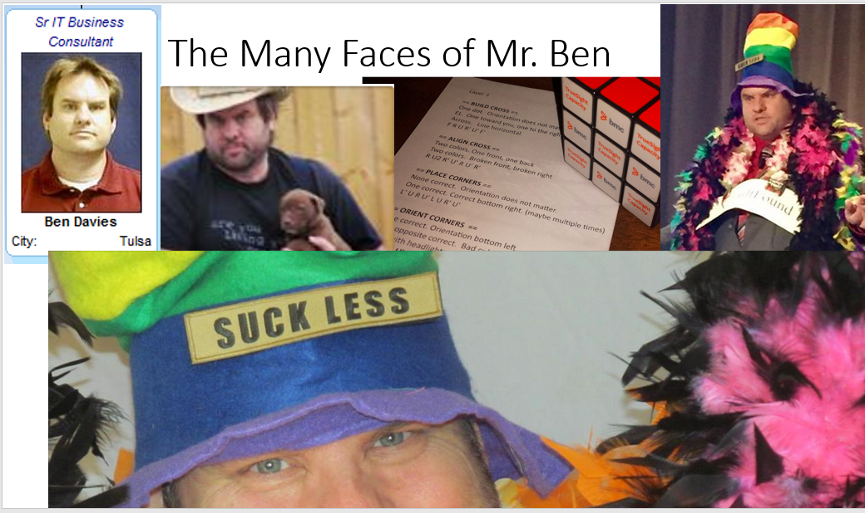

7 Cs of communication -
Clear.
Concise.
Concrete.
Correct.
Coherent.
Complete.
Courteous.
Notes:
Introduction
My name is Ben Davies AKA @MrBenHoney www.mlcu.com
I have been doing IT for a long time, first in the NAVY as a cook (good story there). My first floppy disk was for an 8-inch drive using WordStar 1.
Jump to 2009 or so and I work at an insurance company with a 'problem solving team'. Our task at that moment was to try to figure out an equitable charge back system and thus starts the part of my journey if interest to you. Note that it is three or more years until I meet my favorite Mr. Vasco. What was I doing during that time? learning how NOT to do charge back.
This conversation is part of what I learned NOT to do. So I am going to save you YEARS of FUSTRATION. You are welcome.

Slide 3
Benisims (insightful rubbish Mr. Ben says)
Charge back has nothing whatever to do with finance, and everything to do with changing behavior.
Cost of the service has nothing to do with the charge for that service.
Nothing changes until the status quo becomes sufficiently uncomfortable.
Nothing changes until you make the status quo sufficiently uncomfortable.
The status quo is emotionally involved, so immune to logic, reason, or facts.
We make decisions with emotion and justify those decisions with logic.
Emotion is a fearsome opponent of logic, reason, and facts.
Notes:
Let me share some of the Benisims (insightful rubbish Mr. Ben says) and quotes that we came up with during this time (around charge back / cost accounting).
You can sense the frustration in the environment that produced these thoughts.
Charge back has nothing whatever to do with finance, and everything to do with changing behavior.
Cost of the service has nothing to do with the charge for that service.
Nothing changes until the status quo becomes sufficiently uncomfortable.
Nothing changes until you make the status quo sufficiently uncomfortable.
The status quo is emotionally involved, so immune to logic, reason, or facts.
We make decisions with emotion and justify those decisions with logic.
Emotion is a fearsome opponent of logic, reason, and facts.

Slide 4
IT Accounting and Chargeback
Chargeback
Accounting
Cost Recovery
Cost Recovery actually charges the accounts of the Business Units for their usage of IT services.
Cost Allocation
Cost Allocation distributes the costs to the business units.
Cost Identification
  Cost Identification focuses on achieving cost transparency inside the IT units.
http://mlcu.com/CMGSW2019-AdventuresWithChargebackUsefulConsistentLie.pptx
Notes:
The next few slides are from a presentation about chargeback.
http://mlcu.com/CMGSW2019-AdventuresWithChargebackUsefulConsistentLie.pptx
IT accounting and chargeback has three relatively simple ‘steps’.
First is the accounting bits…
>>COST IDENTIFICATION<< focuses on achieving cost transparency inside the IT units. The objective is to identify actual costs for the different IT services, and thus control the efficiency of their provision. The process is mandatory, whether or not the costs are further allocated to the business units
>>COST ALLOCATION<< Cost Allocation distributes the costs to the business units. The objective is to enable business and IT managers to control what the money is spent on (e.g. cost share per Business Unit).
These steps are being done normally, to one degree or another, and are iterative. At some point they seem mature enough, or there is senior management requirement to make a charge back system of some sort. Show back, shame back, charge back, or whatever it is called.
Then the Chargeback bit.
>>COST RECOVERY<< actually charges the accounts of the Business Units for their usage of IT services.
It is natural to think that the charge back conversation is a continuation of the previous steps, but it is a separate, distinct, unrelated, process.

Slide 5
Mitigate the Misunderstanding
Cost of Goods and Services Sold
Price of Goods and Services Sold
The Cost of Goods and Services Sold is the cost attributable to the production of the goods sold in a company.
The Price is what is charged to meet a recovery target.
When creating a Chargeback Model, you should consider the Recovery Target as your goal.
Cost of Good Sold provides virtually zero help with a Chargeback Model
Notes:
To mitigate the misunderstanding
First, we point out the difference between the “Cost of Goods and Services Sold” conversation, and the “Price of Goods and Services Sold” conversation.
Cost of goods and services sold is the costs attributable to the production of the good or service. This is a useful conversation internally to determine where the investments the company has made gets into the product. Raw material, parts, paint, direct labor, etc.
In a charge back model, PRICE is what you charge to get to recovery target. If you have 100 things and wish to recover $1000 dollars, the price is $10 each. It matters not one bit that the thing costs 3 cents in plastic, 8 cents in electricity, 18 cents in marketing and 17 cents in shipping. The PRICE is $10 each.
To reiterate…
Costs of goods and services sold is a separate, unrelated, conversation, and has no place in a charge back (price) model conversation.
===
https://en.wikipedia.org/wiki/Pricing_strategies
Target pricing business
https://overheadwatch.com/target-pricing-strategy/

Slide 6

The Value of a Useful Consistent Lie
An Useful Consistent Lie is everything around you and how you understand it.
When your understanding is sufficient for a conversation, you use that understanding. The value of the useful consistent lie is that the conversation can now be conducted with a reasonable degree of mutual understanding.
Try to answer: what time is it, right now?
Notes:
What is a useful consistent lie, and what is its value?? Well it is everything around you and how you understand it. When your understanding is sufficient for a conversation, you use that understanding, that is the useful consistent lie, and the value of the useful consistent lie is that the conversation can now be conducted with a reasonable degree of mutual understanding.
For example, what time is it, right now? Whatever your answer, it is not the most correct answer. It IS a useful consistent lie. The time may be 12:18 in the afternoon by my digital watch, but you may have said it is quarter after noon, lunchtime, mid-day, or any other of a host of answers. To the extent that your understanding moves the conversation along, it is a useful consistent lie. If you wish the most correct answer, you should ask a physicist and set aside a weekend for the nuance of the ‘truth’. And STILL that understanding will ‘only’ be a useful consistent lie.
The value of the useful consistent lie is that the conversation can happen with this ‘good enough’, mutual understanding. The closer you look, the more you realize the ‘truth’ is an expensive illusion. Useful consistent lies are all around you.
When the mutual understanding breaks down, then a new, “more correct”, useful consistent lie is needed. These are never the EXACT correct answer.

Slide 7
The Useful Consistent Lie in a Chargeback Model
Recovery Target
IT budget
Line Items
Multiple Items
Line Item Price
?
Line Items | Inventory Count | Target % | Line Item Price/yr | Extended Cost
Server | 12,000 | 64.8% | $27,000 | $324,000,000
Storage | 150000 | 25% | $833 | $125,000,000
Memory | 15,000,000 | 10.2% | $3 | $51,000,000
SUM |  | 100% |  | $500,000,000
In our Chargeback Model, the Line Item Price is the Useful Consistent Lie
Notes:
The following example of charge back of information technology goods and services is set up the same way. Instead of desks, phones, laptop computers, and people, as the line items we use servers, storage, and memory.
In this example, we have a recovery goal was 500 million and we have some twelve thousand devices. In this case our cost for a server was 27 thousand dollars.
While the numbers are bigger, the method is still the same.
The price column IS the useful consistent lie for this model

Slide 8
4 Key Takeaways
Chargeback is EASY, except for the people
Cost of Goods Sold vs. Price to Achieve a Chargeback Recovery Target
Charge back is all about changing behavior. The model should be consistent, transparent and well understood
The Value of Useful Consistent Lies They help the conversation along with a reasonable degree of mutual understanding
Questions, Comments,
Disagreements, Challenges?
Notes:
So! What do you take away from this??
Charge back is EASY – except for the people
Cost of goods sold is a completely different conversation than Price to achieve a charge back recovery target
The value of a useful consistent lie. They help the conversation along. In the case of the charge back price no one is suggesting that the price represents the cost of the goods or services, just that it is a proxy, a useful consistent lie, to achieve a chargeback recovery target.
Thank you for your time.
Questions, Comments,
Disagreements, Challenges?

Slide 9
Opportunity Cost
Economists think of costs as consequences of choices. In the real world, resources are scarce. Because resources are limited, all necessary interventions cannot be implemented. When decisionmakers choose to implement a program, the resources expended will not be available for other possible uses.
For instance, the decision to allocate funds for a public health program renders these funds unavailable for education, housing, or defense spending.
Therefore, the true cost of a program is not just the amount of funds spent on it. It is also the value of benefits that would have been derived if the resources had been allocated to their next best use. Economists call it the opportunity cost of a resource or program.
Notes:
A helpful idea.

Slide 10
Good Corporate Citizen
The act of charging based on consumption is disruptive to the entire decision making eco system. There will be unintended consequences, including overtly bad ones, but there will also be unintended consequences that are overtly positive, and not easily relatable directly to cost transparency.
…people that may have supported you may now be threatened. The status quo hates you. Be diligent. You will find cost transparency to be an agent of change that is trophic cascade of change.
  http://blog.ted.com/2014/02/18/video-how-wolves-can-alter-the-course-of-rivers/
  George Monbiot poetically explains how reintroducing wolves to Yellowstone National Park after a 70-year absence set off a "trophic cascade" that altered the movement of deer, sent trees soaring to new heights, attracted scores of new animals to the area (think: beavers, rabbits, bears, bald eagles and more), and stabilized the banks of rivers making them less susceptible to erosion.
However, you will find that questions that could not be answered in the past are now answerable. The old application that costs 50,000 a month in old hardware support costs but only brings in 400,000 a year in revenue. To the good corporate citizens, you are now a hero, to the status quo of the application, you are a mortal enemy.
Good corporate citizens tend to make better corporate decisions when more complete information is available. … a more complete picture of the actual cost, and perceived cost, vs the actual benefit, and perceived benefit.
Notes:
2014 BMC Engage presentation - good slide
If all of the elements are in place and you decide to undertake cost transparency, you stand to gain huge benefits beyond simple cost transparency. The act of charging based on consumption is disruptive to the entire decision making eco system. There will be unintended consequences, including overtly bad ones, but there will also be unintended consequences that are overtly positive, and not easily relatable directly to cost transparency.
As the disruption is anticipated, or starts to actually happen, people that may have supported you may now be threatened. The status quo hates you. Be diligent. You will find cost transparency to be an agent of change that is trophic cascade of change.
http://blog.ted.com/2014/02/18/video-how-wolves-can-alter-the-course-of-rivers/
George Monbiot poetically explains how reintroducing wolves to Yellowstone National Park after a 70-year absence set off a "trophic cascade" that altered the movement of deer, sent trees soaring to new heights, attracted scores of new animals to the area (think: beavers, rabbits, bears, bald eagles and more), and stabilized the banks of rivers making them less susceptible to erosion.
However, you will find that questions that could not be answered in the past are now answerable. The old application costs 50,000 a month in old hardware support costs but only brings in 400,000 a year in revenue. To the good corporate citizens, you are now a hero, to the status quo of the application, you are a mortal enemy.
You will be able to show that the policy that said every 'critical application' must have 100% duplicate systems in DR, can now be shown to have a significant cost. Good corporate citizens tend to make better corporate decisions when more complete information is available. Now with the perceived value of the rule, someone can enforce that rule with a more complete picture of the actual cost, and perceived cost, vs the actual benefit, and perceived benefit.

