Slide 1





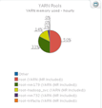



BMC Day
Chicago
March 2, 2017
Loews Chicago Hotel
455 North Park Drive
Chicago, Illinois, 60611
Phone: 312-840-6600
Reservations: 1-844-204-5639
Notes:
=======
http://bmcdays.bmc.com/chicago/
Explore Digital Transformation at BMC Day Chicago
Join us on Thursday, March 2nd 2017
Get the tools, training, and technology you need to drive digital transformation in IT and business.
BMC Day 2017 in Chicago offers you a full agenda of IT management topics, networking, and exposure to BMC products and solutions. Participate in discussions on strategies, best practices, and technologies with BMC experts, industry thought leaders, and your peers.
This event will enrich your professional development in three ways:
Learn: Discover new strategies and solutions for top IT challenges in your organization.
Connect: Interact onsite and online to expand your professional network and social contacts.
Advance: Deepen your understanding of trends and technologies that are fueling digital transformation.
Mark your calendars for BMC Day in Chicago, part of our global IT management event series
Track 3 – Performance, Capacity & Analytics
2:20 – 2:45 Customer Case Study, Actionable Intelligence using filter based reporting
Ben Davies, Senior IT Metrics and Reporting Analyst at a very large insurance company, who is now a Senior Consultant at Moviri will review how to get Actionable Intelligence using the tools and techniques of filter based reporting in BCO. These techniques are independent of how the workspace is organized. These tools and techniques are valid as soon as the first ETLs are implemented.
As a Moviri consultant, Ben Davies applied these tools and techniques, delivered Actionable Intelligence within 10 minutes of starting the reports. This is a powerful tool that is relatively easily deployed but takes some practice to use well.
===
Session 2B: Insurance Customer Case Study, Actionable Intelligence using Filter Based Reporting; Speaker: Ben Davies, Senior IT Metrics and Reporting Analyst at a very large insurance company, who is now a Senior Consultant at Moviri
Ben Davies will review how to get Actionable Intelligence using the tools and techniques of filter based reporting in BCO. These techniques are independent of how the workspace is organized. These tools and techniques are valid as soon as the first ETLs are implemented.
As a Moviri consultant, Ben Davies applied these tools and techniques, delivered Actionable Intelligence within 10 minutes of starting the reports. This is a powerful tool that is relatively easily deployed but takes some practice to use well.

Slide 2
Filter Based Reporting with TrueSight Capacity Optimization
Actionable Intelligence Series
BMC DAY CHICAGO
Loews Chicago Hotel - 2017, March 02
Ben.Davies@Moviri.com
We make heavy use of the notes section.
Notes:
Good Morning, Welcome to BMC Day in Chicago. This is the Filter Based Reporting with TrueSight Capacity Optimization session. Part of the Moviri Actionable Intelligence Series.
We make use of the notes section, so down load the presentation and see what sort of Scooby Snacks are in the presentation.
There is a test later.. The answer is “Filter Based Reporting”. Lets say it together….. Filter Based Reporting.
======
This is part of the Moviri Actionable Intelligence Series of presentations.
Presentation developed January 2017, it applies to BMC Capacity Optimization product 9.x and 10.x
The tools and techniques presented here are highly customizable for particular purposes. While examples are presented here, this is not the only way to apply the tools and techniques.

Slide 3
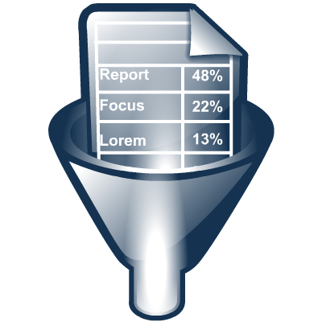

Agenda
Quick introduction
Problem statement
Current State
Solution
Deliver Actionable Intelligence
Questions
Notes:
Today we will do a quick introduction, present our problem statement, expand on the current state, then propose a solution. Finally we will open up for questions but feel free to ask clarifying questions as we go.
The intent here today is for you to get an idea of how you can use these tools and techniques to deliver actionable intelligence to your environment.
The tools and techniques presented here are highly customizable. While examples are presented here, this is not the only way to apply the tools and techniques.
====

Slide 4
Introduction To Two Versions Of Mr. Ben
Ben Davies - TSCO Power User
Ben Davies - Movirian
Capacity Planning for 4 years using seriously cool Excel spreadsheets
Power User of TSCO for 3 years making several presentations at Engage
Developed tools and techniques to deliver actionable intelligence using TSCO. Including this one
Now as a Movirian (one of the cool kids at Moviri) We can help you explore these possibilities, help implement and help them deliver actionable intelligence to your organization.
So, call us. We can be cool together.
Notes:
My Name is Ben Davies and I did capacity planning for four years using a seriously cool Excel spreadsheet, then was a power user (for 3 years) of TSCO with a large insurance carrier here in Chicago. While there, I created these tools and techniques to improve my ability to report on items of interest in real time, like on phone conversations, or during active investigation and analysis efforts.
The company outsourced much of IT, including capacity, and I was fortunate enough to become one of the cool kids at Moviri.
This matters because if I gave this presentation a year ago, and you wanted to explore it more, the best I could do is give this presentation.
But now. Now with Moviri, I can spend as much time as you wish to explore how you can use this technique and even help you set it up and make it work for your team. If you wish to explore this option, call us, we can be cool together.

Slide 5
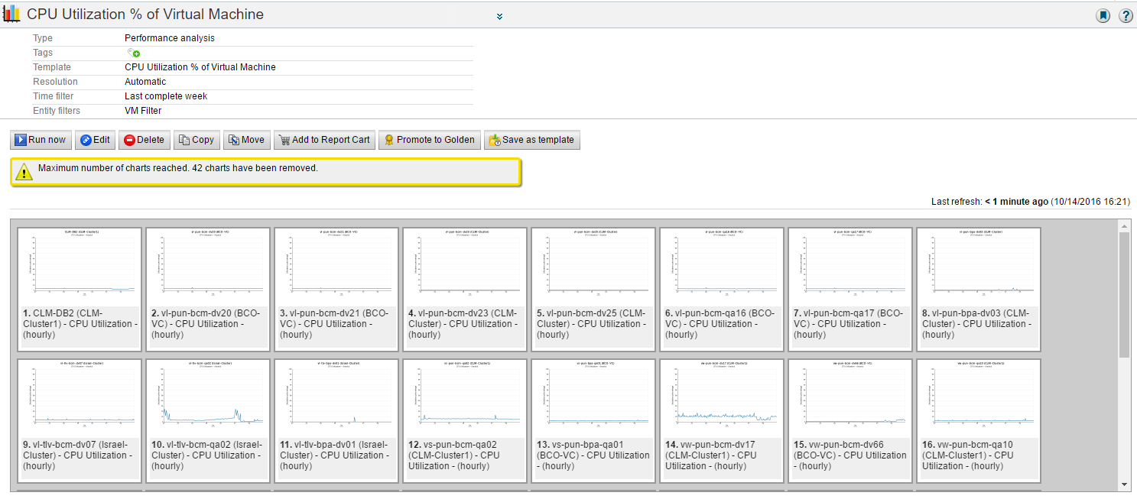
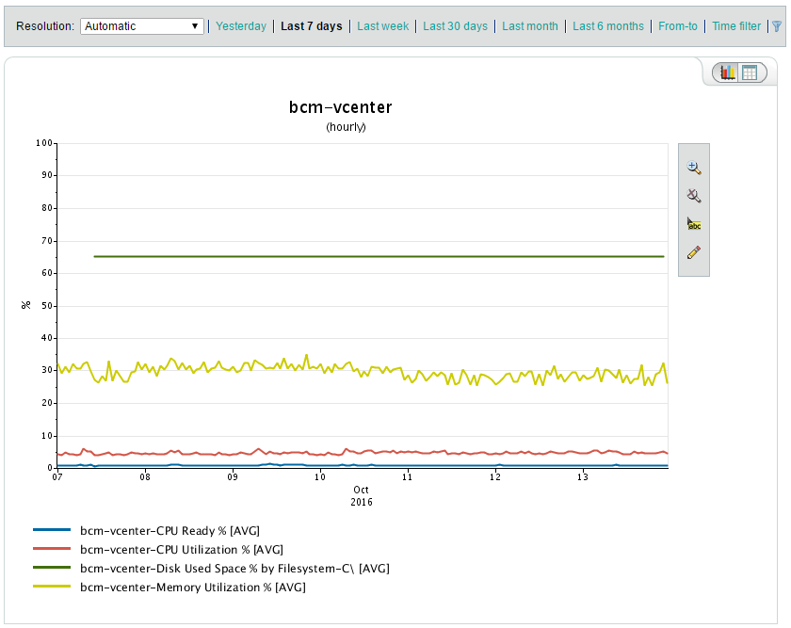
The Situation
Quick Analysis
Works Reporting
Notes:
The situation with TSCO reporting is that there are two basic reporting options. Quick Analysis and Works Reporting.

Slide 6
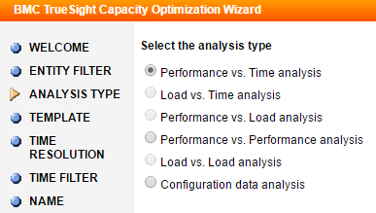
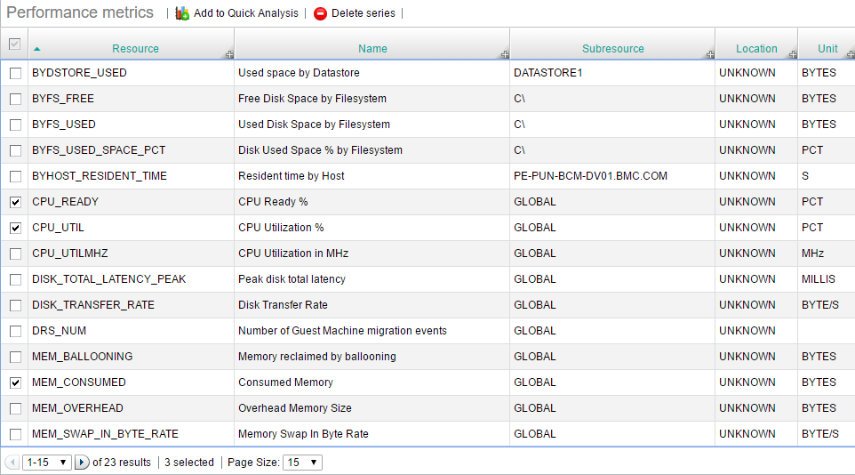
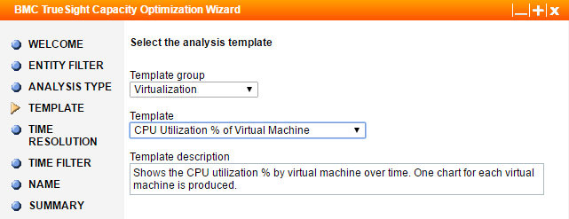
Problem Statement
Quick Analysis
Works reporting
Notes:
The “problem” is that these two reporting tools and techniques have benefits and limitations.
Quick analysis is by definition quick, in that any metrics can be compared to any other metric very quickly, but not formatted quickly.
Works Reporting can be formatted to present information ‘just so’ but can not quickly change metrics.
Lets explore these is more detail.

Slide 7
Quick Analysis
Metrics can be added or removed easily from the chart.
Takes time to select each metric if metrics are across several systems.
Notes:
Quick Analysis easily places any metrics on one chart . Objects are chosen easily and removed from the chart easily.
This is a great technique and you should be using it often.
But … this does not remember your ‘favorite’ report methods, tools, and techniques. And it takes some time when there are several objects to report on.

Slide 8
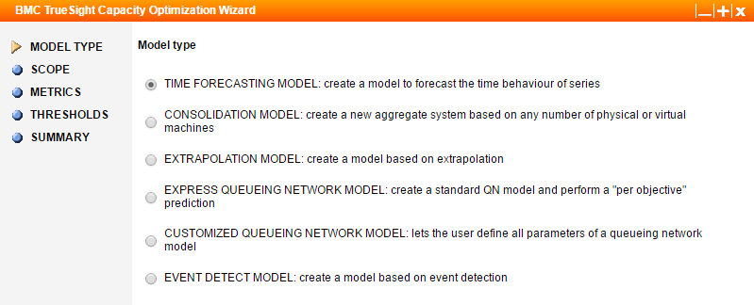
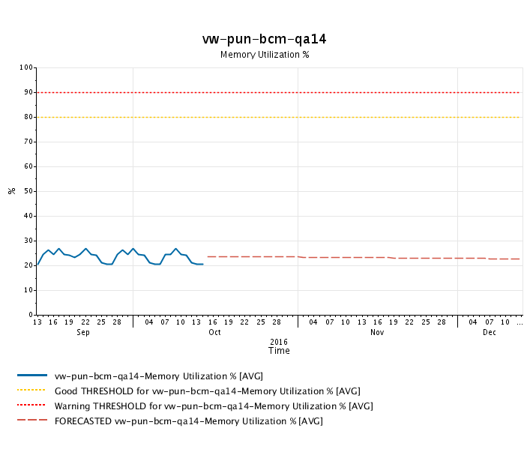
Works Reporting
Have the option to create different types of analyses, and use templates.
Can also create models and reports, which compile your data in a nice, digestive way.
Difficult to define objects not already in a ‘bucket’
Notes:
Works Reporting remembers your ‘favorite’ report methods, tools, and techniques. You can save different versions for specific types of analysis, and can copy from one ‘bucket’ to another.
I have made hundreds of these, use them freely and often.
but does not lend itself to changing the objects in the charts, as they are anchored to the ‘buckets’

Slide 9

What is an Analyst to do??
Quick Analysis
Works Reports
Quick to make
Not easy to change
Can have many different types of custom reports
Not easy to change objects
Hummm.
I wish a mix of each.
Is there such a thing?
Suck Less
Notes:
So what is an analyst to do??
This is the dilemma I faced. What is an analyst to do when I know my favorite chart layouts to quickly identify the actionable intelligence, but can not easily define my data, or can easily identify my objects (quick analysis) but then have to modify the chart significantly.
What I need is a mix of Quick Analysis and Works Reporting. Is there even such a thing?

Slide 10
Is There An Alternative?
The Best of Both?
Quick Analysis
Can have many different types of custom reports?
Super Easy to change?
Works Reports
Quick to make
Not easy to change reports
Can have many different types of custom reports
Not easy to change objects
???
???
Notes:
IS there an alternative?
Is there an alternative that allows for reports to be setup ‘ahead of time’ like in the Works Reporting solution, and the objects to be reported on, supplied ‘just in time’ like in the Quick Analysis idea.
To be clear this third option would NOT replace the other two methods, but rather, to supplement them
So what do you think? Is there a solution?? We should put on our thinking caps, or in my case my Suck Less hat on and work on a solution.

Slide 11

Time for the Suck Less hat…
Notes:
Well Lets put on our thinking cap – or Suck Less Hat

Slide 12
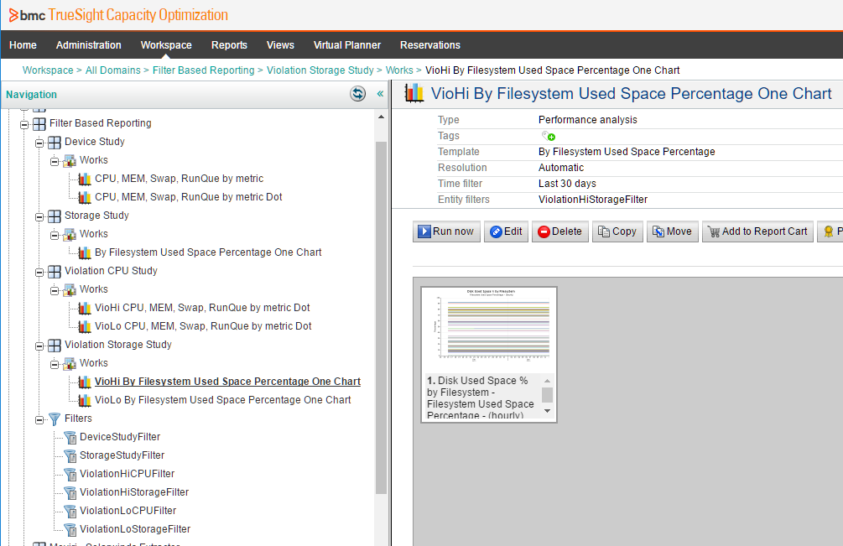
Filter Based Reporting
New hires 2013 (+ 10%)
Filter based reporting looks like this:
Several reports are staged for particular investigative topics.
A device based study,
storage study or
storage in violation of thresholds.
Each study type has its own filter.
Objects are selected just in time, placed in the filters and the reports run.
Filters can be searches.
Notes:
Remember before that you would be asked a question. What was the answer???
So if you said that “Filter Based Reporting” then you would be right.
What IS “Filter Based Reporting”???
Filter Based Reporting is reporting where the chart contents and formatting have been developed with a particular objective in mind, then the objects contained in the report is chosen at report time by being defined in a filter.
This allows for the best of both worlds. The charts are formatted as desired to make quick actionable intelligence determinations AND the objects are chosen just in time.
Filter based reporting looks like this:
Several reports are staged for particular investigative topics. Such as a device based study, or storage study or storage in violation of thresholds study.
Each study type has its own filter.
Objects are selected just in time, placed in the filters and the reports run. The filter can be based on searches, even complex searches.
In this example there are only a few charts but there is no limit. One filter drives a whole series of charts.
--
So lets look in detail how this works.
Device study, the first section, has a couple of charts. Those charts are driven by the filter DeviceStudyFilter. So set the filter, then run the charts.
Storage study, the next section, has a chart. That chart is driven by the StorageStudyFilter. Again set the filter, then run the chart.
The last two sections each report has its own filter. They just got mixed up alphabetically. Anyway same idea, set the filter, run the chart.
====
https://docs.bmc.com/docs/display/btco105/Entity+filters
https://docs.bmc.com/docs/display/btco107/Managing+entity+filters

Slide 13
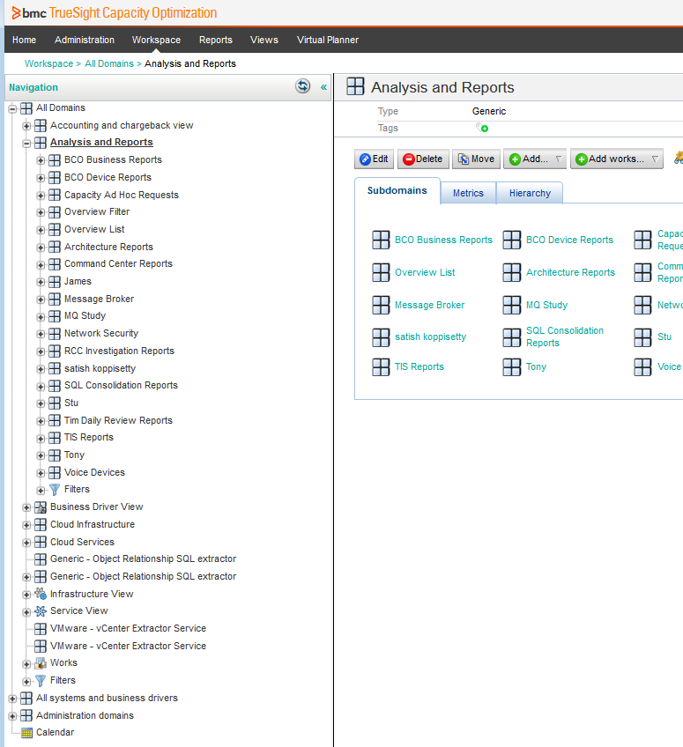
Analysis And Reports Section
2
Setup an Analysis and Reports section and dedicate a ‘space’ to each person or mission.
We setup on for the ‘Capacity Group”, Architecture Group, Command Center, Network Security Group, Database Group and others as they decided to use this technique.
1
Notes:
We setup an Analysis and Reports Section and dedicate a ‘space’ to each person / mission / use case.
We setup one for the “Capacity Group”, “Architecture Group”, “Command Center”, “Network Security Group”, “Database Group”, and others as they decided to use this technique.
(The filters place at the bottom of the list supplies filters potentially to all of the sections, but most groups made their own filter groups.)
This is an excellent way for non capacity users to gain value from TSCO. These users can make their own actionable intelligence. On their own. Without your help.
In the next slide we will look in the Command Center Report bucket 1. Then the Capacity Ad Hock Request bucket 2

Slide 14
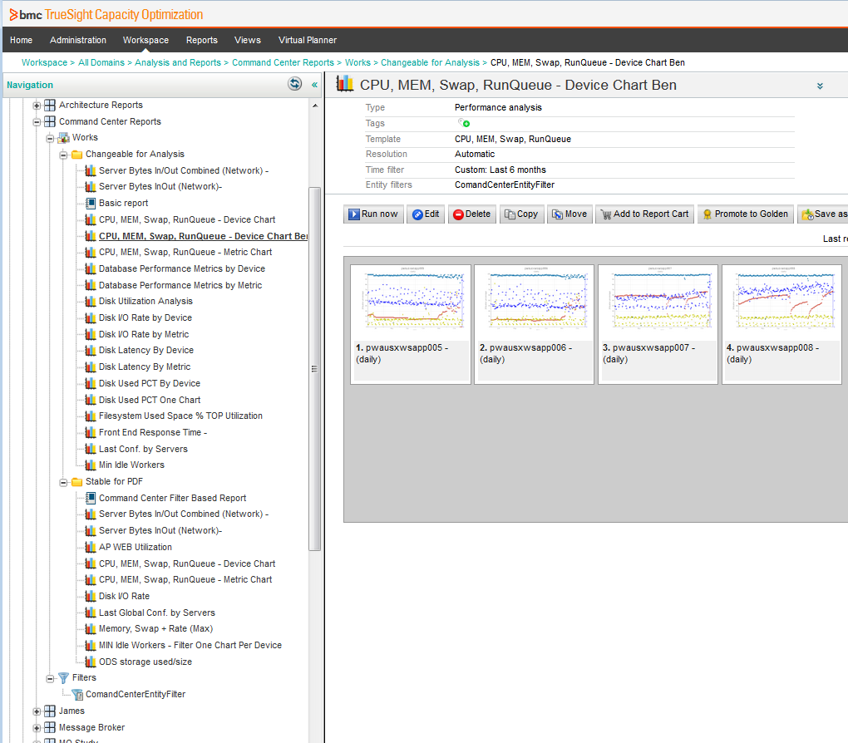
Use Case – Command Center / Help Desk
This group of reports are for the command center. As new situations arise, new reports are generated, then re-used when a similar situation comes up again.
Systems are identified and placed in the filter.
One filter drives all of these reports.
Notes:
The Command Center / Help Desk for example, has a series of reports predefined. All of these reports are driven from the ONE filter CommandCenterEntityFilter. You can see which filter is driving the report in the top right section, next to Entity filters.
When a system or set of systems comes up in the context of a call or investigation, those systems become the filter, and the appropriate reports are run. So when you are investigating storage set the filter and run the storage reports. When investigating the database, set the filter and run the database reports.
As this technique is used additional charts are created. Eventually you end up with a significant collection.
Some for very specific purposes.
This technique is fast. A quick filter and a few reports can draw attention to a particular device or allow the focus to move to other devices, which then changes the devices in the filter, and the reports re run. This can be done very quickly.

Slide 15
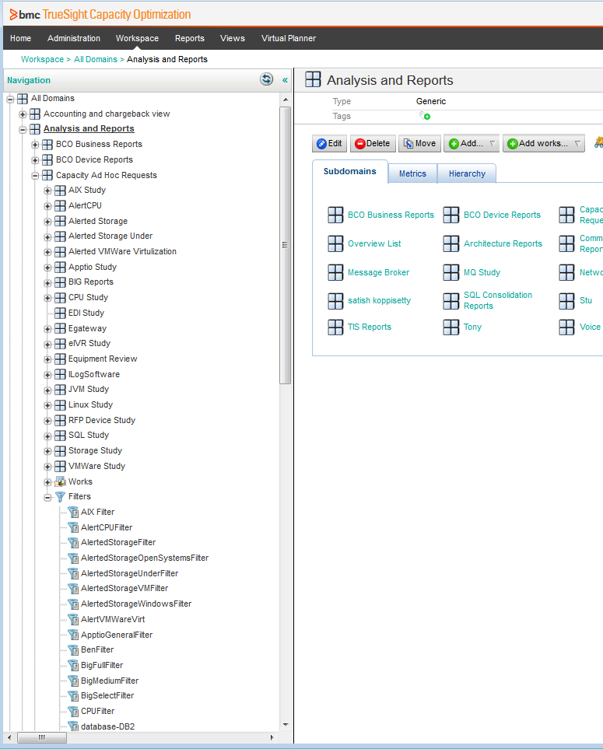
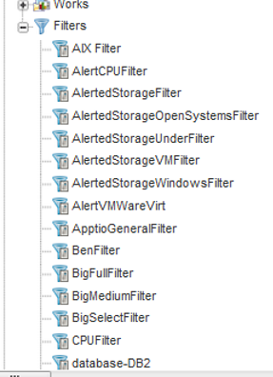
Use Case - Capacity Ad Hoc Requests
In this section, there are so many reports they are placed in folders. The filters are in one list which allows reports to be copied to a folder and pointed to a new filter.
Easily Sharing reports helps to create a “Study Group”
Notes:
This use case is that of the capacity team, which is involved in a whole host of investigations and conversations, so they have a bunch of reports grouped together for particular mission or study group.
To study AIX devices for example, place the search string in the AIXFilter, then run the AIX reports. Maybe there is a generic search of tag:AIX that may be modified to narrow the pool. Anyway, the collection of reports are easily run and are formatted to show actionable intelligence. The most useful reports can be shared with other studies by copying, then changing the filter that the new report is looking to.
On the next slide we go to Alerted Storage.
====
There is some nuance to this technique and you will have to ‘play with it’ to make it work for you.

Slide 16
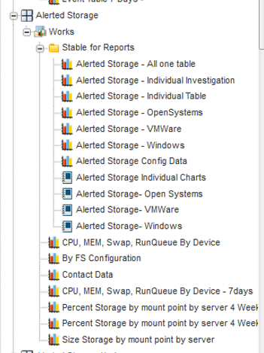
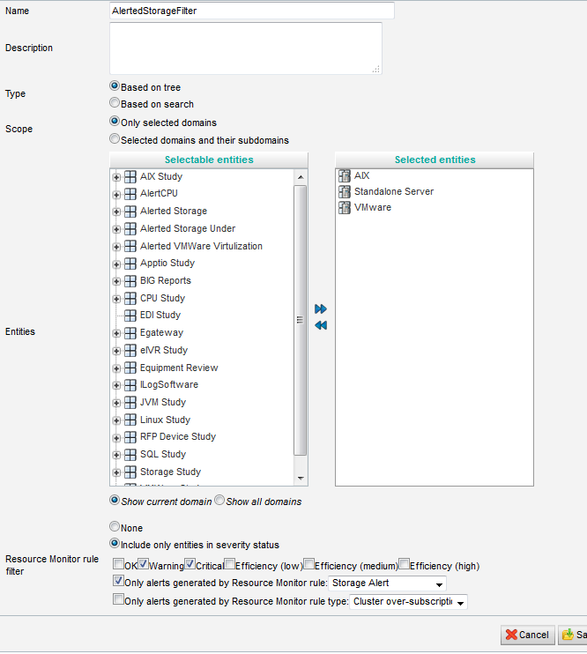
Use Case - Alerted Storage
Notes:
This use case is about alerted storage. First make a “Resource Monitor” rule (right side, and next page) with the intent to use it within the alerted storage report group (left side).
This rule says “Look in AIX, Standalone Server, and VMWare domains and devices marked that violate the resource monitor rule “Storage Alert”

Slide 17
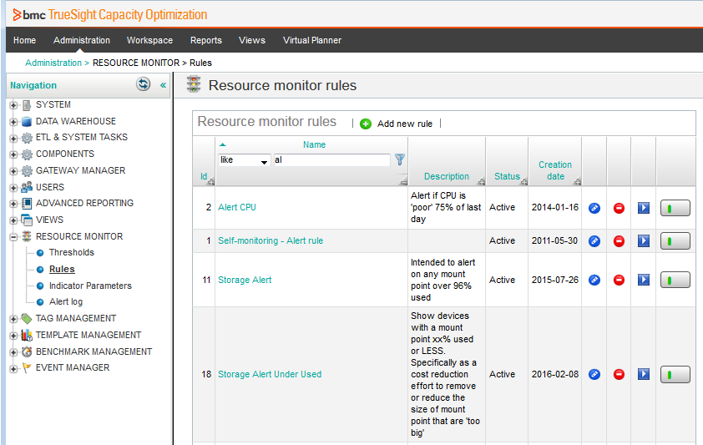
Resource Monitor
Notes:
If you have not seen a monitor rule, here is an example.
The storage alert said alerts on any mount point that is over 96% used.

Slide 18
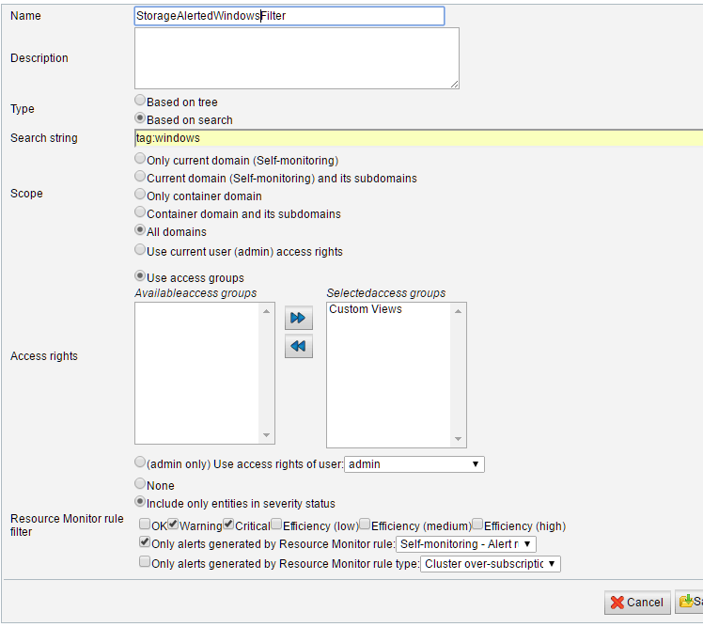

Use Case - Alerted Storage Windows Filter
Combine filters. In this case it is tagged with Windows and in marked with a storage alert.
This filter drives a single specialized report.
Notes:
This use case is on alerted Windows storage. Here we combine an OS based filter with a resource monitor rule to flag devices.
You can make a report that shows all Windows devices that have triggered the storage rule. And a separate report that shows all VMWare devices that have triggered the rule.
These reports can be run directly by the technology owners to monitor their environment. Our reports give a historical chart with the lasts 180 days of history, so that the mid term history can be evaluated. A stable 98% may be less concerning than a volatile 85% device. The reports give enough information to easily show actionable intelligence.

Slide 19
Example Search String
Any search string can be used in a filter,
And you can test the search string in the TSCO console
And combine with tags (if you use tags)
And combine with ( AND OR + - ) *
(type:sys –type:object)
(+(tag:AIX AND sys:p* NOT sys:*@*) –type:object
(((sys:*app01 OR sys:*app02) AND tag:Unix) –type:object)
Notes:
So what do these search strings look like in filters?? Here are a few examples.
Note that
Any search string can be used in a filter,
And you can test the search string in the TSCO console
And combine with tags (if you use tags)
And combine with AND OR + - ( brackets ) *
The middle filter says Include everything tagged AIX, and starts with a p, which is probably production; but NOT systems that have an @ in the name. Also excluded anything that is a type ‘object’, which are reports
====
Further information
https://docs.bmc.com/docs/display/btco107/Search+string+syntax
https://docs.bmc.com/docs/display/btco107/Managing+entity+filters
https://docs.bmc.com/docs/display/btco107/Adding+tagging+rules

Slide 20
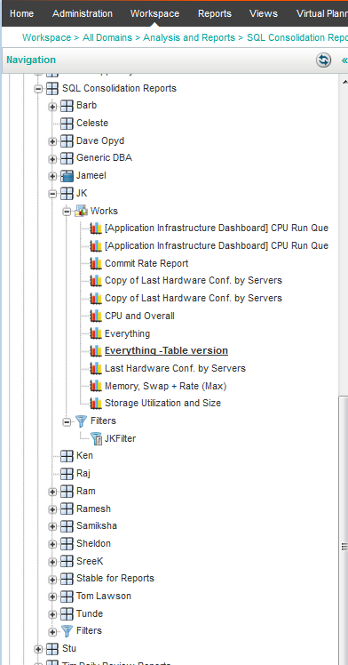
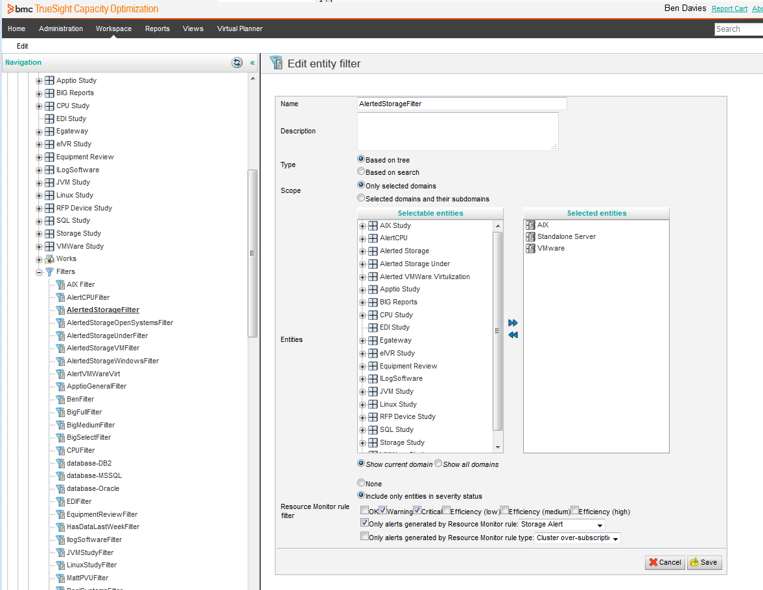
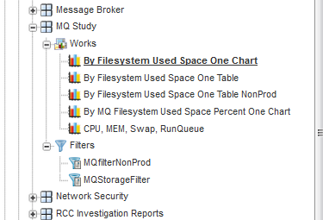
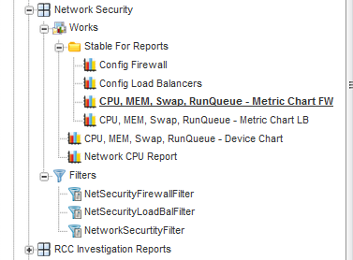

Slide 21
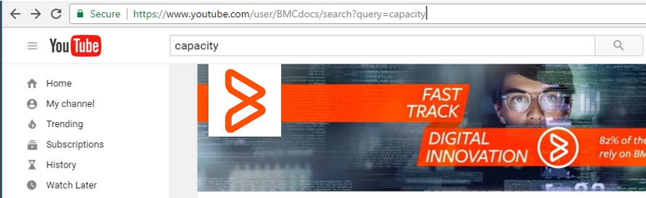
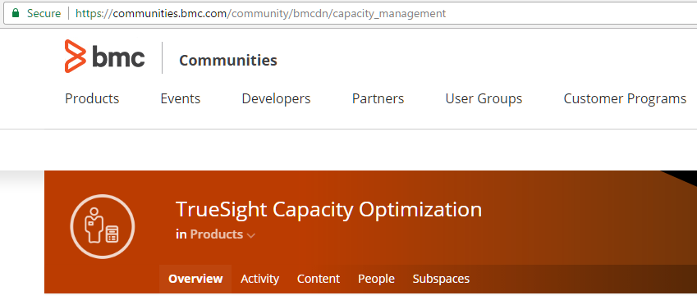
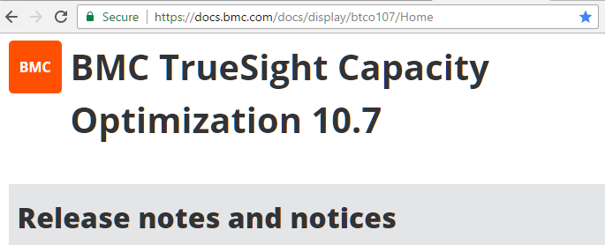
Available References
Notes:
There is a lot of help with the individual components.
The support site, Everyone should be using the support site.
a YouTube channel, Who knew BMC had a YouTube channel?? There is a sub channel for capacity
the Communities, The communities is a good place to get questions answered. Many users have said how they solved problems even if it were not the official BMC suggestion. This is a place that gets better the more people that use and contribute to it.
the 4 thousand page user document. I refer to this document a lot, especially as I try new things. So I would go to a talk like this, then use the document to clarify what things are and how they basically work. There are 6 pages of search syntax
However, putting this all together can be bit confusing. So give us a call and we can help stich together a solution with you.
Using these tools and techniques, It won’t take long for YOU to be finding ACTIONABLE INTELIGENCE with your data.
======
https://www.youtube.com/user/BMCdocs/search?query=capacity
https://communities.bmc.com/community/bmcdn/capacity_management
https://docs.bmc.com/docs/display/btco107/Home

Slide 22
Thank you
Questions??
Give us a call, Let us help you
Deliver Actionable Intelligence
Notes:
And that is the presentation…
We hope this helps YOU deliver actionable intelligence
Questions??

Slide 23
Keywords and Concepts
Questions??
Quick Analysis
Works Reports
Filter based reports
Search strings
Update filters –
filters drive reports, drive filters
Resource Monitor rules
Separate report section
Sub sections for groups / mission
Copy reports
Deliver Actionable Intelligence

