Slide 1

INCORPORATING WEATHER DATA INTO CAPACITY PLANNING ANALYSIS:
AN EFFECTIVE APPROACH TO MAKE IT RESILIENT DURING ALL SEASONS
2017/11/09
Mr. Ben Davies – ben.davies@moviri.com
Notes:
Good afternoon.
Welcome to the CMG impact session 412 “Incorporating Weather Data Into Capacity Planning Analysis”. This is a conversation about trying and failing, to get weather data incorporated into our capacity planning effort. The original intent was to use this to help liberate other business data that we wanted to incorporate into our capacity planning efforts, which we eventually did. Along the way we stumbled into using weather data to forecast a spike in VPN and VDI usage.
Note that a paper was submitted for publication in the CMG Journal. So look out for that, or come talk to us.
We have a booth in the vendor area, and would love to talk to you about this or any of our other presentations.
===
Congratulations! It is my pleasure to notify you that your paper "Incorporating Weather Data into Capacity Planning Analysis" has been accepted for the CMG imPACt 2017 Conference to be held November 6 - 9, 2017 in New Orleans. The Program Committee has scheduled your paper to the following session.
Author(s): Benjamin Davies
Session Number: 412
Subject Area: CAP
Session Date and Time: 11/9/2017, 11:00 AM-12:00 PM
Room Assignment: Beauregard

Slide 2
Agenda
Business Need
Solution Summary
Benefits
Solution Description
Lessons Learned
Questions & Answers
Notes:
Today we will cover what the business need is (was), our solution summary, the benifits of this solution, description of the solution, lessons learned then open up for questions.

Slide 3
Business Need

Slide 4
Business Need
Encourage data owners to liberate Corporate data.
“These data are Corporate assets and must be liberated to all legitimate purposes”
We used weather data to make the point that ‘non capacity’ data can inform capacity conversations.
The new business need then became to leverage weather data vs. VPN systems and VDI systems, and Insurance claim counts.
Notes:
The business need in this case was to encourage data owners to liberate their metric data to the capacity team for capacity studies.
Our mantra became: These metric data are Corporate assets and must be liberated to all legitimate corporate purposes.
Every data owner were resistant to this revolutionary (for us) idea.
The capacity team decided to incorporate weather data into the capacity studies and show that ‘non capacity’ metrics were, in fact, useful metrics to account for in capacity studies.
The “business need” then became to leverage weather data into the existing capacity plans of the VPN (Virtual Private Network) systems, the VDI (Virtual Desktop Infrastructure) systems and insurance claim volumes.

Slide 5
Solution Summary

Slide 6
Battle Plan
Battle Plan:
Just go get weather data
Put it in BCO
Make observations and actionable intelligence
Narrow focus:
  Is weather a key driver for insurance claim volumes?
  Is weather a key driver in work from home infrastructure utilization?
Notes:
Our battle plan was to ‘just go get weather data, put it in BCO (BMC Capacity Optimization), then make some comparisons’.
Like most battle plans, it did not survive long.
We had to modify the plan to narrow the scope to some specific thesis statements, that we could then attempt to prove (or not).
The thesis statement became “determine if and how weather conditions affect customer interaction, employee behavior, and infrastructure utilization”.
It was further narrowed to these thesis questions:
Is weather a key driver for insurance claim volumes?
Is weather a key driver in ‘work from home' infrastructure utilization?

Slide 7

Inventory
Inventory what is needed vs. on hand
  Insurance claim volumes - Check, in BCO
  VPN use counts – Check, in BCO
  VDI use counts – Check, in BCO
  Weather Data - nope
Notes:
To answer the thesis questions, it is clear that we need the business metrics:
The insurance claim volume, already present in BCO
The work from home metrics in terms of
Total authorized VPN and VDI users
VPN and VDI connected users
Bandwidth statistics (In, Out, Available)
That left only the “weather data”….

Slide 8
Find Weather Data
Data was public and free, now mostly pay for data sites
The weather data is in CSV format
Method of iterative brute force:
  Compare metrics
  Make observations
  Prove thesis statement
Notes:
Weather data can be collected for free from the internet.
Finding a site to connect to at the time was easy as I remember. Looking now yields paid sites, and a lot of projects that have compared other metrics vs the weather. (Like crime vs the weather - http://crime.static-eric.com/
and how weather is ruining sex - http://www.smh.com.au/comment/how-climate-change-could-ruin-your-sex-life-20151105-gkrc67.html
or how weather determines the sex of lizards https://www.sciencealert.com/scientists-find-australian-lizards-that-swap-gender-in-hot-weather )
Weather data was in CSV format. While other formats were available this was the easiest for us to use.
We gathered weather data and compared with business metrics. The overall method was one of iterative (brute force):
Compare metrics
Make observations
Try to apply this to prove or disprove our thesis statements.
Sometime this caused us:
to find new data
clarify the definition and meaning of existing data
alter our understandings of the systems and sub systems involved
and revise the thesis statement.
We quickly found out that ‘the weather data’ is an incompletely defined term, since you need to grade the combination of weather conditions (temperature, humidity, precipitation…) into a single metric. Good day, ice day, cold day, snow day etc.

Slide 9
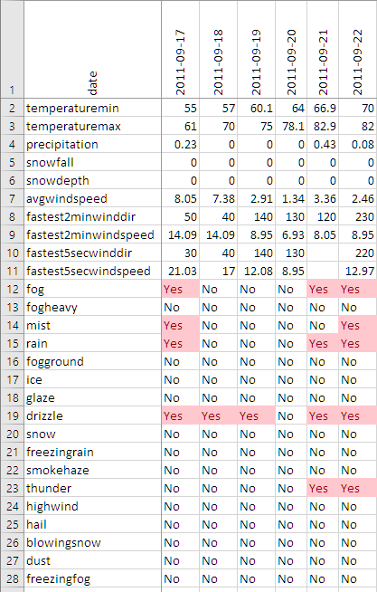
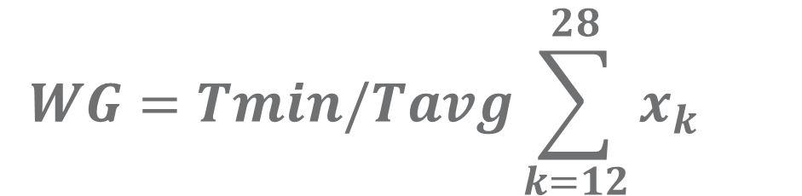
How to ‘grade’ the weather for a day
Temp not useful by itself
Tried a formula
Tried a formula to account for season and region. Never came up with a formula that made sense.
$$WG=Tmin/Tavg\sum_{k=12}^{28}{x_{k} }$$
Rubbish formula to show the stuff we tried.
Notes:
Here is a bit of weather data. Temperature was not useful by itself. We thought of grading a good day or bad day based on rain, ice or snow. So the first column could be temp /seasonal average – (sum of lines 12 through 28) Or some such non sense. But a good winter day is quite different than a good summer day.
We used a score as viewed through the lenses of that region. 110 in Arizona (a good day) is quite different than 110 in Chicago (uncomfortable day). We also tried to define vs season. 40 and sunny in the winter (very good day) vs 40 and raining in summer (not such a good day)
We wished a single ‘day grade’ so that we could compare one weather metric to one business metric. (claim count, VPN login, VDI login)
By this time we realized that the business metric data would never match as it was never going to become a small enough region to compare to regional weather data. Combining regions was silly as one day could have 9 different ‘day grades’ throughout our five state regions.
Other studies we found on the internet were based on smaller geographic regions so temperature was used along with precipitation (snow, rain, ice etc.). This worked in there studies.
Matching geographic weather to geographic metric count is necessary, and we did not have it.

Slide 10
Equal opportunity causations
People being inside or outside did not diminish their propensity to hurt themselves.
Dumb luck and dumbassery are equal opportunity causations for injury. Inside, outside, good weather or bad
Notes:
We found that the insurance claim lifecycle is not consistent enough to correlate claim count to the weather. The time between being hurt (weather related or not), to filing a claim is haphazard, and one event may create dozens of claims over extended periods of time. Claims that are not weather related overwhelm any weather induced claims. While the actuarials could tell the cost of the claims that were ‘weather related’, the counts of claims on a given day, did not correlate to the weather.
We also found that the weather driving people inside or outside did not diminish a person's propensity to hurt themselves, as measured by claim counts. Dumb luck and dumbassery are equal opportunity causations for injury. Inside, outside, good weather or bad. One can rock climb indoors and even sky dive indoors. We have even combined sports that can be played anywhere. Cycle Ball and Unicycle Hockey
https://en.wikipedia.org/wiki/Cycle_ball
https://en.wikipedia.org/wiki/Unicycle_hockey

Slide 11
Benefits

Slide 12
Benefits
Expected benefits:
‘Non capacity metrics’ would be made available for our capacity studies
Our studies would be better informed and more accurate
The capacity tool would be used to answer other business questions (free business value)
We achieved all of these benefits
Notes:
Our expected benefits are that having more ‘non capacity’ metrics, enrich the capacity studies and make them more accurate.
Moreover this additional data would be used to attract more users to the capacity tool, to answer other business questions (not related to capacity) and increase the value of the tool.
We achieved all of these benefits

Slide 13
Why non capacity data is helpful
Sales Start dates and end dates VS. Web traffic
Promotions, coupons vs. Call for information
Social media driving web and calls.
Notes:
We wished non capacity data so that we could help the business look for forecast artifacts that relate to the business. Sales start date and end date as compared to web views (and CPU use on web sites)
Promotions, coupons, tv ads, and other artificial drivers of web traffic to show a ‘spike’ is in relation to these forces OR NOT.
We found that web traffic spikes (small but noticeable) were driven from news stories, social media and other sources outside our control.
Noticing that social medial drove some web use helped convince the business units to create social media offices .

Slide 14
Understand your data better
Claim counts are not original claims
Doctor visit with x-ray vs Doctor visit without x-ray Huge difference in claim count.
We got a better appreciation of what the count was more exactly
Notes:
One of the benefits as we got a better understanding of the metrics we though we understood.
Claims processed seems straight forward but these are original claims, reprocessed claims from before, follow-on claims, secondary provider claims, medication claims etc.
What we found out was one doctor visit with x-ray (for example) could yield a dozen claims. Dr. office, x-ray, x-ray reader, consultant, specialist service, pharmacy, nursing, and office visit. But a Dr. visit without x-ray was the office visit and Dr. time and were probably on one claim.
Our assumptions were dispelled and we ended up with better appreciation of what the count of work was exactly (or more exactly).

Slide 15
Solution Description

Slide 16
Finding a Correlation with Claims
Finding a correlation with claim data was super difficult.
We had the global daily claim data, but NOTHING made sense to compare to local weather data.
Notes:
Finding a correlation with insurance claims data was super difficult since we had data which comparison made no sense: all of our claim counts were global daily counts in a single large bucket, but our weather data was hourly based on a dozen of our largest serviced cities.
In detail all the claims were related to business unit and not regional. Data were not divided in offices.
Moreover often claims occurs days later than the actual injury.
This makes weather data not comparable.

Slide 17
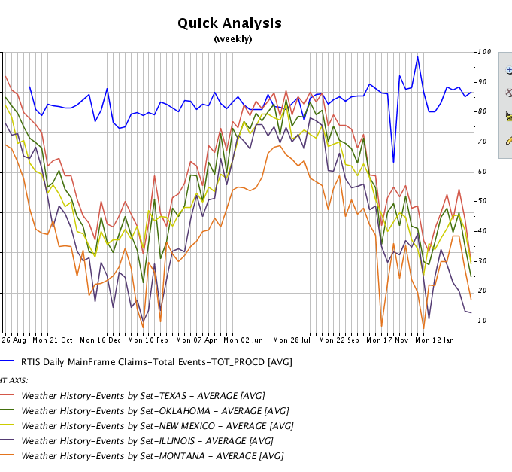
Claims Submitted VS. The Weather
Notes:
In this chart we can see the number of claims per weeks submitted in 5 different cities. There is a slight increase in the number of claims submitted over the time of the chart. This is driven by acquiring more members, the fluctuation in the claims line is within the ‘voice of the process’, except the Nov and Dec variations which are driven by external forces, not the weather.
The determination made is that, even with the limits of these metrics, claims are submitted in a regular cadence, so even if the weather is a meaningful component, there are likely other components that impact the claims submission rate as well. Therefore, such a simple comparison (average temperature vs claim submission rates) is not sufficient to determine the impact of weather on claim submission rate.
http://www.isixsigma.com/dictionary/voice-of-the-process-vop/
How you use that data is up to you. Play around with the tools you have, make mistakes and learn from them. Analysis isn’t black and white, make sure you are looking at the problem from all angles.
===
TSCO will allow you to compare any number of metrics. We have compared insurance claims against the weather, with the thesis of good and bad weather increases the rate at which claims are submitted. Assuming that when the weather was nice people would be out more, and get hurt more. When the weather was bad, people would be skiing (and other winter sports) and get hurt more. We found that people file claims independent of the weather. OR that the process of submitting claims mutes any fluctuation that would have indicated a connection to weather. OR that the metric of average temperature is a poor proxy for the weather that would drive behavior that would result in more or less claims being filed.

Slide 18
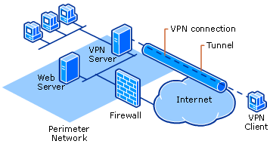
Forecast VPN Vs Weather
Notes:
Local weather did not impact VPN in a significant way. No weather events drove VPN over background variation. The largest driver to increased VPN use was a ‘modernization’ of business process that made work from home a more normal business operation mode.

Slide 19
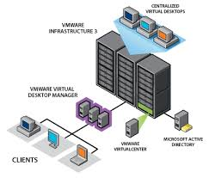
Forecast VDI vs. Weather
Notes:
Local weather did not impact VDI in a significant way. No weather events drove VDI over background variation. Here too business process modernization drove increases in VDI use.
We observed that IF an event would need additional VDI resources it takes several days to build servers and half a day to incorporate that into the pool. Internal efforts were then dedicated to shorten build times. These efforts would prove most helpful, as we will see.

Slide 20
Finding a Correlation with VPN and VDI
Weather correlation was a bust!
Cultural events drives spikes in VPN and VDI
Notes:
Analyzing VPN and VDI we found weak to no correlation with the local weather.
So again a bust.
But we DID find a correlation with big local cultural events. When there was a ‘large’ cultural event, mostly in Chicago, we found that many of the Chicago HQ employees would work from home, driving VPN and VDI spikes.
As the VPN and VDI environments were concentrated, these local surges did not overwhelm the systems.
While the observation was helpful, it was not actionable (nothing to change).

Slide 21
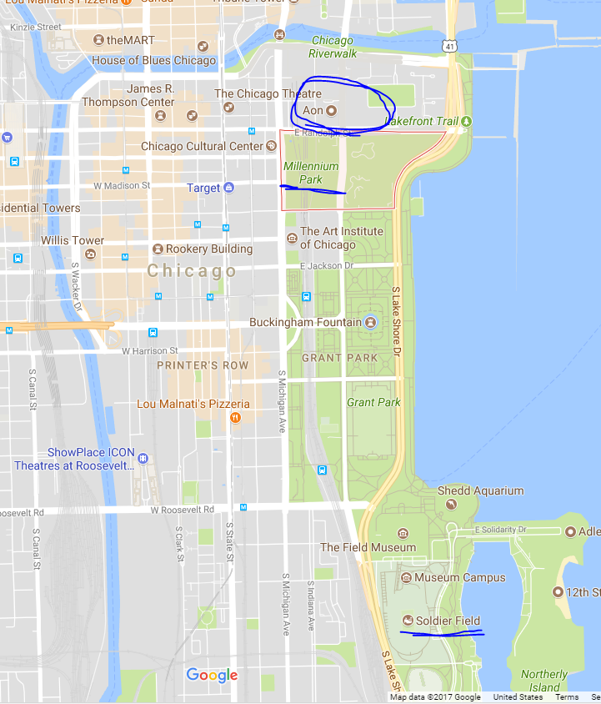
Big Local Cultural Events
Presidential Politics at the AON building
Black Hawks Win Sir Stanley’s Cup
Cubs World Series
Chicago Food Week
NATO Summit
Notes:
Chicago Cultural events impacted the office because it was at the north end of Millennium Park. And these events brought millions of additional people into the city, closed roads, and generally made the area around Millennium park a mess.
Our office is in the circle at the top of the map. Solder Field (Chicago Bears Stadium) is at the bottom and Millennium park is in-between.
The events that had a large impact was:
Presidential Politics at the AON building next to our building
Parades for Black Hawks Winning Sir Stanley’s Cup and the Cubs World Series win,
Also Chicago Food Week and the NATO Summit caused impacts.
===
2010 Chicago Blackhawks win Stanley Cup (June 2010)
2012 NATO Summit Chicago (May 2012).
2013 Chicago Blackhawks win Stanley Cup (June 2013)
2015 Winter Storm (Feb 2015)
2015 Chicago Blackhawks win Stanley Cup (June 2015)
2016 Presidential trips (April, October)
2016 Chicago Cubs win World Series (October 2016)

Slide 22
There we have it -
Local weather has
NO correlation with Global claims counts
NO correlation to VPN
NO correlation to VDI
Notes:
So there we have it. Local weather has NO correlation with global claims counts, NO correlation to VPN usage, and NO correlation to VDI utilization.

Slide 23
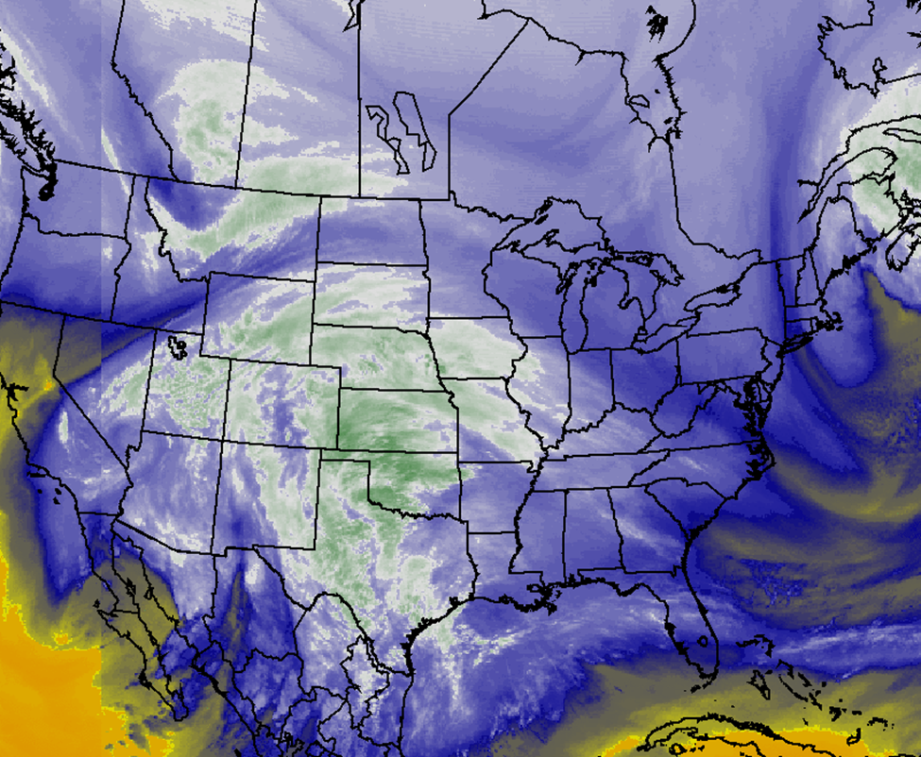
Except BIG Weather
February 2015 Snow
Notes:
While local weather did not drive large spikes, this big weather event surly would. As if it were a very large cultural event. Making a mess of not only Millennium part but half of the country.
The monster storm of Feb 2015 would combine these regional (cultural) impacts in not trivial ways. Our models predicted a five to ten fold increase in utilization of the work from home technologies and infrastructure. The various technology owners exercised the business continuity plan (which is distinct from a disaster recovery plan) and quickly reinforced the VPN and VDI capacity to service 7 times current capacity, and adjusted to accommodate the 8 times capacity spike seen for the week of the weather event.

Slide 24
Forecast VPN
Enough Server for 90%
Not enough bandwidth
Borrowed other Internet ‘pipe’
Notes:
Previous studies of VPN resources suggested that the hardware was ‘enough’ for 90% of the authorized user count, but the bandwidth would not ‘handle the load’. The solution to this was cleaver in that when there was 90% of the authorized users on VPN they would NOT be ‘in the office’, so the outbound internet connection would be leveraged via load managers, and clever network addressing to allow for inbound VPN traffic.
Essentially we would commandeer the outbound internet pipe for inbound use of the VPN.

Slide 25
Forecast VDI
Need to build more
Ended up with 8x more capacity
Notes:
VDI needed to built out. And our previous efforts made the build process less than a day. So by leveraging business continuity processes, disaster recovery equipment, and other resources (test and dev equipment) VDI was quickly expanded to 8 times ‘normal’ to account for the surge.

Slide 26
Significant Result
We stayed open – processing claims and answering questions
After the storm, the aftermath made travel hazardous, but still we remained essentially fully staffed using the work from home resources, and business process that made working from home a ‘normal business activity’. Yes, many people did take PTO (Personal Time Off), but quite a few did not, specifically because business processes were modified to use the work from home technology, and the technology was expandable to meet this demand.
Notes:
This is a significant result as these employees, working from home, allowed the company to function uninterrupted. While many other companies were closed, losing revenue and disappointing customers during a stressful time, we remained open and processing claims, answering provider and user questions, and reacting to the local demands of the storm as it affected our locations.
This was made possible by a few brilliant observations that a big weather event is equivalent to a cultural event (not local weather), and allowed the capacity team to combine and forecast cultural event type impacts on the network resources.
After the storm, the aftermath made travel hazardous, but still we remained essentially fully staffed using the work from home resources, and business process that made working from home a ‘normal business activity’. Yes, many people did take PTO (Personal Time Off), but quite a few did not, specifically because business processes were modified to use the work from home technology, and the technology was expandable to meet this demand.

Slide 27
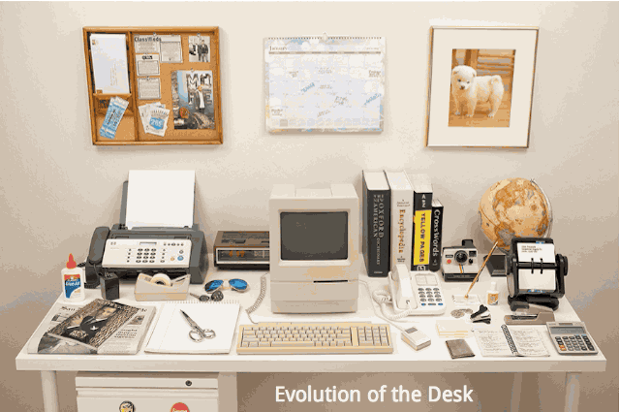

Budget Impact shown by the data
Notes:
Side note
Business modernization.. Expanded the demand for VPN and VDI which capacity detected and expanded the service. This was an unplanned un budgeted expense. IT got more expensive. However the business began closing small offices and saved real estate money.
This was a double bonus to the business as they got what amounted to free IT service and saved on real estate. Once this was ‘discovered’ it caused the typical uncomfortable conversation about how expensive IT has become.
<start the gif>
We found a GIF that illustrated all the items that used to be on the desktop that ended up on the computer. IT never got reimbursed for this value add. That is why IT is ‘so expensive’. The business quit paying for things that were now on the desktop but never transferred the budget to IT. It happened so slowly at first that no one noticed or did notice but were so excited that the computers were being used they did not mind.
But when the million dollar telephone system ended up on a $100,000 computer system, IT got more expensive, and the business quit paying the million bucks. Rinse and repeat and you have what we have today.
https://boygeniusreport.files.wordpress.com/2015/07/desk-evolution.jpg

Slide 28
Lessons Learned

Slide 29
Lessons Learned
Non capacity data is helpful for capacity studies.
Look at data for understanding, then capacity.
Each brilliant insight is based on dozens of failed thesis statements.
Notes:
Non capacity data is helpful for capacity studies.
Look for at data for understanding, then capacity.
Each brilliant insight is based on dozens of failed thesis statements.

Slide 30
And you can do this too..
If we were geographically smaller, weather data would have worked.
If we were nor right next to Millennium park
You should see these weather and social impacts on your network
Virtual cultural events too (well maybe)
Notes:
If we were smaller geographically the weather would have worked
IF we were not RIGHT NEXT to such a large cultural place, millennium park, the cultural events may not have been such a big deal.
I am sure there are observations to be made for your environment on these two points. Weather vs location. Cultural events vs location,
and I may suppose that virtual cultural events social media may cause spikes or valleys in your data..

Slide 31
Should have asked differently…
Side Note
Be careful of what your request sounds like.
Notes:
We have said it a few times now about ‘non capacity’ metrics. These are everything not ‘capacity metrics’ which are: CPU, MEM, Storage, and IO.
What we realized, way too late, is that we should have been MUCH more obvious and asked for ‘workload counts’ or something like that, rather than ‘business metrics’, ‘transaction data’ or ‘non capacity data’ which they heard as wanting the inside the transaction data (like names, dollar amounts, and other federally protected data).
With this understanding, they were right to reject our request out of hand and write us off as lunatics.
Once this was cleared up, thanks to our weather data examples, we got much of our use counts data and we achieved all of our expected benefits.

Slide 32
So there is a white paper on this as well.
In the CMG Journal
Or come talk to us. We have a booth in the vendor area.
Notes:
Note that a paper was submitted for publication in the CMG Journal. So look out for that, or come talk to us.
We have a booth in the vendor area, and would love to talk to you about this or any of our other presentations.

Slide 33
Questions & Answers

