Slide 1

Adventures with Charge Back
And the Value of a Useful Consistent Lie
2017/11/09
Mr. Ben Davies – ben.davies@moviri.com
Notes:
Good afternoon.
Welcome to the CMG impact session 2L6a "Adventures with Charge Back and the Value of a Useful Consistent Lie “. This is a conversation where, using a real-world example, we will explore our adventures with an information technology charge back system, and the value of a useful consistent lie.
Note that a paper was submitted for publication in the CMG Journal. So look out for that., or come talk to us.
We have a booth in the vendor area, and would love to talk to you about this or any of our other presentations.
===
Congratulations again on the acceptance of your paper/presentation "Adventures with Charge Back and the value of a useful consistent lie" for the CMG imPACt 2017 Conference to be held November 6 - 9, 2017 in New Orleans.
Author(s): Benjamin Davies
Session Number: 2L6a
Subject Area: CAP
Session Date and Time: 11/7/2017, 2:30 PM-2:45 PM
Room Assignment: Feliciana West
===
https://www2.eventsxd.com/event/3865/cmgimpact2017/sessions
ADVENTURES WITH CHARGE BACK AND THE VALUE OF A USEFUL CONSISTENT LIE
Tuesday, November 07 - 02:30PM to 02:45PM
Ben Davies
This is a summary of our adventures with chargeback, and the value of "useful consistent lies". Let's start with stating that change back is easy. Trivial even. It is simple math. What is your recovery target divided by the number of items expected to be 'sold'. There you have it. That is it. You are done. So what is a useful consistent lie, and what is its value?? Well it is everything around you and how you understand it. When your understanding is sufficient for the conversation, you use that understanding, that useful consistent lie, within the conversation, and the value of the useful consistent lie is that the conversation can now be conducted with a reasonable degree of mutual understanding. Like this. What time is it, right now? Whatever your answer, it is not the most correct to the exclusion of all others, answer. It IS a useful consistent lie. The time may be 12:18 in the afternoon by my digital watch but you may have said it is quarter after noon, lunchtime, mid day, or any other of a host of answers. If you wish the most correct answer you should ask a physicists and set aside a weekend for the nuance of the 'right answer'. So how do these ideas fit together? In a 15 minute session we attempt to explain that. At the end we expect that you realize charge back is easy except for the people. But you should try it anyway.

Slide 2
Agenda
Charge back is easy – Except for the people
Formula Example
Confusion / Resistance come from a Misunderstanding
Useful Consistent Lie
Summary and Call to Action
Notes:
In the next few minutes we will discuss that information tehnology charge back is easy... Except for the people.
Then show some quick examples of charge back formulas
Clarify that most of the confusion / resistance comes from a misunderstanding
Introduce a useful consistent lie
We will finish with a summary and a call to action

Slide 3
Mission of Charge Back
Charge back has nothing to do with finance and everything to do with driving behavior
Notes:
Charge back has nothing to do with finance and everything to do with driving behavior.
Consumers, faced with choices between server types, memory and storage amounts, at a price, are able to select appropriate technology for a purpose, and minimize expense.
Manipulating prices can drive behavior. Driving behavior is the purpose of a charge back system.

Slide 4
Charge Back is Easy – Except for the People
Charge Back Model
Recovery Target
Line Items
Line Item Price
Recovery Target=∑ (#Items * Items Price)
Notes:
Lets start with information technology charge back is easy.
At its most basic, you
pick a recovery target
pick items that will be used to recover
pick a price based on the number of items expected to be sold
As a formula you get something like this.
Recovery target = ∑ (Line Item * Line Item Price)
The goal of any charge back system is to determine a recovery target then determine prices of the items for ‘sale’ to achieve the recovery goal.
The hard part is the people. Which we will get to in a minute.
====

Slide 5
Simple Example
Recovery Target=∑ (#Items * Items Price)
$1,000,000=∑ (125 * $8,000)
consistent, transparent, and understandable
Notes:
The charge back mission is to recover one million dollars spent on information technology, and for data I have the counts of: employees, phones, cell phones, desks, offices, desktop computers, etc. to choose from. After some conversation of which are appropriate proxies for a charge back, the consensus is to charge by Employee then each group pays for their number of employees.
If there are 125 employees, $1,000,000/125 = $8,000 per employee.
This solution is consistent, transparent, and understandable. There is no expectation that each employee actually costs that amount, but it is understood that it is a ‘good enough’ answer. There are consistent perspectives on the useful consistent lie that each person costs $8,000, and with this, the recovery amount will be collected. Mission accomplished.
Until… Some VP decided that he is paying too much, and insists the model change…

Slide 6
Slightly more complex
Notes:
And comes up with this slightly more complex model.
Note the recovery target remains at one million dollars. And each person now only costs $3,200. However, now there are other things that get charged for.
Our VP is happy that his people only cost $5,600 or so.
To the extend that this is consistent, transparent, and understandable, the prices for each line item is the useful consistent lie.
There is a lot of information to unpack here. We start to do that in the white paper in the CMG Proceedings

Slide 7
Confusion from a Misunderstanding
“Cost of Good Sold”
Notes:
The people part is usually smart technical people. They have a hard time when you ‘sell’ a server for $27,000 when they KNOW it only cost seven thousand dollars to put in the rack.
Most of these conversations center around the notion that you have to know what all the stuff costs, then sell/ charge only that to your customers.
This is a useful conversation to know how to make items you offer less expensive by finding inefficiencies. But this is not the charge back pricing conversation
This conversation is called the “Cost of Goods Sold” conversation.
This is the basis of a misunderstanding.

Slide 8
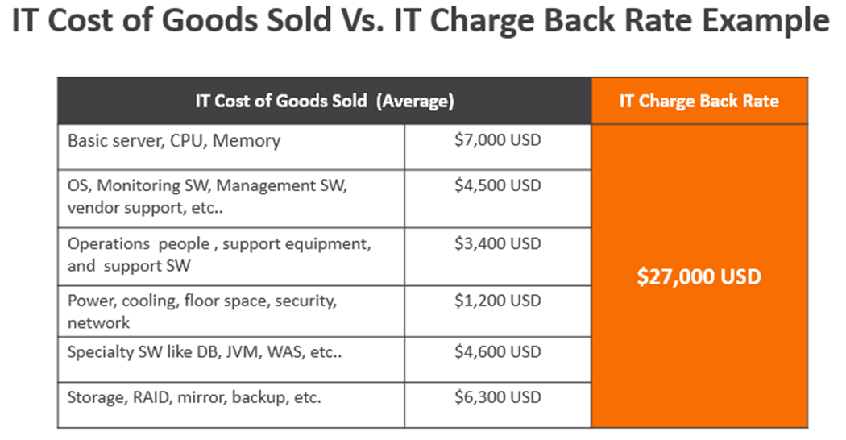
Notes:
The misunderstanding comes from the two different ideas
One is “Cost of Good Sold” the other is “Charge Back Price”

Slide 9
Mitigate the Misunderstanding
Cost of Goods Sold Vs. Cost Recovery Target
Useful Consistent Lie
Notes:
To mitigate the misunderstanding
First we point out the difference between “Cost of Goods Sold” conversation and the “Cost Recovery Target” conversation
The line items are understood to include other things needed to deliver that service. and the more expense that is included, the more expensive the items become.
This is sufficient to clear up most of the misunderstanding.
The next step is to explain the “Useful Consistent Lie”

Slide 10
Useful Consistent Lie
After Noon
12:18 PM
Quarter Past
What Time Is IT?
Lunch time
Mid Day
Tuesday
2017/11/07 19:18.37.86327 GMT
Notes:
What is a useful consistent lie, and what is its value?? Well it is everything around you and how you understand it. When your understanding is sufficient for a conversation, you use that understanding, that is the useful consistent lie, and the value of the useful consistent lie is that the conversation can now be conducted with a reasonable degree of mutual understanding.
For example, what time is it, right now? Whatever your answer, it is not the most correct answer. It IS a useful consistent lie. The time may be 12:18 in the afternoon by my digital watch, but you may have said it is quarter after noon, lunchtime, mid-day, or any other of a host of answers. To the extent that your understanding moves the conversation along, it is a useful consistent lie. If you wish the most correct answer, you should ask a physicist and set aside a weekend for the nuance of the ‘truth’. The value of the useful consistent lie is the conversation can happen with this ‘good enough’, mutual understanding. The closer you look, the more you realize the ‘truth’ is an expensive illusion. Useful consistent lies are all around you.
When the mutual understanding breaks down, then a new, “more correct”, useful consistent lie is needed.

Slide 11
A Bigger Model
This IS the Useful Consistent Lie
Notes:
The following example of charge back of information technology goods and services is set up the same way. Instead of desks, phones, desktop computers, and people, as the line items we use servers, storage, and memory.
In this example, we have a recovery goal was 500 million and we have some twelve thousand devices. In this case our cost for a server was 27 thousand dollars.
While the numbers are bigger, the method is still the same
The cost column IS the useful consistent lie for this model

Slide 12
Summary and Call To Action
Cost of Goods Sold vs. Charge Back Price
Change behavior
Consistent, Transparent, Well Understood
Useful Consistent Lie
Recovery Target
Evaluate Making a Charge Back Model
Charge Back is EASY – Except for the People
Notes:
In summary..
Here is the trick of doing charge back:
Charge back is all about changing behavior. The model should be consistent, transparent, and be well understood
Define the recovery target.
Then find helpful items to charge back on.
Create enough line items to be useful to the business to control their costs, but not so many that it is impossible to select.
Recognize that the COST of goods sold conversation has no place in the PRICING of the items conversation.
Know that the pricing of line items is a useful consistent lie, and has nothing to do with the cost to produce.
The call to action is for you to evaluate making a charge back model. It is easier than you think – except for the people.
Know that Movìri is available to help.

Slide 13
Questions & Answers

