Slide 1
Benjamin Davies
V 5.21
Ben.Davies@moviri.com, @MrBenHoney
Cook and restaurant management
Navy Cook and hotel management
Computer consultant
Technical support manager with ISP back when AOL was still cool.
Data security
Data security, audit, policy and procedure.
Process improvement
Capacity planning, metrics
We like - Tools and techniques, one of which is to suck less, the other is to use precise language precisely, but only the degree necessary.
Power user of Excel, competent at other Office Tools
I like to leg wrestle a problem, not to kill an idea, but rather, explore the various parts of the problem. While the language may be unconventional, it is without malice. Embrace it and fight back, please.
Pronouns are sub-optimal. WebEx is our friend.
I see the world differently than you do.

Slide 2
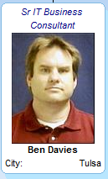
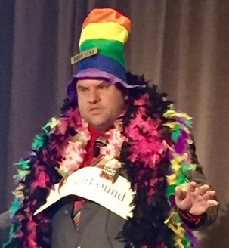
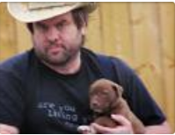
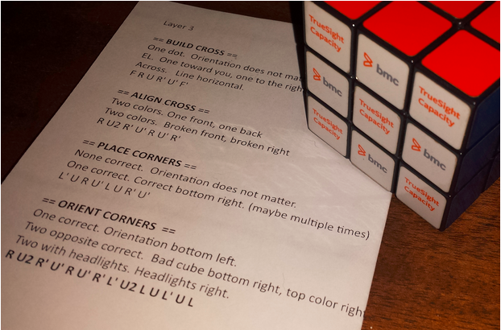
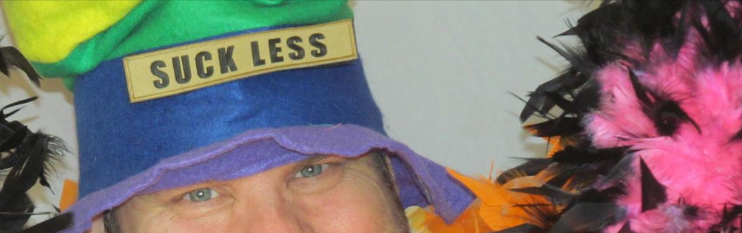
The Many Faces of Mr. Ben

Slide 3



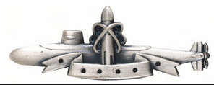
≈ 10 Years in the NAVY

Slide 4

≈10 years in Security and Audit

Slide 5
≈ 8 Years IT Cost Analysis and Capacity
Actionable Intelligence
Presentations at BMC Engage (Five sessions over ‘14, ’15, ‘16)
Thought leader in Cost Accounting
  Cost Centers to components to sub-services to services
  Updated Model 7+ times
  Used costs to price to subsidiaries and realize just how poorly we were doing pricing.
Thought leader in BCO (BMC TrueSight Capacity Optimization)
  Chargeback for projects
  Chargeback for applications TCO
  Reports and reporting techniques
    filters and Excel lists
    Basic infrastructure reports
    Detailed application reports completely contained in BCO

Slide 6


Now a Movirian
Joined Movìri as a consultant
Ready to make you as much of a power user as you want to be.

