Slide 1



Cost Transparency with
BMC TrueSight Capacity Optimization
Rick Kickert, IT Planning Senior Manager
HCSC – Health Care Service Corporation
Notes:
http://bmc.g2planet.com/bmcengage2014/public_session_view.php?agenda_session_id=65
Ensuring Cost Visibility for Effective Health Care Services: the HCSC Experience with Capacity Optimization
Session Number: 170 Track: Mainframe Monthly License Charge (MLC) Optimization Workshop, Performance Management and Analytics Date / Time: Wednesday, October 15, 10:00 am - 11:00 am Room: E-4 Session Type: Customer breakout Session Level: Intermediate Product Category: BMC Atrium, BMC Capacity Optimization Content Type: Business Speaker(s): Rick Kickert
IT Planning Senior Manager
Health Care Service Corporation
Session Description:
In today's competitive HealthCare Services market, optimal delivery of service is key. Learn how the implementation of an automated capacity management process based on BMC Capacity Optimization is effective in achieving the level of cost visibility required to properly manage a variety of different services. In this session you will discover how HCSC used BMC's Capacity Optimization solution to implement a fair and effective cost transparency process. Business outcomes from this type of approach will be discussed and several best practices for implementing a similar approach in your own environment will be covered.
In this session you will learn:
- The preparation required to develop a cost transparency methodology
- Key stakeholder buy-in and steps required to develop an effective cost transparency process
- Return on Investment and cost efficiency outcomes

Slide 2
Updated for
Agenda
BMC Technology Day
Digital Transformation for the Enterprise
Chicago, March 11th 2015
The Metropolitan Club
233 South Wacker Drive
66th Floor, Willis Tower
We make extensive use of the comments section.
Notes:
This is essentially the presentation given at the BMC 2014 Engage session.
The business context has changed to a state of more situational understanding and less fluctuation. The charge back conversation, or Cost Transparency conversation as that is now more appropriate, has changed as well.
However, the history is the same (with updates), the goals are the same (with updates) and the process we used and are using are essentially the same.
========
Session 2: Customer Case Study Health Care Services Corp (HCSC);
Speaker: James Kistler HCSC, Ben Davies HCSC
In today's competitive HealthCare Services market, optimal delivery of service is key. Learn how the implementation of an automated capacity management process based on BMC Capacity Optimization is effective in achieving the level of cost visibility required to properly manage a variety of different services. In this session you will discover how HCSC used BMC's Capacity Optimization solution to implement a fair and effective chargeback process. Business outcomes from this type of approach will be discussed and several best practices for implementing a similar approach in your own environment will be covered.
===
http://www.bmc.com/events/seminars/Chicago-BMC-Technology-Day-Digital-Transformation-for-the-Enterprise.html
Chicago BMC Technology Day Digital Transformation for the Enterprise
Seminars Date: 11 MAR 10:00 AM - 5:00 PM Contact: Heather Tomlinson
BMC Software
Lead Marketing Manager Venue: The Metropolitan Club
233 South Wacker Dr
66th Floor, Willis Tower
Chicago, IL
60606
Registration: Register Now
Join us at BMC Technology Day – Digital Transformation for the Enterprise in Chicago, the event where IT professionals gather to explore BMC products and solutions and the latest technology trends from mainframe to cloud to mobile.
• Gain insights and best practices from a top tier keynote, breakout sessions, and networking opportunities
• Evaluate products and services from BMC and our Partners
• Get the tools and the know-how to optimize your mainframe, mobile, and cloud technologies
Preliminary Agenda:
9:30am to 10:00am: Arrival
10:00am to 10:15am: Welcome Jeff Hardy
10:15am to 11:15am: Anticipating and Leading Market Disruption by Tony Seba, Lecturer at Stanford University
11:15am to 12:00pm: BMC Strategy & The New IT by Herb VanHook, BMC VP Deputy CTO
12:00pm to 1:00pm: Lunch
1:00pm to 5:00pm: Breakout Tracks*
5:00pm to 7:00pm: Networking Reception
* Breakout Tracks include: The New IT Service Management, Cloud Mgmt & Data Center Automation, Workload Automation, Performance Management & Analytics

Slide 3
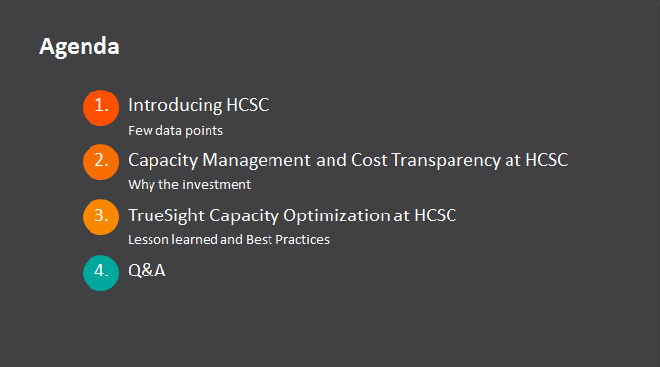
Notes:
Slides were copied from a PDF and broke, in that they did not print images in notes mode.
Screen shots were taken of original presentation and placed here – which makes them ‘impossible’ to edit.

Slide 4
Introducing HCSC
Few data points

Slide 5


Founded in 1936 and with more than 14.5 million members, HCSC is the largest customer-owned health insurer in the United States and fourth largest overall, operating through its Blue Cross and Blue Shield® Plans in Illinois, Montana, New Mexico, Oklahoma and Texas
We provide health coverage through our Blue Cross and Blue Shield Plans and dental, life and disability insurance through Dearborn National
We are greater than our 21,000+ employees, 60 local offices and state-of-the-art technology, including two Tier IV data centers — the industry's highest reliability level — that provide the speed and data security to meet our customers' current and future business needs
Health Care Service Corporation
Notes:
The point of this slide is to say that HCSC is big by almost any definition, has been around a while, and as you might imagine has a complex environment.
==========
Data accurate to late 2014.
http://www.hcsc.com/
http://www.hcsc.com/hcsc_hq.html
http://en.wikipedia.org/wiki/Blue_Cross_Blue_Shield_Tower
Received Trustee award for the HCSC Blue Cross Blue Shield of Illinois (BCBSIL) headquarters vertical completion project from the Chicago Architecture Foundation in 2006
http://www.glasssteelandstone.com/PrinterFriendlyBuildingDetail.php?BuildingName=Blue%20Cross-Blue%20Shield%20Of%20Illinois%20Tower&LocationCity=Chicago&LocationState=Illinois&LocationNation=United%20States

Slide 6
Our vision
Our Purpose
To do everything in our power to stand with our members in sickness and in health.
Drive competitive advantage via efficiencies and cost-effectiveness through IT optimization, simplification, and agile infrastructure & applications
“Provide the lowest cost, most accessible healthcare”
Notes:
This is a shameless plug. HCSC is a good company that tries to be a good company.
We are using BMC TrueSight Capacity Optimization and other BMC tools to directly support our Corporate Vision which directly supports our Corporate Purpose.
However, good software and good intentions are not enough. Effort must be exerted to apply the good software to achieve a goal. This effort sometime is excessive, but effort is required.
The intent is to show that there is intelligence, specific tools and techniques, in this session that you should put into action.
http://www.hcsc.com/purpose.html

Slide 7
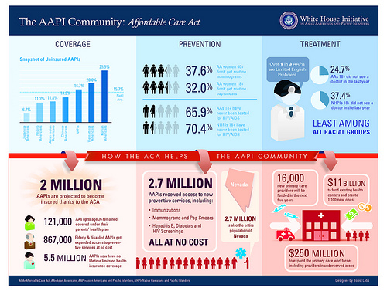


The Insurance Industry Changed... Why?
THE INSURANCE INDUSTRY CHANGED…..WHY?
03/23/2010
11/15/2013
TODAY
AFFORDABLE CARE ACT IS SIGNED
ENROLLMENT BEGINS FOR HEALTHCARE
MORE AFFORDABLE!
https://www.youtube.com/watch?v=sx2scvIFGjE
Notes:
The insurance industry changed. HCSC business model, which was based on groups, now included the individual market, which changed everything. Changed marketing, changed sales, changed billing, changed collection, added a check for subsidy eligibility (never before needed), changed adjudication rules, changed renewals, and HCSC had to maintain focus on existing lines of business. In short, it changed everything while maintaining what was.
Some key rules remained undefined until after open enrolment started. Rules changed, the government site was not ready, vital processes did not work, work arounds did not work, but still the capacity had to be available to react to the business, which was quickly reacting in a volatile environment.
In the end, the 2014 open enrolment situation was managed. Open enrollment for the 2015 benefit year has its own challenges. And now there is more operational stability however, the future of the health care providers, pharmaceuticals, health insurance industries, and support industries is still being debated.
========
Six of One – Obamacare vs. The Affordable Care Act (4:00 minutes)
http://www.youtube.com/watch?v=sx2scvIFGjE
Jimmy Kimmel Live
Which do you think is better - Obamacare or the Affordable Care Act? They're the same thing, but that didn't stop people from weighing in...
Youtube.com search jimmy kimmel Obamacare vs. The Affordable Care Act

Slide 8

7 © Copyright 10/21/2014 BMC Software, Inc
Capacity Management and Cost Transparency at HCSC
Why the investment?

Slide 9
Planned Enrollment – Scenario Example
Insurance Industry Ad Campaign for change……
http://www.huffingtonpost.com/2013/11/19/insurance-company-obamacare_n_4303414.html
Notes:
NOTE TO PRESENTER> click to change to next build… Page plus two clicks
This is what we traditionally expected for open enrolment.
However we projected almost double. There were dozens of projections based on different scenarios. This was knows as the two hump projection.
This is what we got. Not at all the form we expected.
Now I ask. What exactly are long range capacity planners to do with THIS?

Slide 10
Planned Enrollment – Scenario Example
Healthcare.gov website delayed
Constant Re-Planning to adjust for Capacity needs
Constant Re-Planning to adjust for Capacity needs
Constant Re-Planning to adjust for Capacity needs
Constant Re-Planning to adjust for Capacity needs
Constant Re-Planning to adjust for Capacity needs
Constant Re-Planning to adjust for Capacity needs
Constant Re-Planning to adjust for Capacity needs
Constant Re-Planning to adjust for Capacity needs
Constant Re-Planning to adjust for Capacity needs
Constant Re-Planning to adjust for Capacity needs
Notes:
NOTE TO PRESENTER> Just let the slide build
Open enrolment went off with a SLOOWWW start.
Each week official projections were published based on the ‘current known knowns, and known unknowns’
Each week new plans were made, old plans updated, assumptions revisited and evaluations made.
BMC TrueSight Capacity Optimization was still new, but allowed our group of forecasters to contribute to the conversation and quickly run models of likely events, and unlikely events.
Even here when we were spending money ‘freely’, cost control was still a topic of concern.
Long term capacity planners needed to contribute to the conversation by shortening their forecast horizons, and by reminding people of long term goals, while knowing short term goals were the most important. It was understood that there is a spend bubble to transition the business to account for ACA opportunities however, there are long range impacts that were also understood to be ignored until later. When later came around (about now early 2015), those conversations are exceptionally uncomfortable.
========
Constant Re-Planning to adjust for Capacity needs.

Slide 11

Goals for Capacity Management at HCSC
Minimize our risk to production caused by capacity related outages and plan for growth
Reduce resource time used to manually collect and correlate data
Ensure models are aligned to business expectations and give IT runway to implement changes
Minimize future hardware spend by maximizing the utilization of our current investments
Process Optimizing
Business process view
Business Optimizing
Service view
Maturity
Performance Optimizing
Workload view
Fire Fighting
Monitoring
Component View
***
Outcome Focused
Execution Focused
Outcome Focused
Notes:
During the volatility of the Affordable Care Act, there were still the corporate goals to address. Minimize our risk to production, reduce time and effort to collect data, and align capacity to business expectations, while minimizing hardware spend by maximizing current investments.
This required a technology process to mature from exception based fire fighting, towards a more fact based, service view.
BMC TrueSight Capacity Optimization help us mature, which allowed us to better meet or ‘normal’ corporate goals, and allowed us to meet the exceptional goals of the ACA.

Slide 12

A phased approach to increase maturity and scope
Scope
Service
Business
Component
Claims, Calls, Benefits, etc...
Applications (eIVR, Portal, etc.)
MQ, Appliance, Middleware
Starting Point
HW, Network, Mainframe
Facility
Datacenter Efficiency
The all-around Capacity solution
Maturity
Starting point is always physical HW usage measurement
Two streams to increase maturity and scope:
  Upwards (“classic”): accordingly to ITIL
  Downwards (Green IT): to facilities and power consumption
Data Integration
Modeling
Planning
Reporting
4 Step Approach
Notes:
To achieve these maturity goals, we used a phased approach.
Choosing to ignore (for the moment) the datacenter services, We started with physical hardware, then moved ‘up’ to middleware, applications, then business metrics.

Slide 13
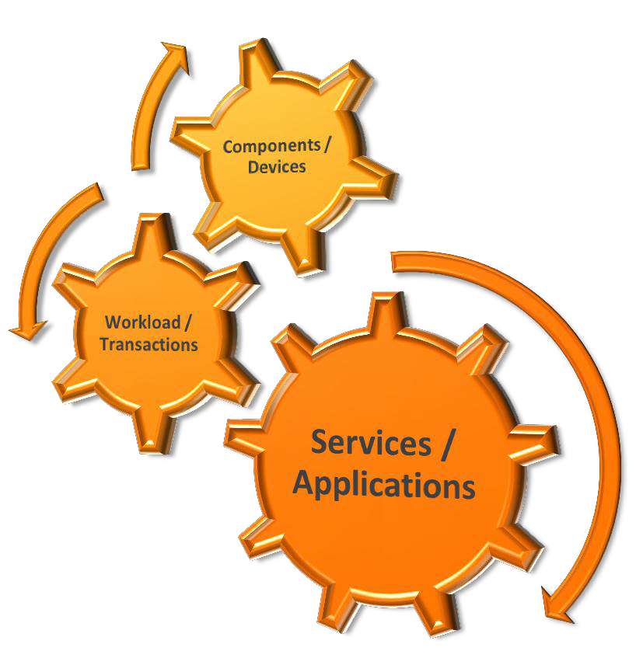
Phase 1: set foundation for Capacity Management
Collected the data about Infrastructure
Needed to understand the workloads
Align Services with the components
and workloads
Ready for Scenario Planning!!!
Notes:
Collecting infrastructure data at first meant connecting our existing data sources to BCO. Once this was done more difficult connections were addressed and continue to be added to this day.
Collecting workloads, known as business metrics in BCO, as also ‘just; connecting our existing sources into BCO. Again additional sources were added later and continue to be added.
Aligning services is to build the ‘application’. Combining the workloads with the equipment that do the work. At first these were done ‘by hand’ in the manually configured applications section but was quickly ‘taken over’ buy BMC Atrium discovered and modeled applications. Now there are only a very few manually created applications that exist in BCO most (200 apps over several environments each) are presented to BCO ‘automatically’
With these applications, scenario planning can be done. Hundreds of scenarios were run, tweaked, run again, tweaked, and analyzed. At this early stage we were not able to authoritatively say: “This application will be fine up to 250 transactions per second” However we WERE able to show where applications ‘broke first’ which allowed the application teams to focus precious resources on likely trouble spots.

Slide 14
#3 Challenge – Automation / Efficiency
100x
Increase
40x
Increase
3300
72x
Increase
Notes:
Automation allowed for quicker turn around and more accurate results.
Before TrueSight Capacity Optimization the capacity team of 7 could perform detailed analysis on about 300 infrastructure devices, (now 3300), about 5 business drivers, (now 90), and 4 applications or services (now 160) in a month. Now we routinely perform analysis on a few dozen in detail and ‘watch’ the 160 modeled apps and all equipment in the TrueSight Capacity Optimization tool in the same time.
We had a customer call at three in the afternoon with a request to decide if he could double his work mission with a new opportunity they were considering and how much extra equipment he would need. In two hours we informed him, authoritatively, that his systems had the capacity to double with room to spare and still maintain their expected service times. We show the charts and analysis notes and discussed the results. He took that analysis and went forward with his new opportunity without incurring infrastructure charges, and indeed had sufficient capacity upon completion of the effort. Before TrueSight Capacity Optimization, this analysis would not have been performed, as this was not an application we had any information on, and the project would have incurred unnecessary infrastructure charges.
OR THE OPPROUNITY WOULD NOT HAVE BEEN PERSUED.

Slide 15



Phase 2: define Cost Models
Vision
Drive competitive advantage via efficiencies and cost-effectiveness through IT optimization, simplification, and agile infrastructure & applications.
“Provide the lowest cost,
most accessible healthcare”
Notes:
With those models in place, our long term forecasting team was able to help define the cost implications of the applications.
We were careful, with the help of our consultants, to arrange our application layouts to support cost modeling as well as performance modeling.
Having consultants help with the implementation of the tool, while we were trying to mature our process, while we were reinventing the basis of our company was, helpful.

Slide 16

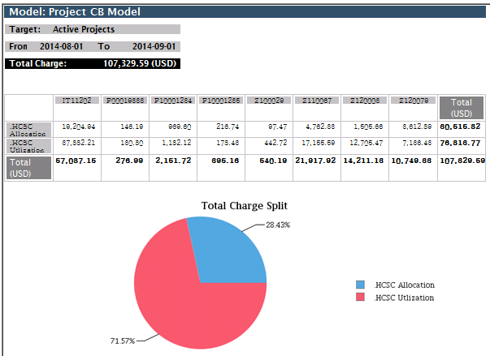

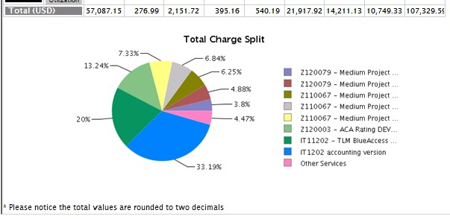

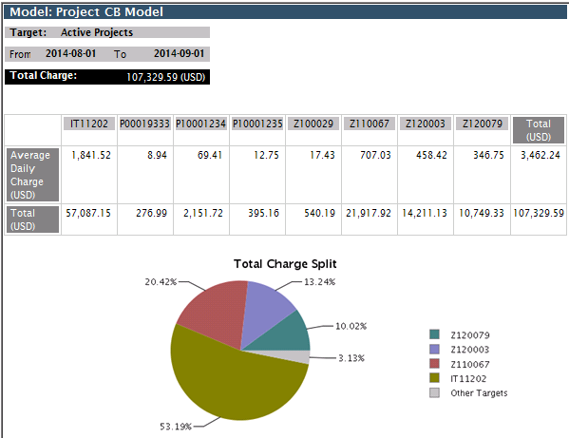
Phase 3: Deliver Cost Visibility
Reports that provide value to
different roles:
Project Managers can track
near real-time costs
Financial planning can use a report to track to budget
Corporate finance can use reports to ‘shift funds’ and allocate resources
Notes:
Starting with project charge back, we were able to provide value to the project managers, financial planners, and the finance groups.
We displaced an existing manual system so our results were materially the same as that process and allowed for a higher level of transparency and auditability.
We are a few months into the actual, live, process and are comfortable that we have done an acceptable job of implementation, and continue to ‘improve’.

Slide 17

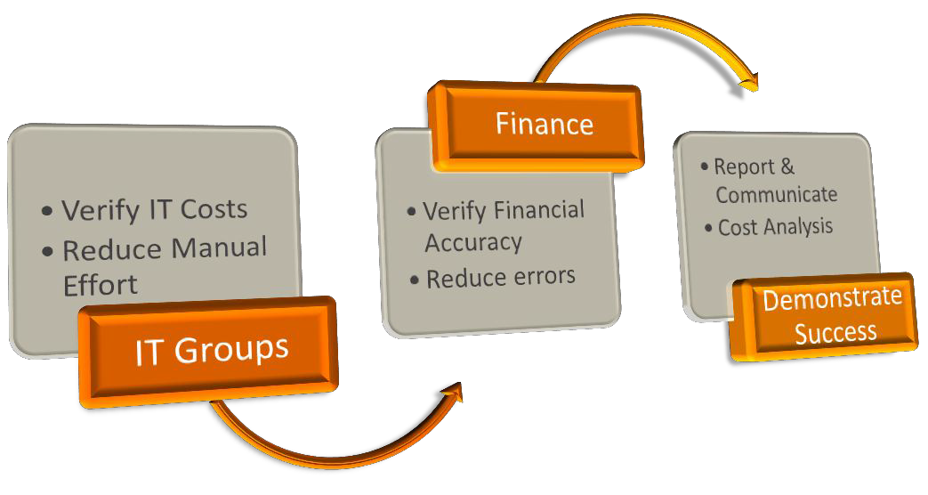
Lesson Learned
Must develop ‘Buy In’ on IT
Costs
Establish Financial Accuracy
Reporting / Cost of Service /
Cost Transparency
Demonstrate Opportunities
& ROI
Notes:
Overall the lessons learned for the infrastructure and cost transparency efforts were the same.
Develop ‘buy in’ that the costs are accurate. Price and inventory and the way things are counted, can have wide variation between ‘experts’.
Establish financial accuracy. Our big surprise is we reveled immaturity in other areas that needed to be addressed for us to be successful. THIS is a huge caution. Others do not wish to change for your benefit (even if they benefit as well). No one wants to hear their baby is ugly. Any suggestions, regardless of how well meaning the suggestion, will be seen as second guessing, arm chair quarterbacking, or out right mockery, and will be resisted.

Slide 18
TrueSight Capacity Optimization at HCSC
Lesson learned and Best Practices
Notes:
So that was the environment we installed BMC software into.
We felt it was important to get an idea of the volatility and chaos that was happening as we implemented.
One so that you can see that your environment ‘isn't that bad’ which should show that you could undertake this effort as well.
And two, to show that there is advantage to implementing a big change while others are distracted with their own big change as well.
Let no crisis go to waste, so to speak.

Slide 19


Lesson Learned – before you start
Before you start:
Cost Transparency is key to business advantages, and benefits are huge - make sure the business case is well defined, understood by stakeholders, and results will became actionable information (or the whole effort will be a costly failure)
Power structures will be perturbed, and the status quo will fight for survival - it is not just about implementing a solution – it is about changing company processes, roles and behaviors
Charge back is not about finance. Charge back is about behavior.
Notes:
We have an internal document (45 pages) we made when we were struggling with what we knew we knew and what we knew we did not know. As our understanding improved the document filled in.. It is an internal document, not intended to be published, so is a little rough / incomplete in places. It does cover our journey to less ignorant.
Leave us your card and we will forward the most recent version.
http://www.ignorance.medicine.arizona.edu/ignorance.html
What is ignorance? Known unknowns …
This presentation is the lessons learned along the way and is intended to help you decided IF you are going to do a cost transparency effort in TrueSight Capacity Optimization, and what to look out for along the way. The issues and observations are not complete, unique to our situation, and your experience WILL BE DIFFERENT.
There is a reoccurring theme in our cost transparency adventure. There is so much to know before you get started, but you don’t know it until you get started. Some choices preclude future choices, other choices create future choices. You will not know which one is ‘best’ and in fact it is difficult to know that a choice has hidden other choices.
To solve for this, you need to do research, make several models, and get help from trusted, knowledgeable, advisors.
This will be difficult to “get right”.
Prepare for frustration.
Prepare to “do it over”.
Prepare to be a disrupting force.
Before you start be sure you SHOULD start. Cost transparency is key to achieving several business advantages and the benefits are huge. However, make SURE the business case is well defined, understood by stakeholders, and results will become actionable information. If not, you will create a lot of turmoil, and have nothing to show for it. The landscape permanently altered, and you will likely be the bunny.
Since Cost Transparency may provide several challenges, power structures will be perturbed, and the status quo will fight for survival - it is not just about implementing a solution – it is about changing company processes, roles and behaviors
Charge back is not about finance. Charge back is about behavior.

Slide 20
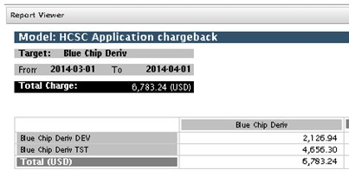
Lesson Learned – start with the end in mind
Start with the end in mind
Define your cost models before you
decide what and how to integrate
Make sure you can automatically maintain the mapping between the chargable items (servers/devices) and the chargeback targets (tenants/departments)
Create your internal “how-to” documentation – again it is not just about knowing the product
Notes:
Starting with the end in mind, what is the mission, deliverables, and data required.
The output of the cost transparency system is an input to other systems, processes and studies. This will go a long way to defining what is in scope, and more helpful, what is not in scope. These users will likely be your supporters. As the system is database driven, there a many views possible, and ways to put this new information to use (for good).
There is probably a cost accounting system of some sort already, so take a piece of that and do a process improvement operation on it. This will help define what the scope is, and more importantly what the scope is not. This customer will likely be an supporter. MANY others are not likely to be supporters.
Make sure you can maintain the mapping between the thing to be charged (server or resource) and the thing that will be charged (pay the bill)
Create an internal ‘how-to’ document. What did you decide, why did you decide it, how did you implement it. This is not a product documentation so much as a decision documentation effort.
The lessons learned will be easily adapted to the next effort.
Once our TrueSight Capacity Optimization install was about 6 months old we realized we had, or soon would have, the data required to do a cost transparency system, and the cost transparency process owner was begging to see if TrueSight Capacity Optimization could take over the manual work. We spend a week researching, then jumped in using two made up projects. It was a disaster. Instructions did not match our mission, we mis read documents, mis understood documents, did not find documents, or otherwise had trouble getting the system to do what we wished. Then got an intern, so used her for focused effort.
The output was our ‘what we know we know, and think we know’ document and a working cost transparency system.

Slide 21

Lesson Learned – it requires an iterative process
An iterative approach
Keep cost models simple initially – fairness is key more than “truth” – and then make them more complex in case
– this should not be a super-detailed accounting effort
Cost transparency should DRIVE BEHAVIOR.
The biggest threats are political, cultural, and inertia. And the status quo.
Strive for a useful, consistent, lie, rather than “truth”.
Price is easy, using Target Return Pricing*.
20
Notes:
Cost transparency in hard! Decisions need to be made that will make people mad. - Cost transparency is disruptive and will have powerful forces supporting and apposing the effort.
You are doing cost transparency now, so treat you FIRST implementation as a process improvement effort. This is far less threatening but still packed with conflict. – start small and grow as results mature. We spent WEEKS on cost transparency with ZERO useable results. Then in a few days applied what we learned to our target of project cost transparency for half a dozen projects. Then in 90 seconds (no kidding) applied it to 125 applications, and all of the environmental versions of the applications.
Cost transparency should result in actionable intelligence. That is to say, DRIVE BEHAVIOR. – Actionable intelligence should result in ACTION, which includes willful inaction.
Cost transparency is an iterative process. – After each round there will be ‘better’ metrics to trigger a charge. Only allow this to the extent that it is useful. Good enough is, good enough. Remember, this is a useful, consistent lie. Perfect is an expensive illusion.
The biggest threats are political, cultural, and inertia. Way down the list are data availability, technology, and implementation difficulty.
It helps to abandon the goal of ‘truth’. There is very little truth in real life, only useful, consistent, lies. For example, what time is it (right now). My clock said 2:33 but that is a lie. It is actually 07:33:47.987345 per US Naval Observatory Master Clock UTC… or 14:33 Central Time (24 hour clock). Even if you chose a time lie, you are then faced the definition of the sentence. Is ‘right now’ when we started or finished the question? Or the time the question was received by the noun expected to answer? Or did they fudge and adjust the answer to coincide to when we were expected to get the answer? The closer you look, the fewer use cases actually depend on the nuance of the ‘truthful’ answer. So in the cost transparency model of TrueSight Capacity Optimization how much something costs has a string of qualifiers attached and should be regarded as a useful, consistent, lie.
http://tycho.usno.navy.mil/cgi-bin/timer.pl
Not compelling enough. Where are you, right now, cosmically. Anything less that GPS in 3 dimensions, to 64 decimal points, is not ‘truth’. But now you have to define what point constitutes ‘you’, and have a cosmic frame of reference. When you figure it out, convey that, and have it understood, you are no longer there. Truth.
What is your name. I am Ben Honey Dad to my girl. But Uncle Sam thinks something different, and my Navy Drill Instructor had something completely different in mind, I still can not fathom.
How old are you, exactly. Now you have to define a host of parameters, some legal, some religious, for the answer to have any meaning or it is not the ‘truth’. For the record I am 29 again (21st anniversary), 283 days, 17 hours, 3 minutes, 25 seconds from the date recorded on by birth certificate, which has a whole host of assumptions attached to it. Feel better about the truth. My 29th birthday needs a drink.
Useful consistent lies are everywhere, mostly because they are, well, useful. The truth is an expensive illusion.
Costs will create a HUGE issue. We could discuss this for hours but, in keeping with the useful consistent lie, think of it this way: What is your cost transparency recovery target? Then as a completely separate thought, what are you able to account for in cost transparency system. That is, the items you are charging for, and how many of them can you ‘sell’. Then do the math (simple division).
I need to recover 100,000 dollars a year. I can account for 100 named servers, in each of the 12 months. That makes 100,000 dollars divided among 1,200 machine months. That makes each one cost $83.33 a month. Target Return Pricing.
This conversation does not concern itself with how much a named server actually costs to produce, only how much do to recover, and how many things can be used to recover that much. This is foreign to us, as it is a business type conversation and not a technical conversation, that is partly why the conversation feels, unfair or dirty, to technical people.
http://www.businessdictionary.com/definition/target-return-pricing.html
Emotion is a fearsome opponent of logic, reason, and facts.

Slide 22

Lesson Learned – product best practices
Best Practices for a solid foundation
Structure the domain hierarchy to reflect your service/tenant hierarchy – this will help you when defining the chargeback hierarchy
Standardize metrics to make them ‘universal’ for all platforms – this will simplify the cost model definition
Define your approach to cost models as soon as possible: fixed, allocation or utilization based – or a combination
Notes:
Structure of the workspace is critical. It MUST be consistent, so to accommodate the many missions the layout must serve, it must be well thought out.
Maintaining the structure, beyond a few entries must be automated. We don’t do this for our projects, but they are limited and it ‘eats our lunch’
Metrics must be universal to the metric you intend to use. For example if system type + brand + model is used to trigger a charge ( Switch + Cisco + 5020) then all switches of type cisco model 5020 must report that data. Alternate example, if you charge for memory installed for all servers, all servers must report the memory installed metric.
You should charge on what is assigned to the device rather than what the device actually uses. Storage is a good example. Ask for a 300 GB drive get charged for 300 GB even when you only ‘use’ 50 GB.
Pricing is easy minus the politics. There can be several cost models EACH with their own rate card. Remember: What to recover / number billable = cost. Arriving at the what to recover can be political so can create problems.
The status quo is emotionally involved so immune to logic reason and facts.
Cost transparency is easy, if built on a solid foundation. Avoid implementing prematurely. Be sure the need exists to do a cost transparency system, you have the commitment to maintain the system, and are willing to let hostile people review what you are doing, and not doing. That is the nature of financial types.

Slide 23

Lesson Learned – Cost Transparency is disruptive
Cost transparency is disruptive – it will cause changes, and cascading change effect (“trophic cascade”)
Unintended consequences negative and positive
Power structures will be perturbed and will resist, the status quo hates you
Sayers of Ney and FUD Dragons
Illusory Superiority in you and others
Do NOT let it become a super detailed accounting effort
http://youtu.be/ysa5OBhXz-Q
Notes:
If all of the elements are in place and you decide to undertake cost transparency, you stand to gain huge benefits beyond simple cost transparency. The act of charging based on consumption is disruptive to the entire decision making eco system. There will be unintended consequences, including overtly bad ones, but there will also be unintended consequence's that are overtly positive, and not easily relatable directly to cost transparency.
As the disruption is anticipated, or starts to actually happen, people that may have supported, you may now be threatened. The status quo hates you. Be diligent. You will find cost transparency to be an agent of change that is trophic cascade of change.
http://blog.ted.com/2014/02/18/video-how-wolves-can-alter-the-course-of-rivers/
George Monbiot poetically explains how reintroducing wolves to Yellowstone National Park after a 70-year absence set off a “trophic cascade” that altered the movement of deer, sent trees soaring to new heights, attracted scores of new animals to the area (think: beavers, rabbits, bears, bald eagles and more), and stabilized the banks of rivers making them less susceptible to erosion.
However, you will find that questions that could not be answered in the past are now answerable. The old application costs 50,000 a month in old hardware support costs but only brings in 400,000 a year in revenue. To the good corporate citizens, you are now a hero, to the status quo of the application, you are a mortal enemy.
You will be able to show that the policy that said every ‘critical application’ must have 100% duplicate systems in DR, can now be shown to have a significant cost. Good corporate citizens tend to make better corporate decisions when complete information is available. Now with the perceived value of the rule, someone can enforce that rule with a more complete picture of the actual cost, and perceived cost, vs the actual benefit, and perceived benefit.
===
Nay, the English spelling of Danish nej "no". There are people that will say “no” to anything new. This is especially true with a disruptive new technology. A nay sayer in a position of authority can be detrimental to the cost transparency effort directly, or impede one of the critical components. Don’t take a ‘no’ from anyone that cannot tell you yes, insist they pass it to higher authority.
FUD Dragons, a Benism (made up word by Mr. Ben). Intended to represent the people that use FUD.
http://en.wikipedia.org/wiki/Fear,_uncertainty_and_doubt
“FUD is generally a strategic attempt to influence perception by disseminating negative and dubious or false information.”
The people that use FUD wish you to imagine a dangerous dragon where there is none. Most times there are no facts supporting FUD Dragons, and the people that create FUD generally turn out to be punks and bullies that cannot stand a fact based conversation. Occasionally, however they can out maneuver you, and take your lunch money. Slay these FUD Dragons as quickly as possible, as the perception of reality becomes reality, even when based in FUD.
Inattention, a cousin of sloth, one of the seven deadly sins, which can kill your efforts.
Inattention or poorly handling the politics can kill the effort, or burden it under bureaucratic or procedural load sufficient to collapse the effort. Cost transparency is an active enemy of the status quo, and will find enemies, literally everywhere. (see FUD Dragons)
You can derail yourself with lack of preparation or thinking the cost transparency will eventually run itself. cost transparency is hard, disruptive, sensitive, and in constant need of diligence.
Illusory superiority in you and others will feed the enemies of cost transparency, and cause you to underestimate the difficulty, or the motivation of foes, and overestimate your abilities. Accept that you are guilty of this, and take care to minimize the effect by being aware that it is present.
http://en.wikipedia.org/wiki/Illusory_superiority
Illusory superiority is a cognitive bias that causes people to overestimate their positive qualities and abilities and to underestimate their negative qualities, relative to others. This is evident in a variety of areas including intelligence, performance on tasks or tests, and the possession of desirable characteristics or personality traits
Do not let cost transparency become the place to do DETAILED billing accounting. Remember the useful, consistent lie. Let cost transparency figure the bill based on facts in evidence, then handle exceptions in the follow on process, and definitely do not try to account for exceptional exceptions. Simple, clean, understandable, cost transparency.

Slide 24
7 © Copyright 10/21/2014 BMC Software, Inc
Review, ‘What Now?’ and Questions
Start with the end in mind
Should I even do cost transparency?
Lessons Learned
Commence Disruption, start adding value
- Take Action NOW-
Notes:
This presentation was about creating actionable intelligence with cost transparency. You should have a fairly clear idea IF you will pursue a cost transparency effort based on this presentation, the handout, and the questions and answers. So take action, even if it is willful inaction, on creating a cost transparency system.
I would generally recommend against doing a cost transparency system. There is a considerable upside, but that upside is exceptionally dependent of having complete data, maintenance process, and a clear mission statement complete with built in users. To the extent that there is question that cost transparency is worth pursuing suggests that the requirements have not been met. There will be a ‘magic point’ where cost transparency is just a no brainer. All the data are available, there is a mission with customer, and sufficient support. Even then, failure is an option.
You would be well served to wait until these things are in place.
So now it is your turn. Take action. Action includes informed, willful, inaction.

Slide 25




James_Kistler@hcsc.net
Ben_Davies@hcsc.net
LinkedIn James Kistler
LinkedIn Benjamin W Davies
Thank You.
Notes:
James Kisstler – LinkedIn http://www.linkedin.com/pub/james-kistler/a7/732/618/en
Ben Davies - LinkedIn http://www.linkedin.com/in/BenjaminWDavies

Slide 26

































What data we collect
Performance Insight
Web Trends
 | Network |  |  | Servers
 | BAM RSC / Portal
 | Public Site Hits / Visits
Databases
 | RSC Hits / Visits
 | Producer Portal Hits / Visits
 | RSC Business Drivers
Quest Performance Analysis
MONITORING TOOLS
SQL
DB2
Oracle
(IBI,ICI, IMI,IPI)
Workers: Public Site, Legacy, RSC
NPI Crosswalk Service Call Counts
NetQoS Internet Circuit Utilization
BUSINESS DRIVERS
BMC Atrium CMDB
V Center
CVP Call Voice Platform
eIVR –
Ingress
Gateway
Edgesite VDI Counts
BMC TrueSight CAPACITY OPTIMIZATION
Cacti
VPN counts
Member Liability Estimation
Real Time Adjudication Counts
Edgesite
AP WEB
Counts
NetQos Application Bandwidth
CMM
NMON
Aceyus
CVP counts
DynaTrace
NetQoS
Cisco Prime Wifi Network
Sentinel
83X
Transactions
Real Time Benefits Transactions
Personnel
Counts
CA Wily
Tivoli Productivity Center (TPC)
Webex Ports
Utilization
RTIS
Mainframe Transactions
BMM
Cisco Prime
ODS
DMIH
Online Sales Channel
Notes:
This is a snap shot of what we collect.
Simply put. If you don’t have a map that looks like this. You are doing BMC TrueSight Capacity Optimization wrong.

