Slide 1
Quest for Actionable Intelligence
Applying Value Proposition and Documentation Options with
Filter Based Reporting
Conversations about TSCO
Andrea Gallo – andrea.gallo@moviri.com
Notes:
This is one of several webinar conversations about the value proposition of Information Technology Capacity Optimization.
Our goal is to help clarify the capacity optimization mission, and to provide tools and techniques to assist in the Quest for Actionable Intelligence.
With a clear mission and actionable intelligence, the capacity optimization function delivers significant value to the Organization.
In this session – Filter Based Reporting becomes the focus

Slide 2
Agenda
Introduce Moviri
Review the TSCO Layout, Business Model Canvas, and Value Proposition
Review our Value Proposition for Capacity Manager
Expand that Value proposition
Focus on Filter Based Reporting as a product & Service Solution for our Capacity Manager
Live Demo ??
Review, Questions and Conversation
Notes:
Agenda:
Introduce Moviri
Review the TSCO layout, Business Model Canvas, Value Proposition
Review our Value Proposition for Capacity Manager
Expand that value proposition
Focus on Filter Based Reporting as a product & Service Solution for our Capacity Manager
‘live’ demo showing how we can implement this solution.
Then open for questions and conversations – but feel free to interject

Slide 3




Why Listen To Us
Movìri is a global IT consultancy with multiple offices in the US and around the globe
More than 200 engineers worldwide
  More Doctors than most hospitals ☺
Developers of Caplan, become BMC TrueSight Capacity Optimization
Movìri has several lines of business:
  Testing & Optimization
  Monitoring
  Operations and Cloud
  Security, Analytics
  Capacity Management
Big picture, many disciplines, much experience
  ContentWise.com; Cleafy.com; AKAMAS.IO
We can help you do this quickly and cleanly
Notes:
So why listen to Moviri?
Movìri is a global IT consultancy with multiple offices in the US and around the globe
More than 200 engineers world wide we have more Doctors than most hospitals!
Started as Neptuny, developers of Caplan, a magic quadrant capacity optimization product. Purchased by BMC in 2010 to become BMC Capacity Optimization, which is now BMC TrueSight Capacity Optimization. Neptuny became Movìri.
Movìri has several lines of business, including Testing & Optimization, Monitoring. Operations and Cloud, Security, Analytics, and Capacity Management – which is to say we think holistically. Big picture, many driplines, much experience, and continue to offer innovative products, including ContentWise; Cleafy; AKAMAS
Movìri has been doing this a long time, and is a thought leader and innovator.
And most importantly, you should listen to Movìri because: We can help you do this – quickly, and cleanly.
So, Let us jump right in…
===
https://www.crunchbase.com/organization/neptuny
http://www.moviri.com/2010/10/goodbye-neptuny-welcome-moviri/
https://www.moviri.com/news-events/akamas-ai-powered-performance-optimization-solution/
https://www.moviri.com/
https://www.akamas.io/
https://www.contentwise.tv/
https://www.cleafy.com/
https://www.linkedin.com/company/moviri/about/

Slide 4
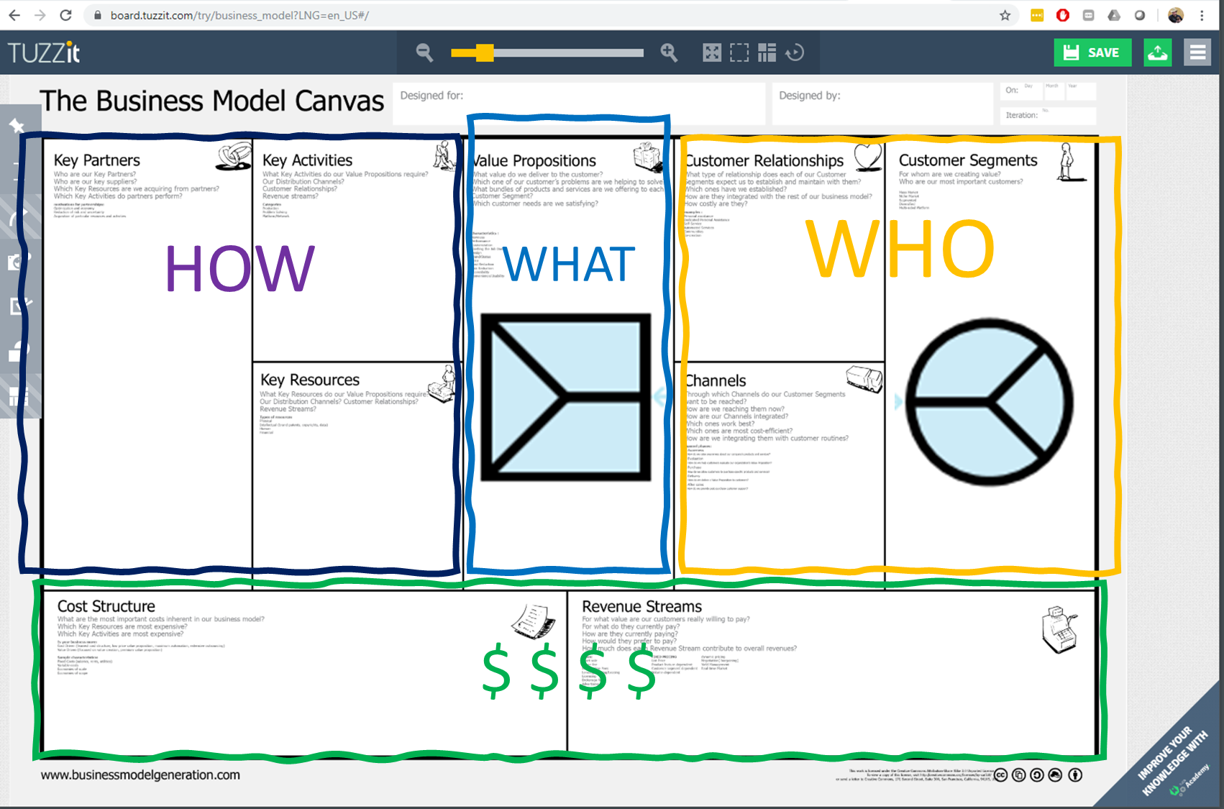
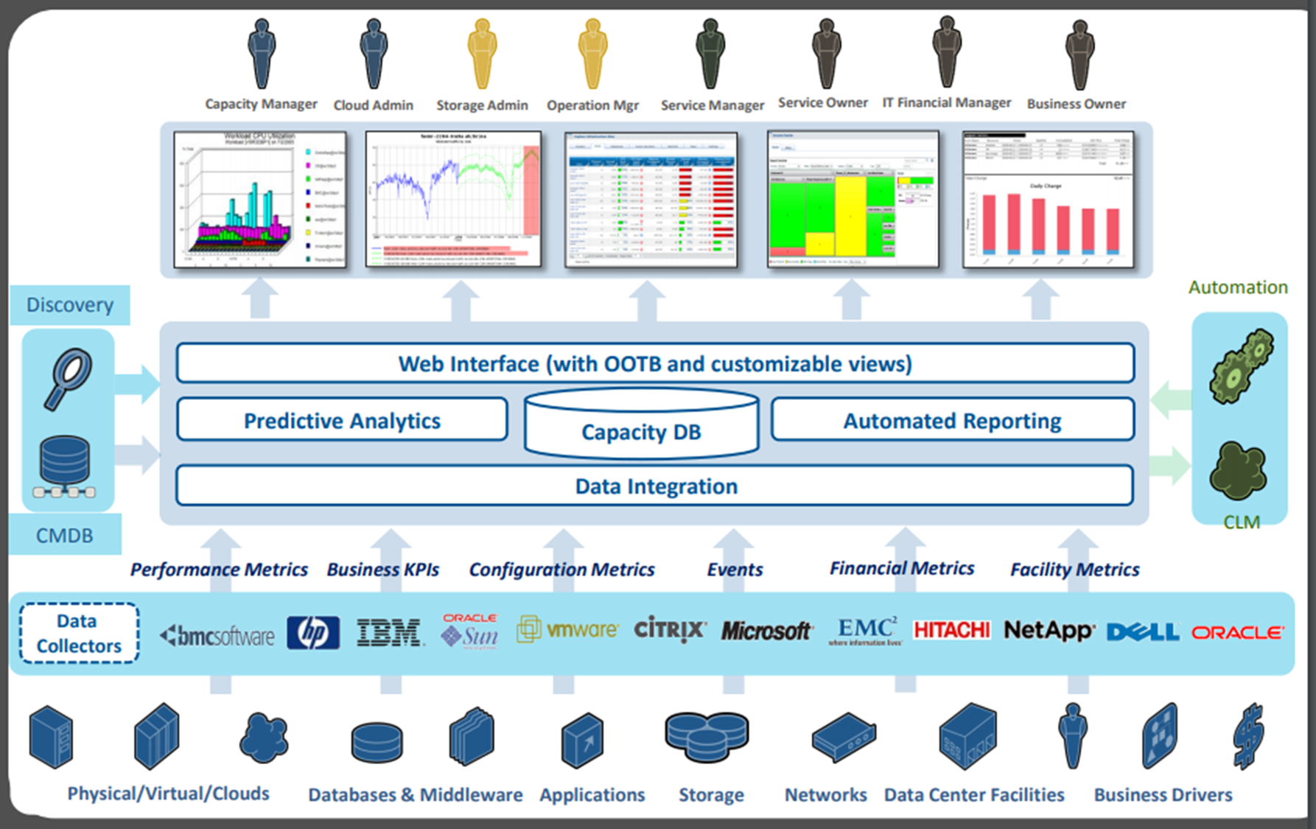
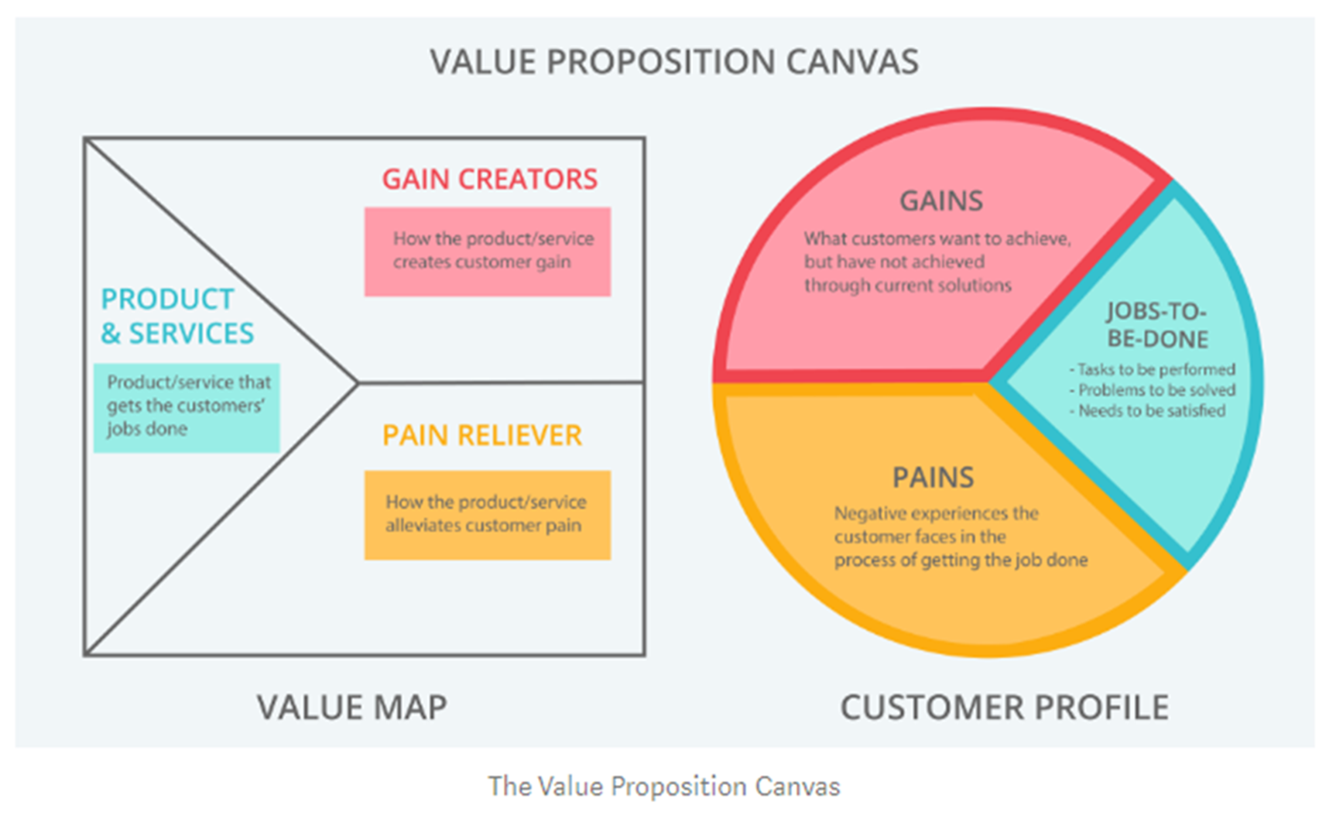
Quick Review
Make actionable intelligence easily available to our Capacity Manager Customer such that they can effectively address their IT capacity, trending, forecasting and anomaly detection concerns in IT and Business terms
Notes:
Quick Review (from the first in the Quest for Actionable Intelligence – Value Proposition conversation)
Top left = basic layout of TSCO. Our customer is the top left persona of Capacity Manager (a version of ourselves)
Top right = Business Model Canvas with a focus on the top right What and Who
Bottom Left = Value Proposition Canvas We will explore this in a bit of detail specific to todays topic
Bottom right = A Concise Value Proposition summary.
Make actionable intelligence easily available to our Capacity Manager Customer such that they can effectively address their IT capacity, trending, forecasting and anomaly detection concerns in IT and Business terms

Slide 5


Value Proposition for Capacity Manager
TSCO Tool
Customer
Products and Services
Workspace tab
Scheduled reports
Ad hoc reports
Filter based reports
Exception reports
Tag based reports
Presentation Service
Technology based reports
Custom reporting
Interactive drill down reporting
Summary reporting
Gain Creators
Self service reporting
Robust ETL Services
Robust reporting and visualization
Multiple association methods
Consolidation of data sources
Business counts and analysis
Gains
Guess less
Be right more often
Confident in analysis
Quickly deliver answers
Talk to business in business language and metrics
Customer Jobs
Current Inventory
Forecast need
Control costs
Accommodate business requests
Gracefully add new technology
Gracefully remove old technology
Provide adequate performance at an acceptable price
Pain Relievers
Data in one place
Quality data presentation methods
Web based for easy access
Gather ‘non capacity’ data
Automatic processes for data update
Pains
Difficult to gather data
Coordinate with business
Communicate with business and tech owners
Present data in clear concise ways
Make actionable intelligence easily available to our Capacity Manager Customer such that they can effectively address their IT capacity, trending, forecasting and anomaly detection concerns in IT and Business terms
Notes:
Here is a Value Proposition for the Capacity Manager as the customer and TSCO tool as the value provider.
Summarized nicely with
“Make actionable intelligence easily available to our customers such that they can effectively address their IT capacity, trending, forecasting and anomaly detection concerns in IT and Business terms”
We are going to expand this a bit –
The Capacity Manager has a job to do of ‘generate well formed charts, tables and analysis for groups of devices that have our attention for whatever reason’
Pains: Not all of these can be directly influenced by the Capacity Manager
The data may come from a number of sources and all data is not likely to be from a single or even a couple sources
The subject devices (systems or entities) are not known ahead of time
Reporting turnaround needs to be less that 15 minutes of effort to first report (research and followon reporting will take longer)
Data owners are not completely sharing useful data. (so TSCO will have data holes)
Trouble shooting situations requires several SMEs and real time data collection. While they can tell what the devices are doing now they rarely understand what ‘normal’ is or has been.
Evaluating what a device has been doing recently is so difficult that no one does it routinely. First the devise has to be identified, then the SME engaged, monitoring application app started, and queried about the device. For each device this can be one or two different SMEs. A short list quickly become a burden and time consuming.
Gains:
Senior managers frequently are frustrated that this sort of reporting is difficult, expensive, time consuming to make. I can be the hero if I could routinely deliver these sorts of reports.
Active trouble shooting situations quickly evaluate devices mostly with live data. I can be the hero if I could routinely deliver recent history trending analysis in near real time during these situations. (data is yesterday and before but help to determine what the recent normal is)
A non SME can report on a list of specific devices (or types of devices) and quickly deliver a number of metrics charts, tables and analysis, regardless of OS, team, mission, device type (assuming the data is in TSCO).
Well designed charts, tables, and analysis can be constructed ahead of time and envoked with any list of devices, on short notice. (note hundreds of reports can be designed and available ahead of time, and only the ones that deal with the question at hand need be used at a given time)
Filter based reporting is (seems like) an appropriate ‘products and services’ to deliver on this value proposition.
OK. So lets implement “Filter Based Reporting”

Slide 6
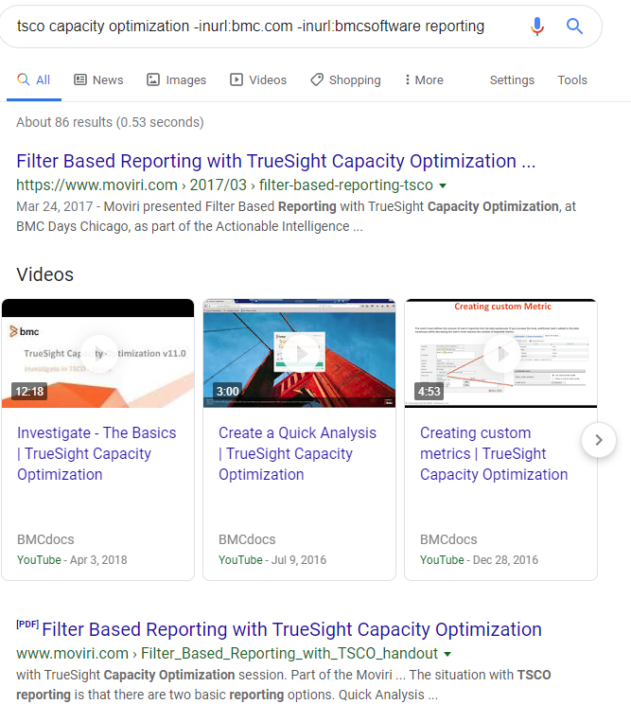
The Difficult Step
Novel combinations of tools and techniques to make new tools and techniques
  Invent on your own
  Call Moviri (or other trusted partner)
  Internet search (use the tools and techniques to narrow the search)
Notes:
This is the difficult step. The imagination of how to put several tools and techniques together to come up with a new, useful tool or technique.
In our case we ‘cheated’ and called our trusted partner (that would be Moviri) OR we can do an internet search
tsco capacity optimization -inurl:bmc.com -inurl:bmcsoftware reporting
Note that we are using ‘interesting’ search tools and techniques https://support.google.com/websearch/thread/2683638?hl=en
normal key word searches does not give us what we wish, So remove bmc.com and bmcsoftware but include the word reporting
The first two links are both mentioning “filter based reporting” so this seem interesting.
The first is a blog entry on the Moviri.com site The second is a PDF of the presentation mentioned in the first link.
===
https://docs.bmc.com/docs/btco113/managing-entity-filters-775472705.html
https://docs.bmc.com/docs/btco113/filters-775472703.html
Lll

Slide 7
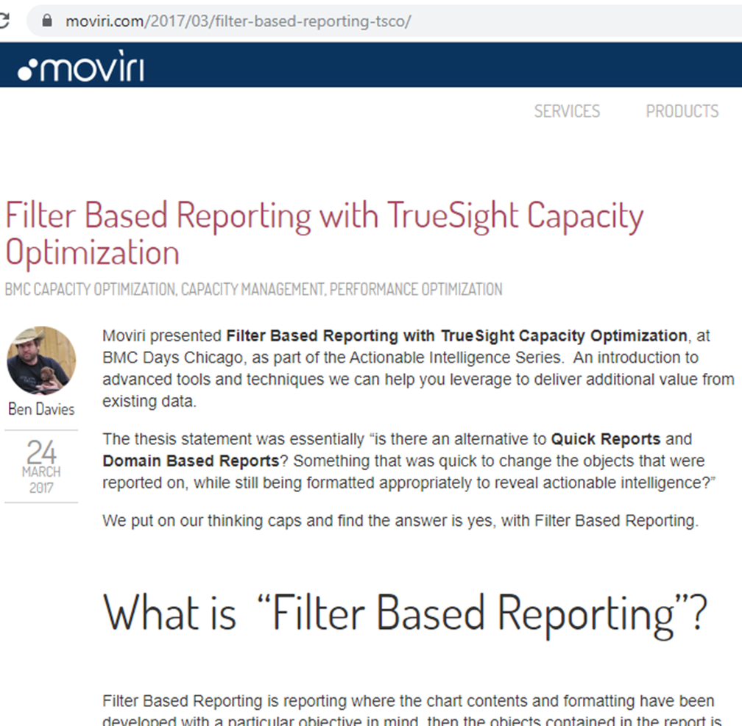
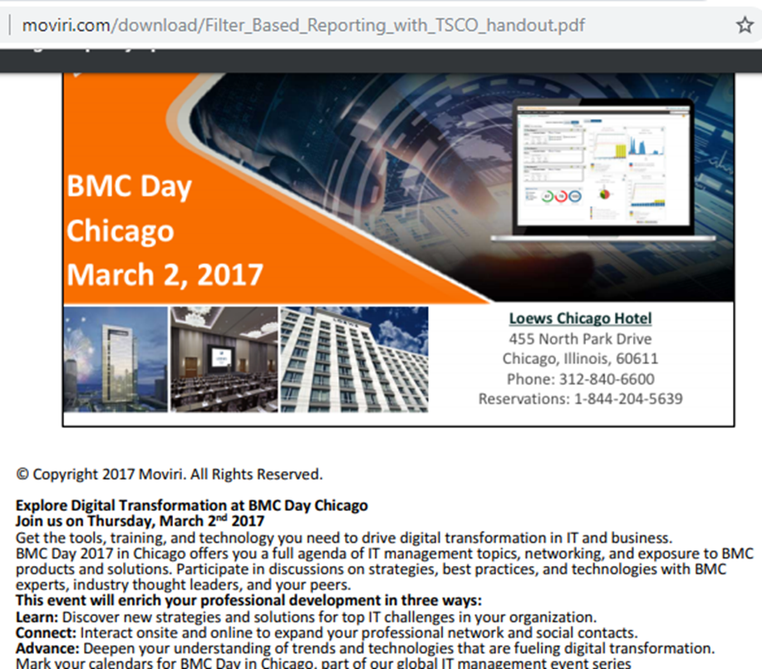
The Two Links Up Close
Notes:
A closer look at the two links. The blog entry starts with
“The thesis statement was essentially “is there an alternative to Quick Reports and Domain Based Reports? Something that was quick to change the objects that were reported on, while still being formatted appropriately to reveal actionable intelligence?”
We put on our thinking caps and find the answer is yes, with Filter Based Reporting.
What is “Filter Based Reporting”?
Filter Based Reporting is reporting where the chart contents and formatting have been developed with a particular objective in mind, then the objects contained in the report is chosen at report time by being defined in a filter.”
That looks very close to what we wish, and the bottom of the article links to the PDF file that is in the search results.
We see that it is the presentation used at a BMC Day, which are local events throughout the world for BMC users to discuss / exchange tools and techniques. If you went to the documentation presentation (which is the second in this series), the BMC Days and similar events are good sources of documentation / ideas in your Quest for Actionable Intelligence.
The presentation discusses that there are Quick Analysis as a reporting techniques and Workspace tab reporting techniques.
The first is ‘quick’ but not so friendly to customizing the charts, The works tab allows for the customizing but is not so friendly to customizing the list of devices.
Then introduces the idea of “Filter Based Reporting”
This seems like it provides useful tools and techniques talked about in our Value Proposition for Capacity Manager

Slide 8
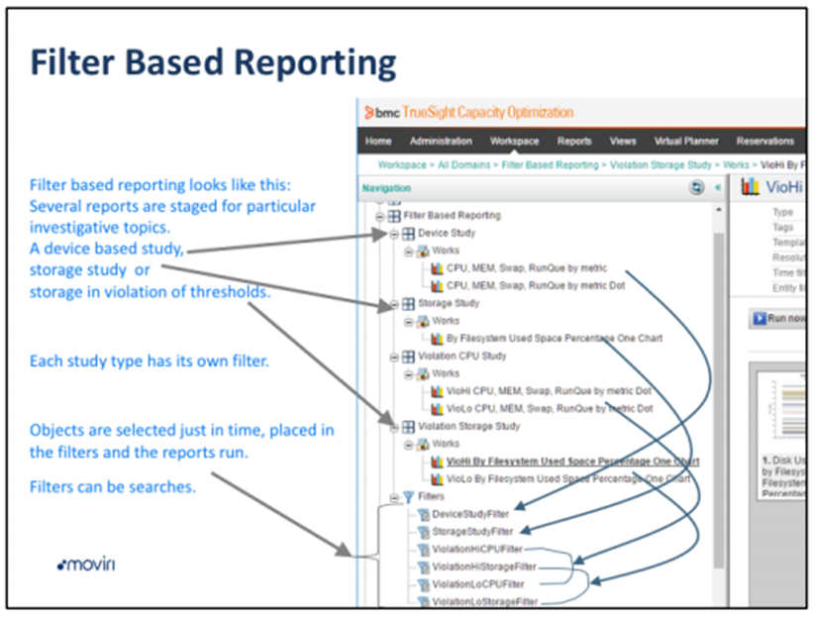
Notes:
So we read the suggestions with an eye towards implementing this based on our own TSCO environment.
A quick review of the documentation states that you can have the best of both worlds by making a series of charts that are formatted exactly the way you wish like in the Work Space tab technique, but then use a filter as the basis for selecting the devices just in time for reporting, as in the Quick Report technique.
It goes on to talk about one filter can be the source of several charts depending on the ‘normal mission’
====
The good stuff starts on page 12 of the PDF Where the charts for the different missions have their own filters to drive them. Shown here as the Device Study has a couple reports (well formatted I am sure to that mission) and are driven from a DeviceStudyFilter. Likewise the Storage Study has a report (could be more) driven from its own filter – StorageStudyFilter.
This gives us well formatted reports where the objects to be reported on are added to the filter just before the chart is run. A good mix of Quick analysis and Workspace Tab Reporting.

Slide 9
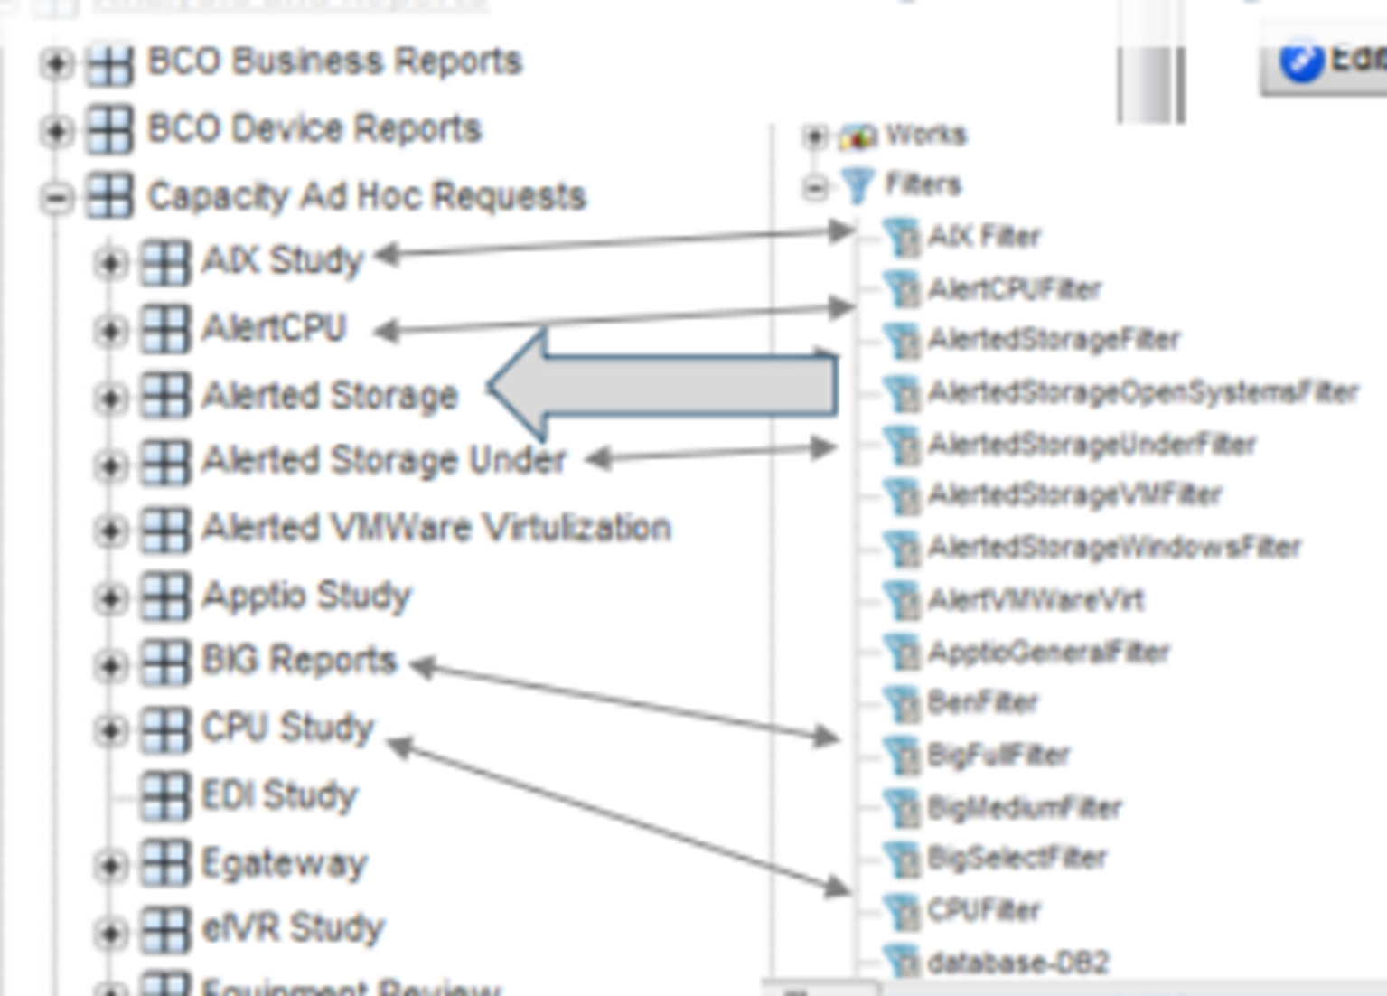
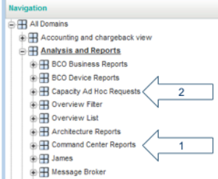
Notes:
Then suggests that many missions can be accommodated. In the example there are places for Message Broker, Architecture Reports but the examples focuses on Command Center Reports and Capacity Ad Hoc Requests.
Skipping to the “Capacity Ad Hoc Requests” shows an example where there are a number of charts for AIX Study and are driven by an AIX Filter. So to a group for CPU Study driven by one filter called CPUFilter. So while not very creative of a naming scheme, it seems straight forward.
Reading the details suggests that the ‘buckets’ should be made first, then the filters, then the reports. Where to put the filters depends on the desire to copy reports from one tree to another.
So Lets to this ‘live’ …

Slide 10
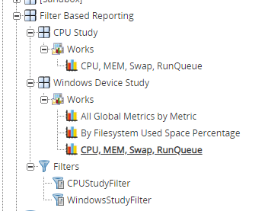
Overview of the demo
Make the Filter Based Reporting Bucket
Make the Windows Device Study Bucket
Make the WindowsStudyFilter
Set Filter to (tag:windows)
Make Reports
Make CPU Study Bucket
Make CPUStudyFilter
Set Filter to
(type:sys -type:object -Storage* -"Datastore")
Make Reports AND / OR Copy Reports
Notes:
Make the Filter Based Reporting Bucket
Make the Windows Device Study Bucket
Make the WindowsStudyFilter
Set Filter to (tag:windows) (tag:windows AND sys:bpa*)
Make Reports based on the filter
Make CPU Study Bucket
Make CPUStudyFilter
Set Filter to (type:sys -type:object -Storage* -"Datastore") (sys:bpa*)
Make Reports AND / OR Copy Reports
These filters are to limit the number of devices so that they run quick enough for a demo. YOUR filters need to be specific to your reporting mission.
(tag:windows AND sys:bpa*)
(sys:bpa*)

Slide 11
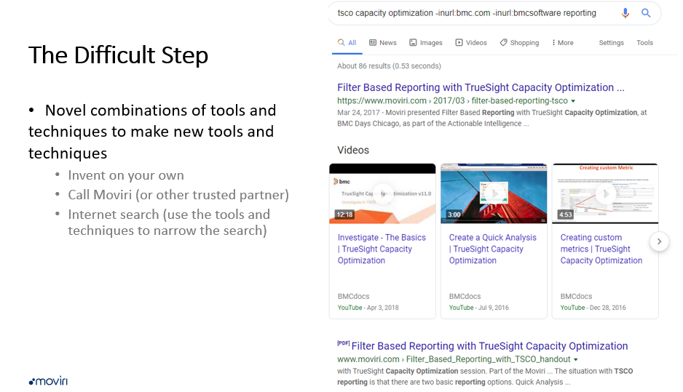
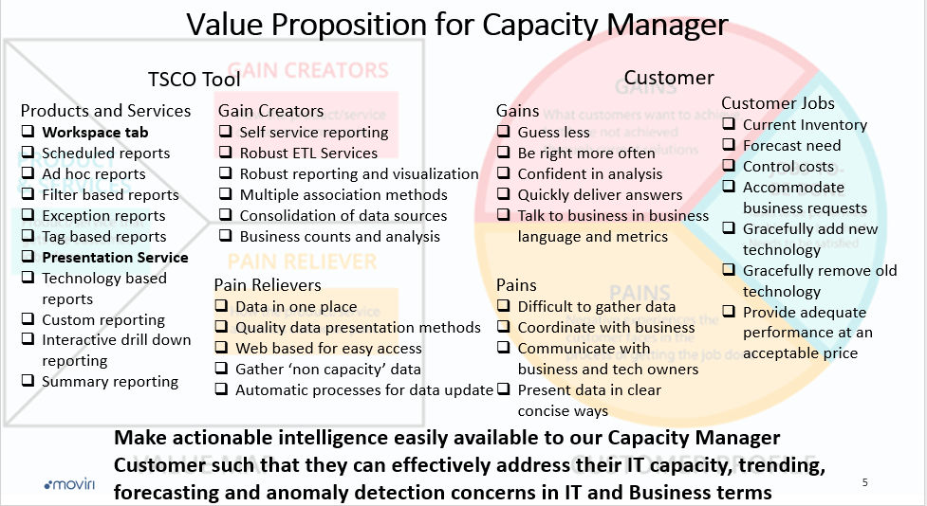
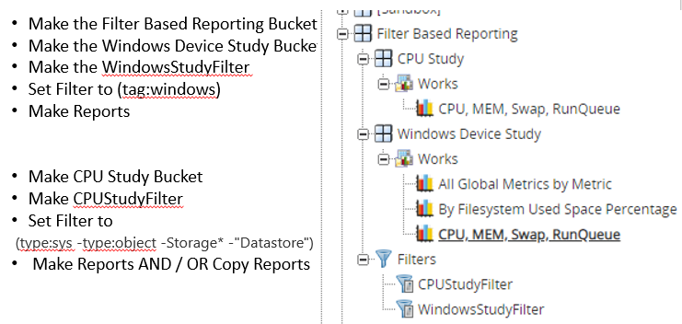

Summary, Questions, Conversation
If I can do THAT, then I should be able to…
Notes:
In Summary,
We discussed our Value Proposition with our customer the Capacity Manager and discovered Jobs, Pains, and Gains that the TSCO solution is likely to be able to deliver on. Which is well defined charts with last minute determination of devices to report on.
An internet search or conversation with our trusted partners suggested tools and techniques that could deliver a product “Filter Based Reporting” that addressed some significant pains, deliver valuable gains, and allowed high value jobs to be done by the customer. While not discussed overtly here, we determined a price for this service, which may have been informed by our cost to deliver the service, and in accordance with our business plan.
With some creativity we applied the tools and techniques, adjusted and adjusted again with our customers SMEs, to deliver a valuable value proposition to this customer.
In the end we enabled our customer in their Quest for Actionable Intelligence and enabled the TSCO solution to offer similar value to other customers. Using the ‘simple’ processes discussed in the first couple sessions.
TrueSight Capacity Optimization Value Proposition for Information Technology
TrueSight Capacity Optimization Documentation Options
And a heavy dose of
If I can do that… then I should be able to…
Any questions or topics for discussion??

