Slide 1
Quest for Actionable Intelligence
Exception Reporting
Conversations about TSCO
Andrea Gallo – andrea.gallo@moviri.com
Notes:
This is one of several webinar conversations about applying the value proposition of Information Technology Capacity Optimization.
Our goal is to help clarify the capacity optimization mission, and to provide tools and techniques to assist in the Quest for Actionable Intelligence.
With a clear mission and actionable intelligence, the capacity optimization function delivers significant value to the Organization.
In this session – Exception Reporting becomes the focus

Slide 2
Agenda
Introduce Moviri
Review the TSCO Layout, Business Model Canvas, and Value Proposition
Review our Value Proposition for Capacity Manager
Expand that Value proposition
Focus on Exception Based Reporting as a Product & Service Solution for our Capacity Manager
Live Demo ??
Review, Questions and Conversation
Notes:
Agenda:
Introduce Moviri
Review the TSCO layout, Business Model Canvas, Value Proposition
Review our Value Proposition for Capacity Manager
Expand that value proposition
Focus on Exception Based Reporting as a product & Service Solution for our Capacity Manager
‘live’ demo showing how we can implement this solution.
Then open for questions and conversations – but feel free to interject

Slide 3




Why Listen To Us
Movìri is a global IT consultancy with multiple offices in the US and around the globe
More than 200 engineers worldwide
  More Doctors than most hospitals ☺
Developers of Caplan, become BMC TrueSight Capacity Optimization
Movìri has several lines of business:
  Testing & Optimization
  Monitoring
  Operations and Cloud
  Security, Analytics
  Capacity Management
Big picture, many disciplines, much experience
  ContentWise.com; Cleafy.com; AKAMAS.IO
We can help you do this quickly and cleanly
Notes:
So why listen to Moviri?
Movìri is a global IT consultancy with multiple offices in the US and around the globe
More than 200 engineers world wide we have more Doctors than most hospitals!
Started as Neptuny, developers of Caplan, a magic quadrant capacity optimization product. Purchased by BMC in 2010 to become BMC Capacity Optimization, which is now BMC TrueSight Capacity Optimization. Neptuny became Movìri.
Movìri has several lines of business, including Testing & Optimization, Monitoring. Operations and Cloud, Security, Analytics, and Capacity Management – which is to say we think holistically. Big picture, many driplines, much experience, and continue to offer innovative products, including ContentWise; Cleafy; AKAMAS
Movìri has been doing this a long time, and is a thought leader and innovator.
And most importantly, you should listen to Movìri because: We can help you do this – quickly, and cleanly.
So, Let us jump right in…
===
https://www.crunchbase.com/organization/neptuny
http://www.moviri.com/2010/10/goodbye-neptuny-welcome-moviri/
https://www.moviri.com/news-events/akamas-ai-powered-performance-optimization-solution/
https://www.moviri.com/
https://www.akamas.io/
https://www.contentwise.tv/
https://www.cleafy.com/
https://www.linkedin.com/company/moviri/about/

Slide 4
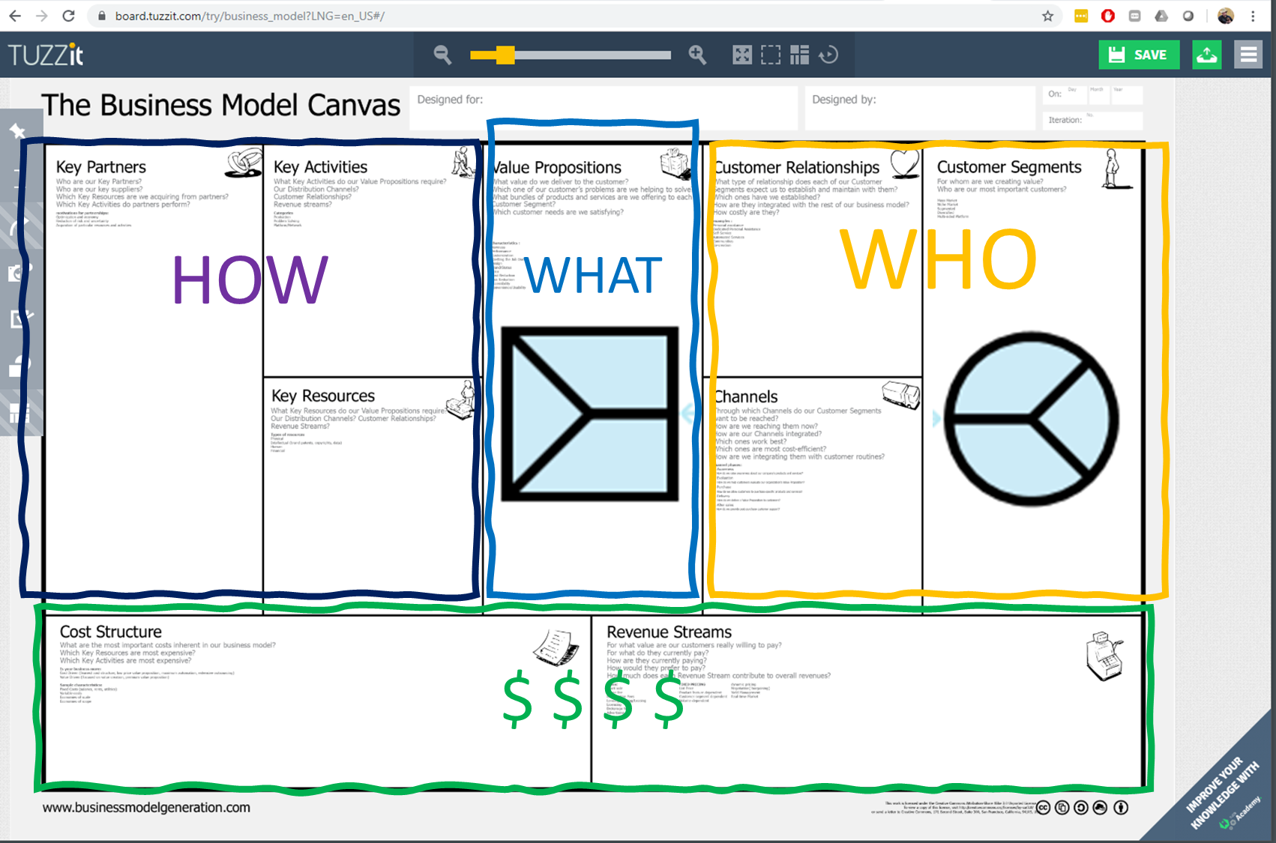
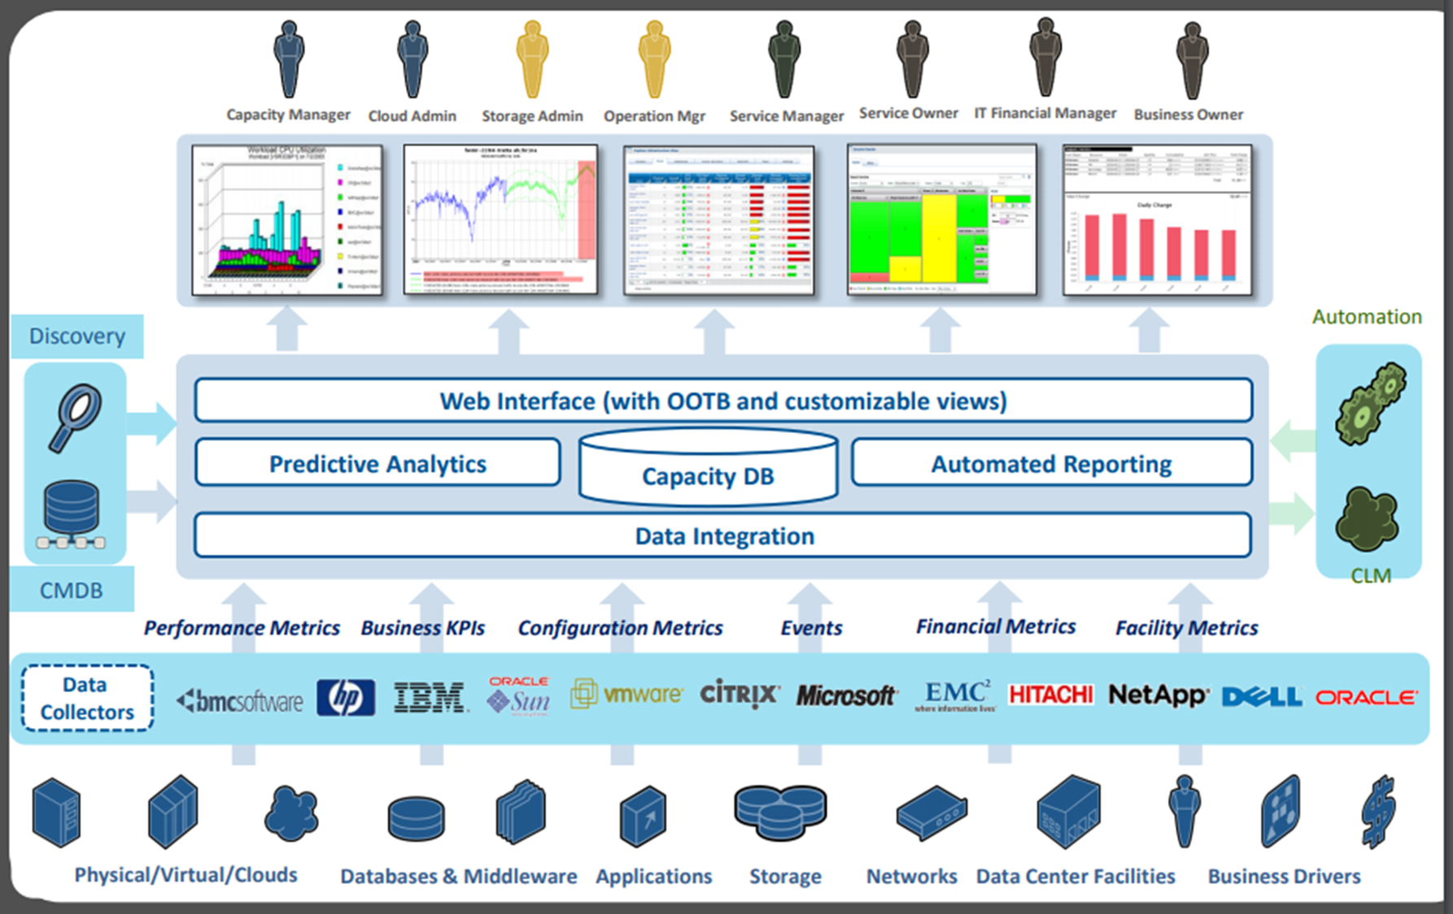
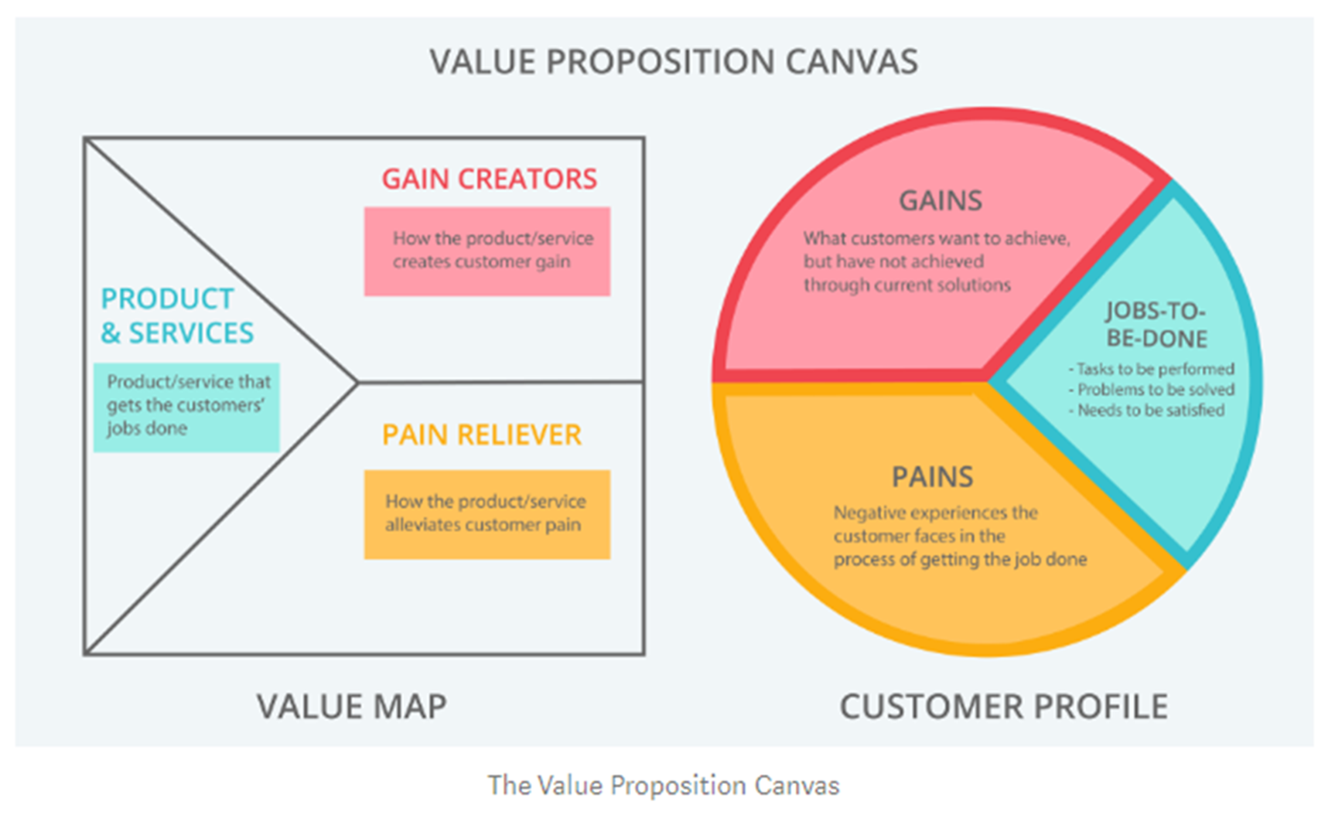
Quick Review
Make actionable intelligence easily available to our Capacity Manager Customer such that they can effectively address their IT capacity, trending, forecasting and anomaly detection concerns in IT and Business terms
Notes:
Quick Review (from the first in the Quest for Actionable Intelligence – Value Proposition conversation)
Top left = basic layout of TSCO. Our customer is the top left persona of Capacity Manager (a version of ourselves)
Top right = Business Model Canvas with a focus on the top right What and Who
Bottom Left = Value Proposition Canvas We will explore this in a bit of detail specific to todays topic
Bottom right = A Concise Value Proposition summary.
Make actionable intelligence easily available to our Capacity Manager Customer such that they can effectively address their IT capacity, trending, forecasting and anomaly detection concerns in IT and Business terms

Slide 5


Value Proposition for Capacity Manager
TSCO Tool
Customer
Products and Services
Workspace tab
Scheduled reports
Ad hoc reports
Filter based reports
Exception reports
Tag based reports
Presentation Service
Technology based reports
Custom reporting
Interactive drill down reporting
Summary reporting
Gain Creators
Self service reporting
Automatic report generation
Robust reporting and visualization
Settable thresholds
Threshold based reporting
Business counts and analysis
Gains
Guess less
Be right more often
Confident in analysis
Quickly deliver answers
Talk to business in business language and metrics
Customer Jobs
Current Inventory
Forecast need
Control costs
Accommodate business requests
Gracefully add new technology
Gracefully remove old technology
Provide adequate performance at an acceptable price
Pain Relievers
Data in one place
Quality data presentation methods
Web based for easy access
Gather ‘non capacity’ data
Automatic processes for data update
Pains
Difficult to gather data
Coordinate with business
Communicate with business and tech owners
Present data in clear concise ways
Make actionable intelligence easily available to our Capacity Manager Customer such that they can effectively address their IT capacity, trending, forecasting and anomaly detection concerns in IT and Business terms
Notes:
Here is a Value Proposition for the Capacity Manager as the customer and TSCO tool as the value provider.
Summarized nicely with
“Make actionable intelligence easily available to our customers such that they can effectively address their IT capacity, trending, forecasting and anomaly detection concerns in IT and Business terms”
We are going to expand this a bit –
The Capacity Manager has a job to do of ‘Develop and maintain a reporting method that examines resources that are out of normal ranges’
Pains:
Thresholds and setpoints are set but difficult to ‘maintain’
Evaluating devices to thresholds is a time consuming, difficult task. This difficulty leads to infrequent if ever evaluation of devices vs thresholds
Thresholds are not well understood so are not well maintained, managed, or monitored
Chicken and Egg game – Thresholds are not correct, so are not used, so are not correct.
Gains:
Senior managers frequently are frustrated that this sort of reporting is difficult, expensive, time consuming to make. I can be the hero if I could routinely deliver these sorts of reports.
Senior managers are frequently frustrated when an infrastructure problem has been preceded with a threshold violation that went undetected. I can be the hero if I could routinely deliver device lists that are over threshold, such that appropriate action can be initiated
Senior managers are frustrated that thresholds are not well maintained, managed or monitored. I can be the hero if I could routinely deliver threshold violations with an eye toward verifying the appropriateness of the threshold level in a specific situation, and can customize thresholds in a general and specific sense.
Thresholds are used to the extent they are helpful and helpful to the extent they are used. After an initial bit of irritation, I can be the hero if I could easily maintain thresholds that area meaningful (potentially down to the device).
Efficiency management is a major value proposition when buying the TSCO solution. Managing the under utilized thresholds delivers on that value proposition.
Well designed charts, tables, and analysis can be constructed ahead of time and envoked with current list of alerted devices
Charts from alerted devices can be automated and delivered to SMEs via email.
Exception Based Reporting is the ‘products and services’ to deliver on this value proposition.
OK. So lets implement “Exception Based Reporting”

Slide 6
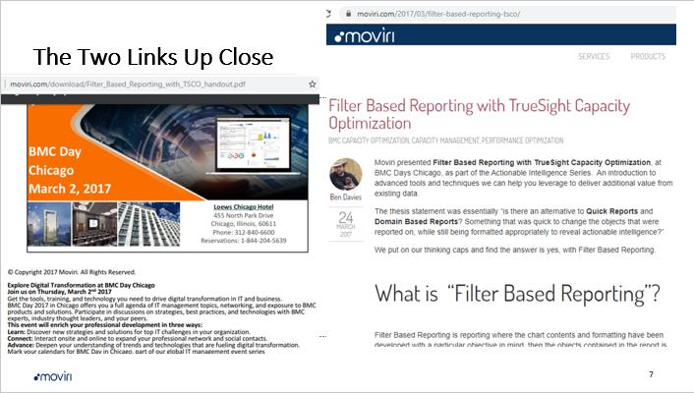
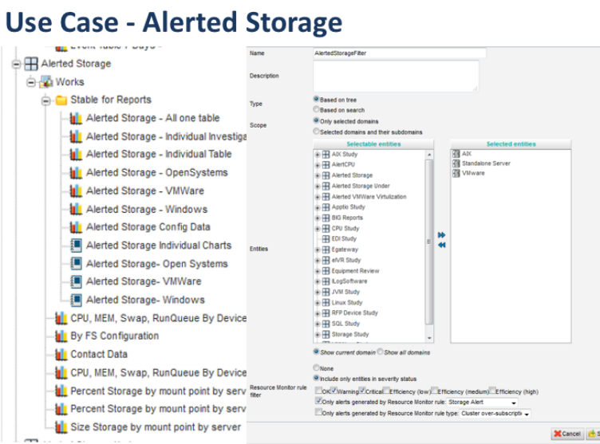
Filter Based Reporting – Mod 1
Notes:
We had a similar exercise that delivered Filter Based Reporting as a solution to a similar but not the same problem. While researching that, there was an intriguing suggestion that we might use here.
There is a suggestion that we can have a filter that is based on “Alerted CPU” and “Alerted Storage” among others.
The process is to make a resource Monitor rule with the indent to use it in the alerted storage reports

Slide 7
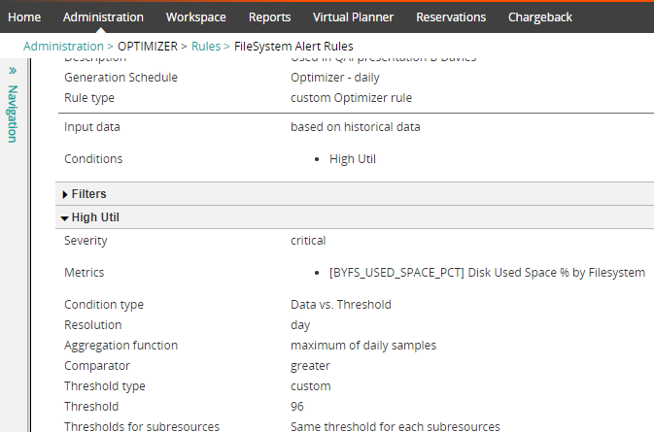
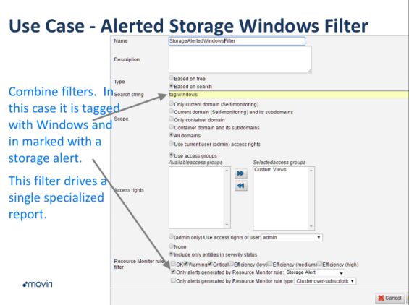
Alerted Storage
Notes:
Todays topic is intended to highlight the reporting abilities .
The example given suggested that we could make a filter based on a search for Windows devices but only the ones that are in a Warning or Critical state for the “Storage Alert” Resource Monitoring rules.
This implies that we need to make an Optimizer rule first. Then to the extent that some resource is in violation of that rule it can be included in Filter Based Reports.
What this actually means is that we can have a filter of all windows devices that are also in violation of Optimizer rule. So While we may have thousands of Windows devices, we only report on the handful that are in an exception state.
Well thought out combinations can produce very focused, well designed, automatically run, emailed to the SMEs, reports that quickly convey an exception state, and give enough additional information to quickly assess the urgency of the situation.
==
While the example is a bit contrived, we will hopefully show you a path from an existing problem (known unknown) to a solution (known known)
https://en.wikipedia.org/wiki/Johari_window
https://www.pmi.org/learning/library/characterizing-unknown-unknowns-6077

Slide 8
Demo …

Slide 9
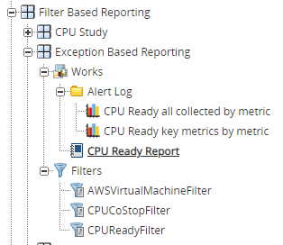
In Case the Demo does not work
Admin Tab | Optimizer
Make an Optimizer Rule (CPU CoStop)
Run the rule
Workspace Tab | Filter Based Reporting |Exception Based Reporting
Make a filter (CPUCoStopFilter)
Make a chart(s) based on the filter
Put most useful charts in Report Cart
Edit report Cart, schedule, and email result to SME
Repeat as necessary (CPU Ready, RunQueue, File Systems …)
Notes:
Admin Tab | Optimizer
Make an Optimizer Rule (CPU CoStop)
CPU CoStop; daily, custom rule;
Warning
Critical
Warning; CPU_COSTOP; Vs. Threshold; Hour; Max hourly samples; greater; custom 5
Critical; CPU_COSTOP; Vs. Threshold; Hour; Max hourly samples; greater; custom 8
Action = Change status
Useful to note that if it triggers the rule but is not flagged it does get the OK flag
Run the rule
****
Workspace Tab | Filter Based Reporting |Exception Based Reporting
Make a filter (CPUCoStopFilter)
Make a chart(s) based on the filter – can be ANY metric, not just what was alerted. Need NOT include the metric alerted.,
Put most useful charts in Report Cart
Edit report Cart, schedule, and email result to SME
Repeat as necessary (CPU Ready, RunQueue, File Systems …)

Slide 10
Where to get the Thresholds
There are NO universal thresholds
There are ‘rules of thumb’*
Internal groups may have standards but are not generally ‘published’
Thresholds are driven by current situation – which means they change
Set and enforce thresholds to solve a BUSINESS problem
  Too many ‘tickets’ ~ over utilization of CPU, MEM, File Systems
  Cost too much ~ under utilization of CPU, File System
  Promote the general health ~ Run Queue, CPU CoStop, CPU Ready, Min Idle Workers, Mem Swap
It is a mistake to enforce all thresholds starting now – Divide and concur
Pick top 10 or adjust the threshold
Notes:
There are no published thresholds at least not like you would think. There are ‘rules of thumb’ but your mission, tolerance for risk, budget, and business plan will dictate what the thresholds should be FOR YOU and your current situation. As the situation changes so should the thresholds, or at least the reaction to the thresholds.
There should be configuration standards formally ‘published’ within your organization. However, my experience is that while the standards ‘exist’ they are by no means ‘published’. Application owners, infrastructure owners, and managers may have their ‘standards’. If they have them, use them. IF not you may wish to set your own, but alerting on thresholds for action will force some sort of response. Be ready for resistance with a business reason to be ‘enforcing’ thresholds.
Set and enforce thresholds to solve a BUSINESS problem.
It would be a mistake to enforce all metrics starting now. Select metrics based on current situation and business needs.
Divide and conquer: Pick your own number – for a long list attack the top 10 and or adjust the threshold
Run Queue > 2 / core
CPU Ready > 7
CPU CoStop > 9
Windows C Drives > 95% util;
any drive over 85% util;
Windows CPU above 60% hourly average;
any CPU 95% hourly average;
[1] https://www.dictionary.com/browse/rule-of-thumb
ftp://ftp.bmc.com/pub/perform/gfc/das/

Slide 11
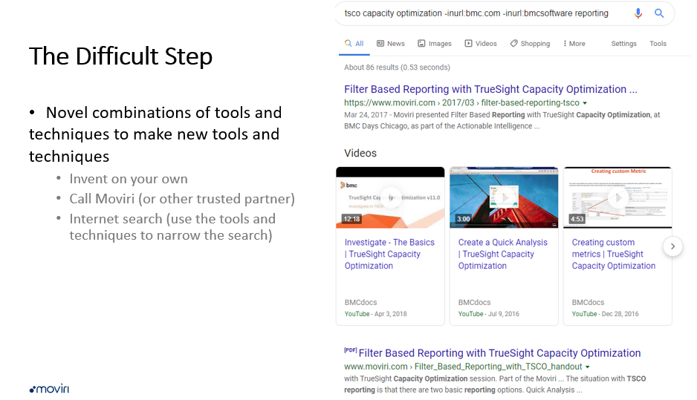
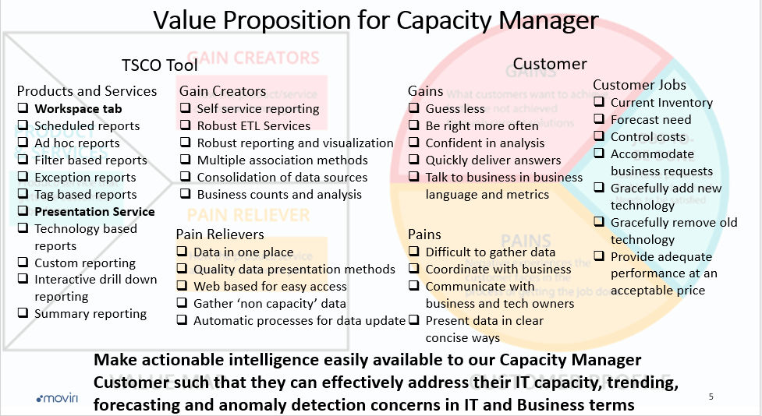
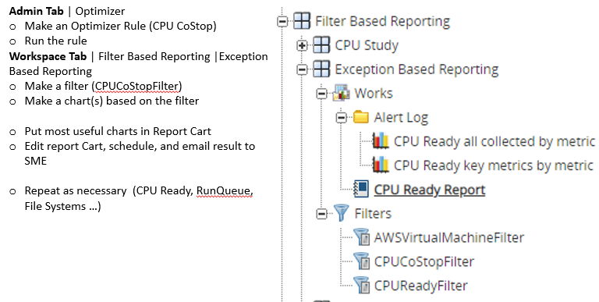

Summary, Questions, Conversation
If I can do THAT, then I should be able to…
Notes:
In Summary,
We discussed our Value Proposition with our customer the Capacity Manager and discovered Jobs, Pains, and Gains that the TSCO solution is likely to be able to deliver on. (Which is well defined charts to quickly evaluate devices that are in an exception state)
An internet search or conversation with our trusted partners suggested tools and techniques that could deliver a product “Exception Based Reporting” that addressed some significant pains, deliver valuable gains, and allowed jobs to be done by the customer.
With some creativity we applied the tools and techniques, adjusted and adjusted again,.
In the end we enabled our customer in their Quest for Actionable Intelligence and enabled the TSCO solution to offer similar value to other customers. Using the ‘simple’ processes discussed in the first couple sessions.
TrueSight Capacity Optimization Value Proposition for Information Technology
TrueSight Capacity Optimization Documentation Options
And a heavy dose of
If I can do that… then I should be able to…
Any questions or topics for discussion??

