Slide 1
Quest for Actionable Intelligence
TSCO Workspace Tab Design and Organization
Conversations about TSCO
Andrea Gallo – andrea.gallo@moviri.com
Notes:
This is one of several webinar conversations about the value proposition of Information Technology Capacity Optimization.
Our goal is to help clarify the capacity optimization mission, and to provide tools and techniques to assist in the Quest for Actionable Intelligence.
With a clear mission and actionable intelligence, the capacity optimization function delivers significant value to the Organization.
In this session – TSCO Workspace Tab Design and Organization becomes the focus

Slide 2
Agenda
Introduce Moviri
Review the TSCO Layout, Business Model Canvas, and Value Proposition
Review our Value Proposition for Capacity Manager
Expand that Value proposition
Focus on ways to organize the Workspace tab
Implications on the Presentation Service
Tags, Filters and Search
Call to action
Review, Questions and Conversation
Notes:
Agenda:
Introduce Moviri
Review the TSCO layout, Business Model Canvas, and Value Proposition
Review our Value Proposition for Capacity Manager
Expand that value proposition
Focus on ways to organize the Workspace tab
Implications on the Presentation Service
Then open for questions and conversations – but feel free to interject

Slide 3




Why Listen To Us
Movìri is a global IT consultancy with multiple offices in the US and around the globe
More than 200 engineers worldwide
  More Doctors than most hospitals ☺
Developers of Caplan, become BMC TrueSight Capacity Optimization
Movìri has several lines of business:
  Testing & Optimization
  Monitoring
  Operations and Cloud
  Security, Analytics
  Capacity Management
Big picture, many disciplines, much experience
  ContentWise.com; Cleafy.com; AKAMAS.IO
We can help you do this quickly and cleanly
Notes:
So why listen to Moviri?
Movìri is a global IT consultancy with multiple offices in the US and around the globe
More than 200 engineers worldwide
Started as Neptuny, developers of Caplan, a magic quadrant capacity optimization product. Purchased by BMC in 2010 to become BMC Capacity Optimization, which is now BMC TrueSight Capacity Optimization. Neptuny became Movìri.
Movìri has several lines of business, including Testing & Optimization, Monitoring. Operations and Cloud, Security, Analytics, and Capacity Management – which is to say we think holistically. Big picture, many disciplines, much experience, and continue to offer innovative products, including ContentWise; Cleafy; AKAMAS
Movìri has been doing this a long time, and is a thought leader and innovator.
And most importantly, you should listen to Movìri because: We can help you do this – quickly, and cleanly.
So, Let us jump right in…
===
https://www.crunchbase.com/organization/neptuny
http://www.moviri.com/2010/10/goodbye-neptuny-welcome-moviri/
https://www.moviri.com/news-events/akamas-ai-powered-performance-optimization-solution/
https://www.moviri.com/
https://www.akamas.io/
https://www.contentwise.tv/
https://www.cleafy.com/
https://www.linkedin.com/company/moviri/about/

Slide 4
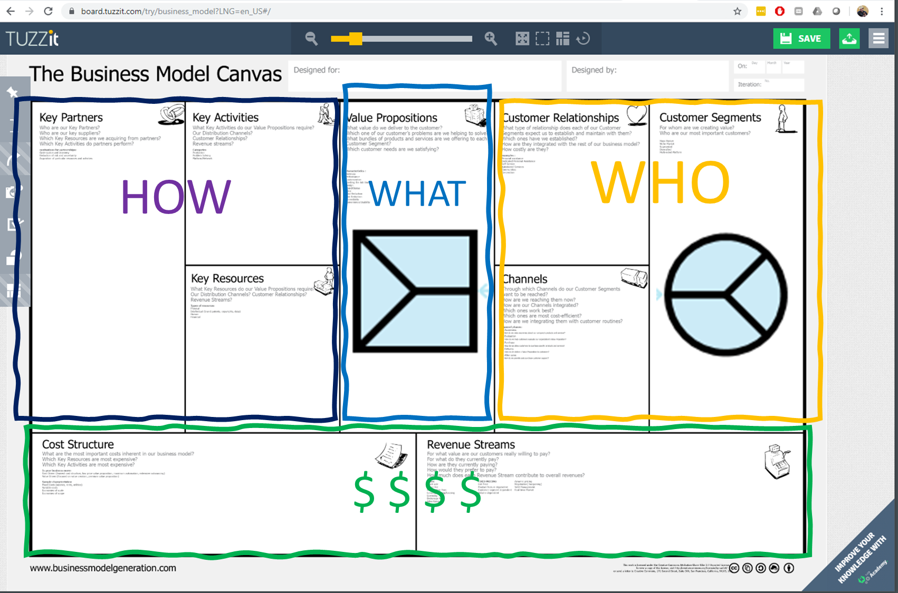
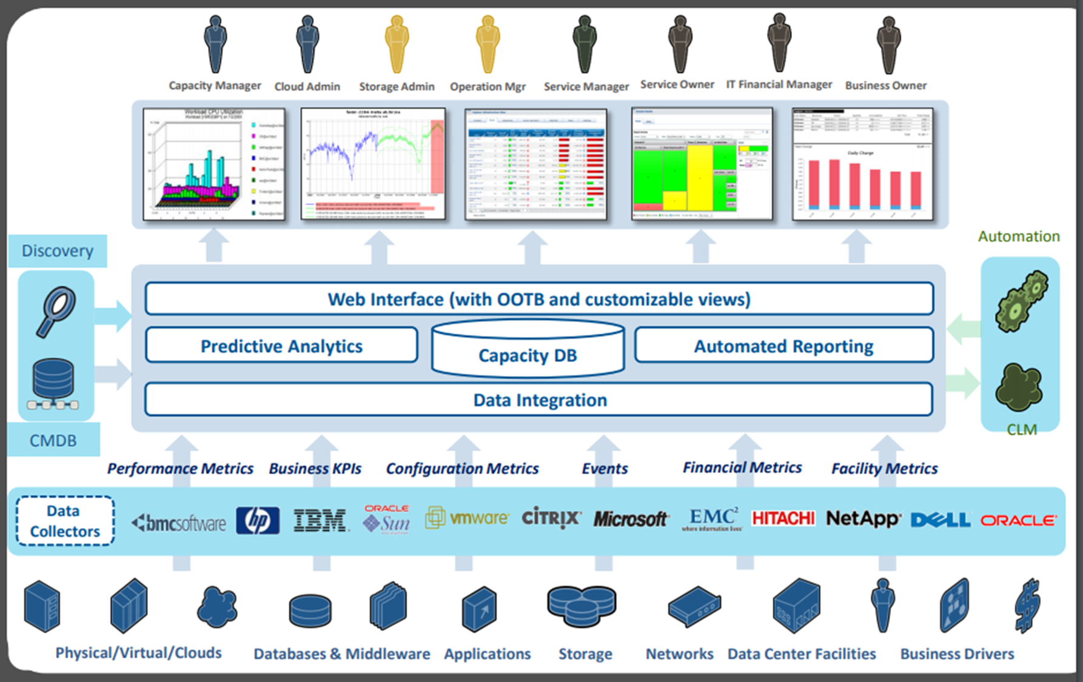
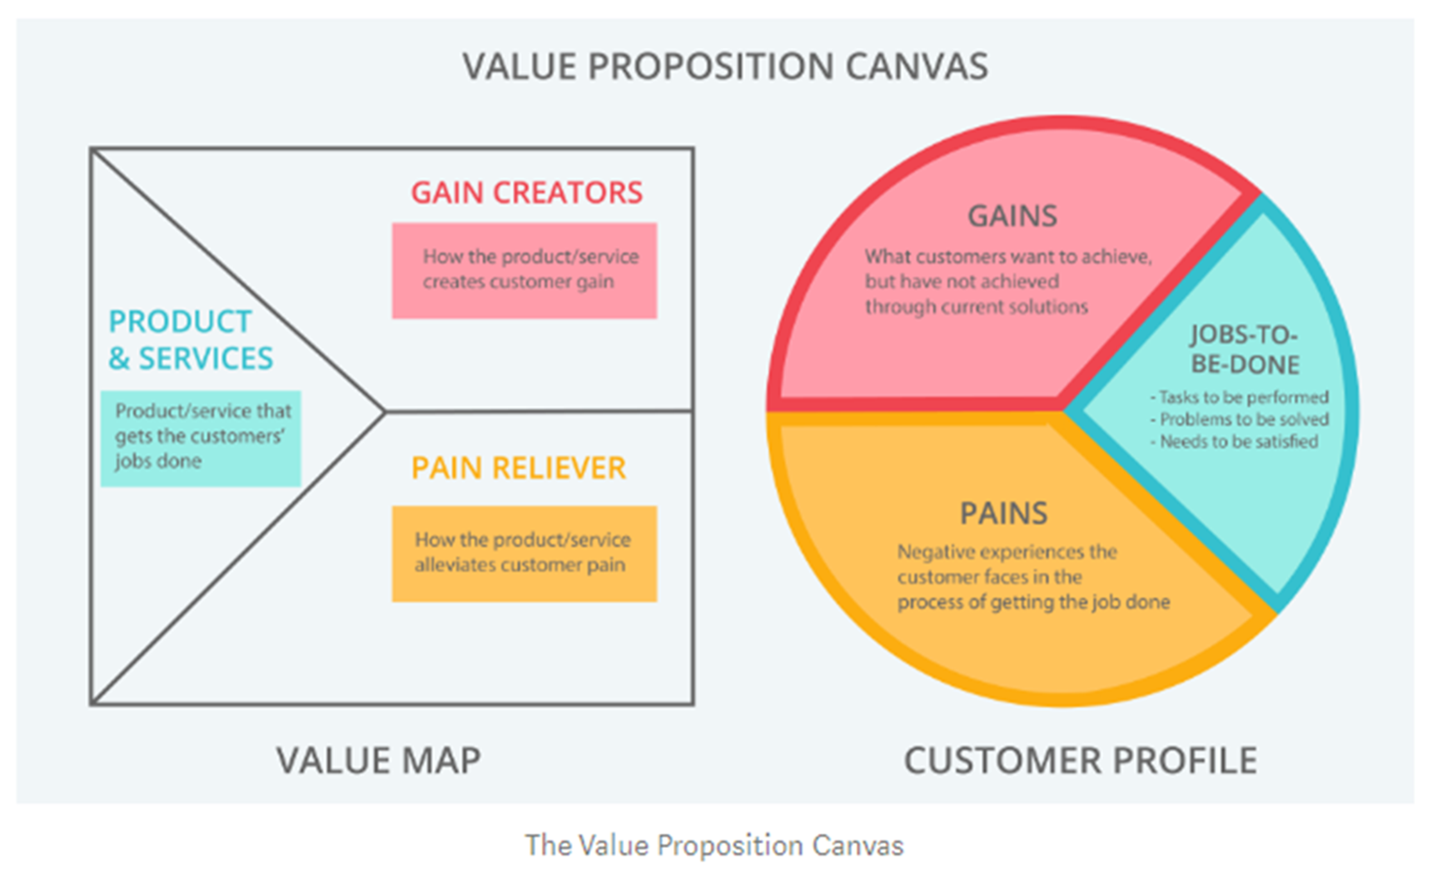
Quick Review
Make actionable intelligence easily available to our Capacity Manager Customer such that they can effectively address their IT capacity, trending, forecasting and anomaly detection concerns in IT and Business terms
Notes:
Quick Review (from the first in the Quest for Actionable Intelligence) – Value Proposition conversation
Top left = basic layout of TSCO. Our customer is the top left persona of Capacity Manager (a version of ourselves)
Top right = Business Model Canvas with a focus on the top right What and Who
Bottom Left = Value Proposition Canvas We will explore this in a bit of detail specific to todays topic
Bottom right = A Concise Value Proposition summary.
Make actionable intelligence easily available to our Capacity Manager Customer such that they can effectively address their IT capacity, trending, forecasting and anomaly detection concerns in IT and Business terms

Slide 5


Value Proposition for Capacity Manager
TSCO Tool
Customer
Products and Services
Workspace tab
Scheduled reports
Ad hoc reports
Filter based reports
Exception reports
Tag based reports
Presentation Service
Technology based reports
Custom reporting
Interactive drill down reporting
Summary reporting
Gain Creators
Self service reporting
Automatic report generation
Robust reporting and visualization
Settable thresholds
Threshold based reporting
Business counts and analysis
Gains
Guess less
Be right more often
Confident in analysis
Quickly deliver answers
Talk to business in business language and metrics
Customer Jobs
Current Inventory
Forecast need
Control costs
Accommodate business requests
Gracefully add new technology
Gracefully remove old technology
Provide adequate performance at an acceptable price
Pain Relievers
Data in one place
Quality data presentation methods
Web based for easy access
Gather ‘non capacity’ data
Automatic processes for data update
Pains
Difficult to gather data
Coordinate with business
Communicate with business and tech owners
Present data in clear concise ways
‘Develop and maintain an organization that is ‘simple’, intuitive, flexible, maintainable, and accommodates multiple customers with multiple use cases’
Notes:
Here is a Value Proposition for the Capacity Manager as the customer and TSCO tool as the value provider.
Summarized nicely with
“Make actionable intelligence easily available to our customers such that they can effectively address their IT capacity, trending, forecasting and anomaly detection concerns in IT and Business terms”
We are going to expand this a bit –
The Capacity Manager has a job to do of ‘Develop and maintain an organization that is ‘simple’, intuitive, flexible, maintainable, and accommodates multiple customers with multiple use cases’
Pains:
By default all new objects end up in the ‘newly discovered bucket’
Multiple data sources need to merge onto common objects but do not have common indexes
Multiple objects are shared across business applications
Identifying change conflicts, and impacts of device troubles, is difficult in a shared environment
Reporting on relevant while excluding not relevant objects is difficult to do manually
Multiple customers have various use cases that need to be easily accommodated. This is difficult to design for, as use cases change.
There are multiple, mutually exclusive versions of ‘truth’ when it comes to grouping objects
Gains:
Many existing tools are difficult to use to find data on an object. I can be the hero if I could expose objects with meaningful associations.
The ability to place objects in multiple places ‘automatically’ allows for a ‘Eat your cake and have it too’ meaning that one device can ‘live’ in several places
Reporting on sub sets of objects, including comparing objects in a sub set to each other, can quickly deliver understanding
Allowing multiple views of ‘truth’ allows for accommodating of various missions
Grouping items that are not already in a group, can add significant utility to reporting.
“Workspace Tab design and organization” is the ‘products and services’ to deliver on this value proposition.
OK. So lets implement “Workspace tab design and organization”

Slide 6
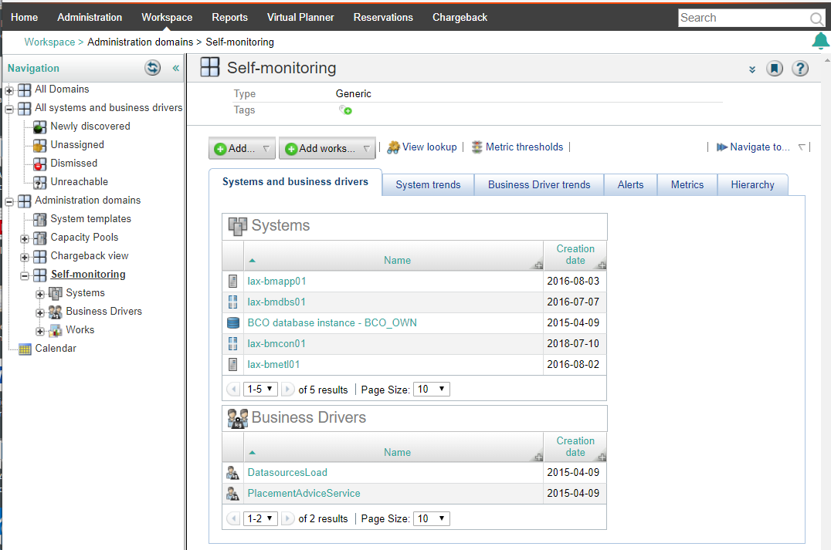
Workspace Domains, Tools and Techniques
All systems & Bus Drivers
Administration Domains
Domains
Sub Domains
Hierarchies
Tags
Filters (search)
Search
Superheroes
Notes:
Workspace Domains, Tools, and Techniques
The BMC documentation defines the various object that are available in the Workspace tab but does not have a discussion of why one design would be better than another. The main reason is that it completely depends on how YOU group things together in YOUR capacity efforts.
When a system or business driver are imported to TSCO it will go to “Newly discovered” unless it is told to go elsewhere. It is useful to note that when systems or business drivers are removed and not assigned to any other domain, it will be moved to “Unassigned”. When the device ‘reappears’ in a domain, it is taken out of “Unassigned
*
This gets us to the domains, subdomains (aka the hierarchies). This is a way to organize the objects in such a way as to support reporting. We will look closer at this in a minute.
*
Tags which can be used in searches and therefore filters. Tags and domains are seen by the presentation service, and Views on the smart reporting service.
Tags, Filters and Search are superheroes within TSCO.
====
Managing and analyzing data from your workspace
https://docs.bmc.com/docs/btco113/managing-and-analyzing-data-from-your-workspace-775472446.html
Setting up and managing domains in your workspace
https://docs.bmc.com/docs/btco113/setting-up-and-managing-domains-in-your-workspace-775472447.html
Hierarchies
https://docs.bmc.com/docs/btco113/hierarchies-775472711.html

Slide 7
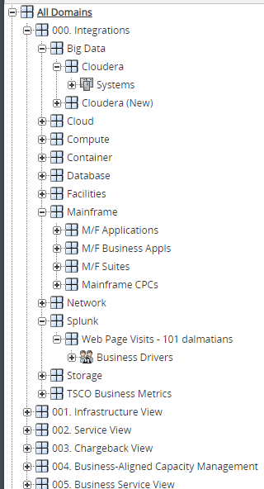
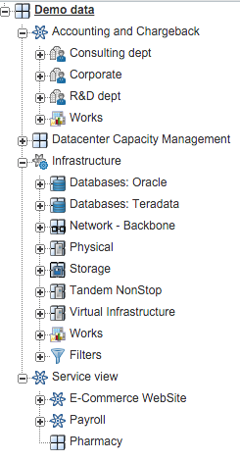
Domains, Subdomains And Hierarchies
Domains and subdomains contain systems, business drivers and works (reports)
One object can be in many domains
Domains are seen by the Presentation service so can be very useful to limit reporting scope
The way YOU wish to organize data determines the way YOU design your hierarchies
Notes:
Domains and subdomains contain systems, business drivers, and works (reports)
One object can be in many domains
Domains are seen by the Presentation service so can be very useful to limit reporting scope
The way YOU wish to organize data determines the way YOU design your hierarchies
So what exactly does this mean to you? Well it depends. So lets look at two examples.
The company on the left apparently has a large accounting and charge back focus with ‘buckets’ for Consulting, Corporate and R&D department. This allows them to report at those four levels (big bucket, and 3 smaller buckets). That is how they decided to answer the question “What helps my reporting?”
In addition there is a whole list of infrastructure groupings with potential sub groupings. This tends to be how the ETL (Extract Transform Load) process gets data into TSCO from each data source but it could be ‘just one big bucket’. Because an ETL tends to get a particular type of data, and capacity planners tend to report on these same groupings, having them separated out makes perfect sense. It should be noted that if you have an Oracle database that lives on physical equipment that object name (OracleServer438) will be listed in both sub trees. Thus shows up in the Oracle database reports and the physical infrastructure reports.
To clarify further we have a “Service View” organization where we can report on the ‘E-Commerce Website’ bucket and or ‘Payroll’ bucket. The same devices in the accounting tree and Infrastructure tree can also be in the ‘Service View’ tree.
While you can take this too far there is no real limit the number of trees. Caution: This organization is best done within a Configuration Management Database and not ‘created by hand’
*
The other company has made the same choices (“what helps my reporting?”) but with a different result. Integrations have several sub domains (buckets) and several major trees that give a particular ‘view’ of the environment. Notice that they used numbers to force the order of the lists. (is ASCII sort order)
*
This internal conversation of designing the tree is likely to take the better part of a day and is likely to be changed several times. When the tree no longer works for your reporting, as your current questions are answered and new questions lend themselves to different hierarchies (different trees) then change, as necessary.
This is an association table not an assignment table (objects are not duplicated to live in multiple places in the trees). The objects ‘live’ in the database and are only displayed in the tree they are associated with, so feel free to change the tree as often as is helpful (and no more).
https://communities.bmc.com/thread/143366?q=workspace

Slide 8
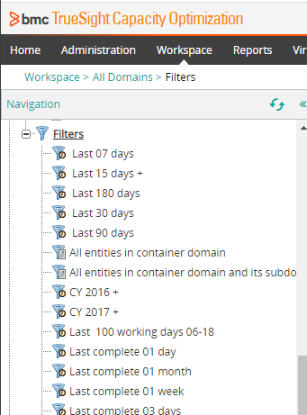
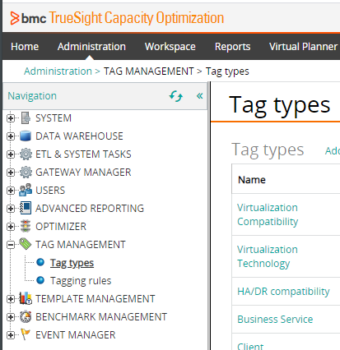
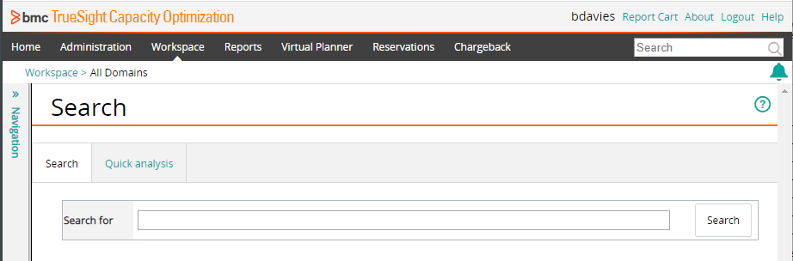
Tags, Filters, and Search
Sys:*web* 248 items
Sys:*web* -Storage 8 items
Sys:*web* -Storage +Tag:* 2 items
Notes:
You will quickly realize that not all items are easy to put in a tree, as the only association they have ‘at the moment’ is that they are being looked at, at the same time. In this case you can use searches and filters (saved searches).
To the extent that you can tag objects, you can have the tag be part of the search. Not just to include but also exclude items in the result.
The names of the object and object types are searchable data points.
So a search for sys:webserver123 OR sys:dbserver765 could be used to find these specific device names. (this would also deliver system named dbserver765a and dbserver765b)
These pieces work together nicely but is difficult to explain.. Imagine a search that progresses like this…
Sys:*web* 248 items
Sys:*web* -Storage 8 items
Sys:*web* -Storage +Tag:* 2 items
IF this gave you a meaningful search result, then it could be saved as a filter and reused were needed again. If the search delivers more results as the environment grows AND that is something you wish, then the filters can ‘expand and contract’ to represent the current environment.

Slide 9
So What Does This MEAN?
Workspace tab is IMPORTANT
NOT one size fits all
Trees Directly support reporting
As the reporting mission changes so can the trees
Object can ‘live’ in multiple places
CMDB are critical to maintain associations
(maintaining a tree ‘by hand’ is a BIG mistake)
Draw it out several times
Where are the association tables?
Design for now allow for redesign
Get help – A trusted partner with experienced power user can help you from messing it up – a real possibility
All of this flexibility allows you completely mess it up such that the reporting is impossible, and the TSCO solution can be rendered virtually useless.
Trees are used in the Presentation Service
And in the Smart Reporting Service.
Notes:
So what does this mean?
The Workspace tab is super important to making reporting ‘easy’.
The organization of the trees, or Hierarchies, is NOT a one size fits all.
The hierarchies should DIRECTLY support reporting including on the Presentation Service and on the Smart Reporting Service
As your reporting mission changes the hierarchies can change as well
You can have your cake and eat it too. Objects can live in multiple places.
Having an association table, like a CMDB (Configuration Management Database) allows the organization to mimic existing associations. Maintaining a tree ‘by hand’ is a BIG Mistake
All of this flexibility allows you completely mess it up such that the reporting is impossible and the TSCO solution can be rendered useless.

Slide 10
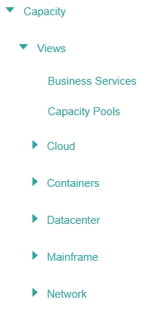
Trees and the Presentation Service
& Smart Reporting Service
The tree structure in the workspace tab (right) are useable in the Presentation Service (left)
The tree should be as complicated as necessary BUT NO MORE
Design ‘rules’ should be made and followed.
The description section should be used as domains are setup to clarify the focus of the tree reporting mission
Notes:
Trees and the Presentation Service and Smart Reporting Service
The tree structure in the workspace tab (right) are useable in the Presentation Service (left) and on the Smart Reporting Service
The tree structure should be as complicated as necessary BUT NO MORE
The pay off is on a view like the Datacenter, which shows ‘everything’, You can focus in on a subgroup as defined in a domain from the workspace tab. Say just the subgroup of Database tree (just above half way) or just the 005 business service view (bottom of list) of the entire datacenter report.
Combining the presentation service views with domain filters can lead to quick, clean, gathering of actionable intelligence
Design ‘rules’ should be made and followed. And using a description of what a domain or subdomain is to contain, where the associations are managed, who the customer is, and the reporting mission of the tree are all useful.
=====
This internal conversation is likely to take the better part of a day and is likely to be changed several times. When the tree no longer works for your reporting as your current questions are answered and new questions lend themselves to different hierarchies (different trees) then change, as necessary. This is an association table. The objects ‘live’ in the database and are only displayed in the tree they are associated with, so change as often as is helpful (and no more).
https://communities.bmc.com/thread/143366?q=workspace

Slide 11
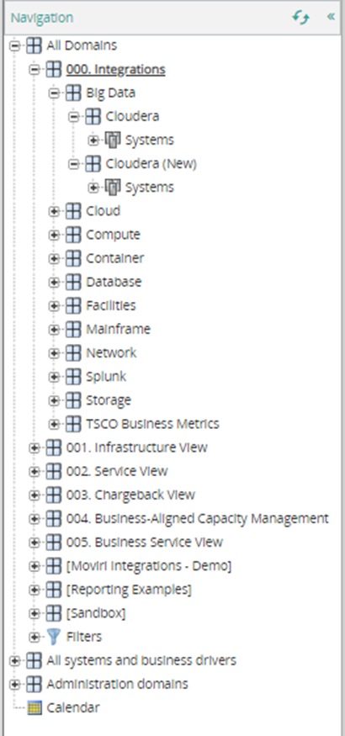
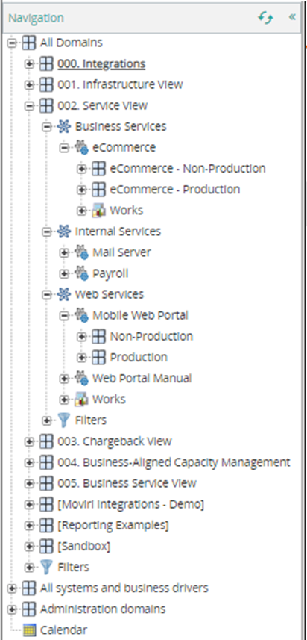
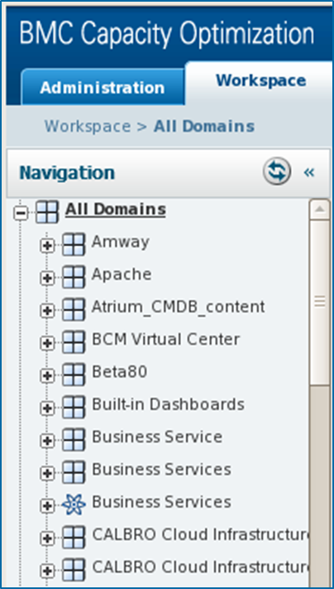
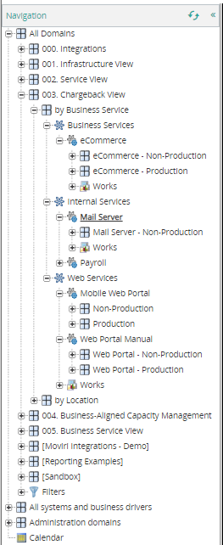
Example Trees
Notes:
Example Trees
The first three are in the same tree. Design features to note
Forced order by numbering 000, 001 etc (an alternative could be to count by 10 like in basic code) the square bracket orders later, while the space orders earlier.
000 Integrations seems to be where the ETLs place their data. The objects are repeated as necessary in 002 Service View, 003 Chargeback View etc
The details in 002 service View and 003 Charge back view are very similar but this is NOT a requirement. While it makes sense that this is how the grouping are seen internally, that is how they are reported on, so that is how the tree is designed, but there is NOT a requirement that the trees ‘match’ each other.
The tree example on the right has more on the ‘root level’ and are not as deep. But as this represents how these items get reported on, this is a perfectly acceptable design.

Slide 12
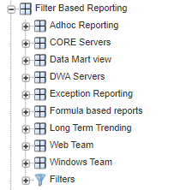
Filter Based Reporting Tree
Filter based reporting assembles items by virtue of being in a filter. This is very powerful as there is no need to create a tree for short lived associations.
Cleaver use of wildcards, negative filters, and combining filters can yield an expansive reporting method.
This series has specific topics covering “Exception Reporting” and “Filter Based Reporting”
Tags are useable in filters – HUGE opportunity here
Notes:
Aside from the trees that focus on hardware and hardware types; software and applications and services; we can have a filter-based reporting tree that allows us to associate devices into a filter, such they can be reported on simply by being in the filter.
Cleaver use of wildcards, negative filters, and combining filters can yield an expansive reporting method.
Tags are useable in filters – HUGE opportunity here
This is explored more completely in
Quest For Actionable Intelligence (3) Filter Based Reporting
Quest For Actionable Intelligence (4) Exception Reporting

Slide 13
Call To Action
Planning goes a long way but…. Just do it.
Make as many trees as is necessary to support reporting – and NO MORE
Keep your automatic trees automatic; and your manual trees manual (actually… avoid manual trees)
Use Filters to augment tree reporting
Use Tags to augment filters
Notes:
Planning goes a long way but…. Just do it. Designing the tree can be an iterative process so don’t fret getting a perfect design first.
Make as many trees as is necessary to support reporting – and NO MORE
Keep your automatic trees automatic; and your manual trees manual (actually… avoid manual trees)
Use Filters to augment tree design for reporting.
Use tags to augment filters

Slide 14
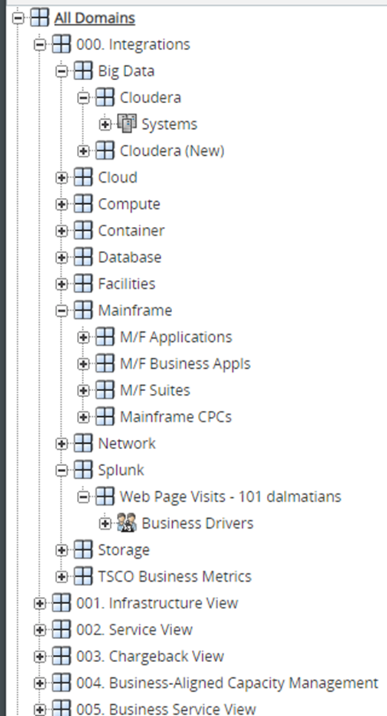
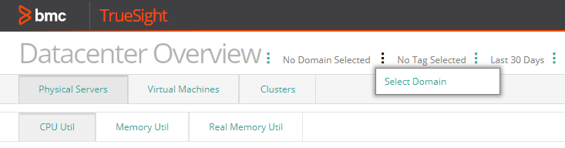
Review, Questions and Conversation
Focus on ways to organize the Workspace tab
Implications on the Presentation Service, and Smart Reporting Service
Tags, Filters and Search
Draw it out several times
Where are the association tables?
Design for now allow for redesign
Get help – A trusted partner with experienced power user can help you from messing it up – a real possibility
Notes:
There we go. Time for a
Review, Questions and Conversation
====
Focus on ways to organize the Workspace Tab
Implication on the Presentation service (and Smart Reporting Service)
Tags, Filters and Search can help without making a ‘new tree’

Slide 15
Questions
Can I delete the tree and start over? Short answer: Yes. Long answer: Yes But
  Yes but as trees are removed the objects will eventually go to “Unassigned” . When the ETLs run, if they are set to make a place in a tree, the tree will become rebuilt to the extent the ETLs are set to make the trees. As the tree rebuilds the ‘unassigned’ devices will be associated to the new tree.
  There is more nuance to this answer
Can I automate a tree that I am maintaining by hand? Short answer: Yes. Long answer: Yes But
  Yes you can use a CMDB type data source to build the tree. The structure can be ‘the same’ or not to how it is managed manually, but the manual additions will have to be removed manually as well.
Can I have several trees from several CMDB sources? Short answer: Yes
  We have done this and label the tree as “reality according to Server team”, “Reality according to Application team”, and “Reality according to finance team”. Each team has their own reporting requirements and each tree supports those specific requirements.
  Configuration data from each source augments the objects data. This enhances the understanding of how objects relate to each other. Remember the tree is an association list and objects can be associated to any number of domains.

